Slide 1
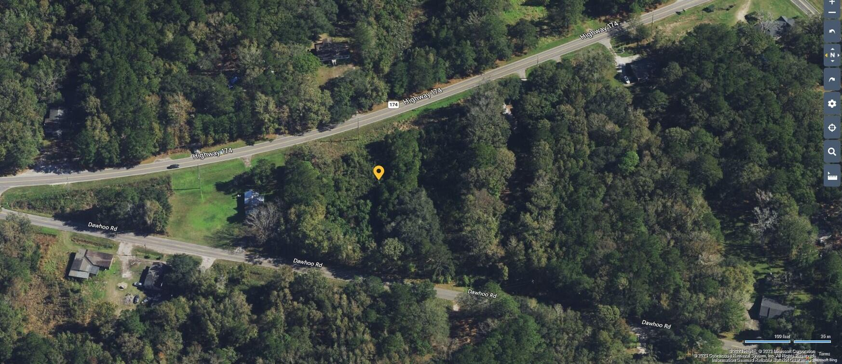
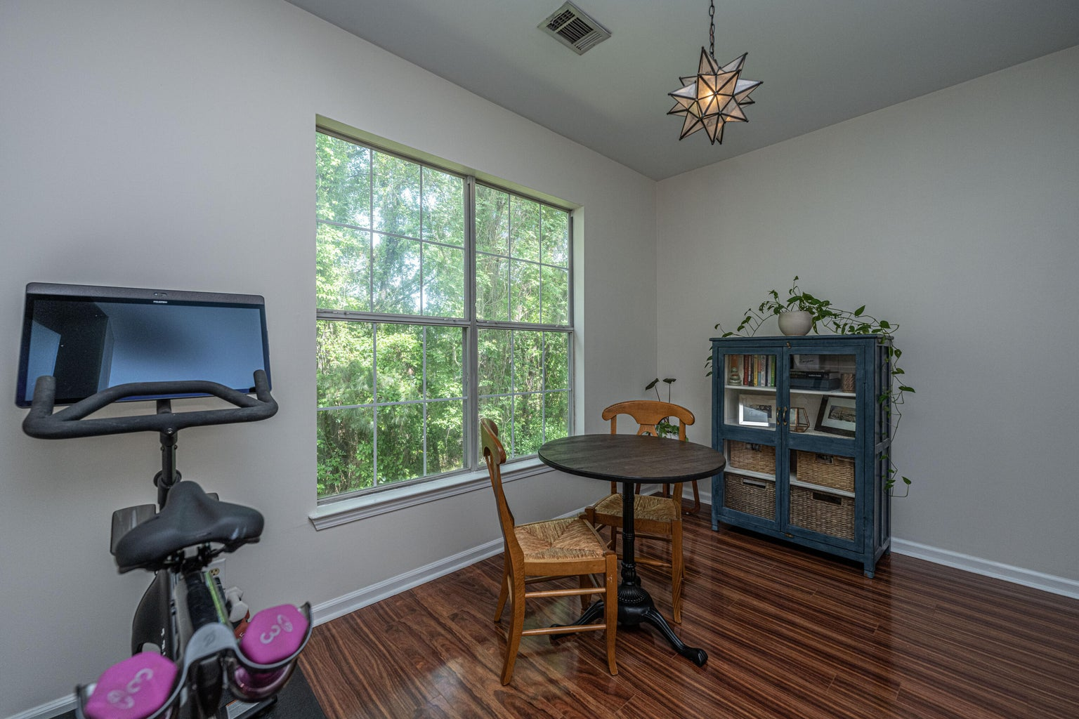
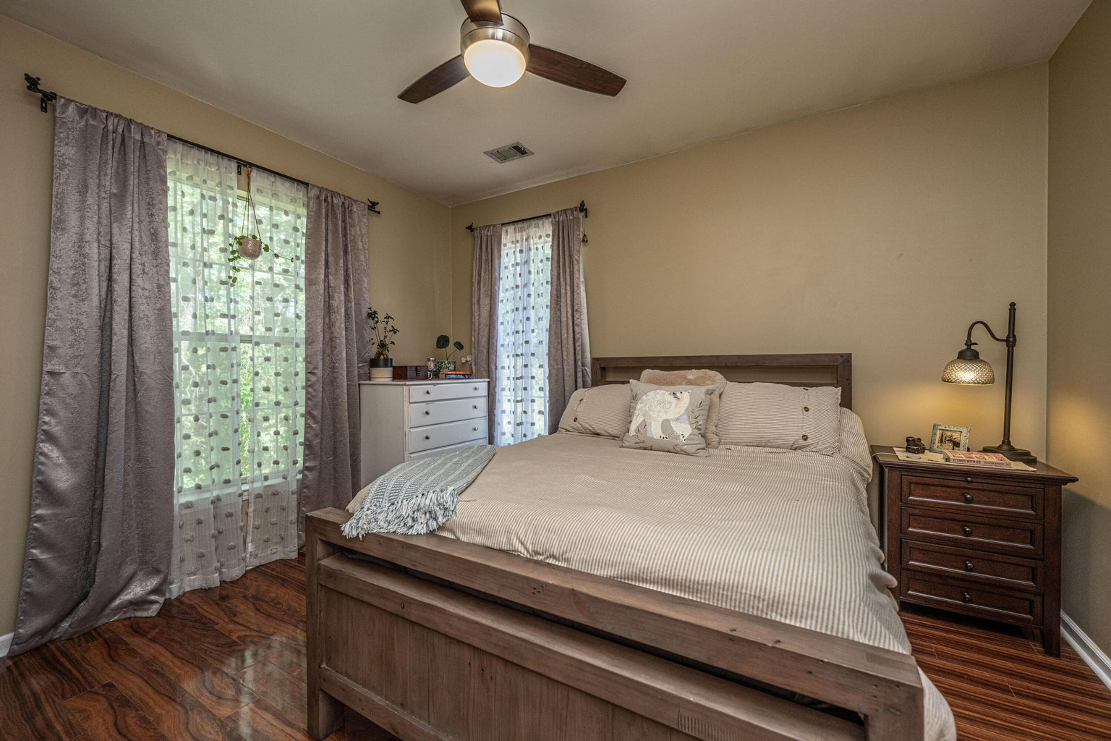



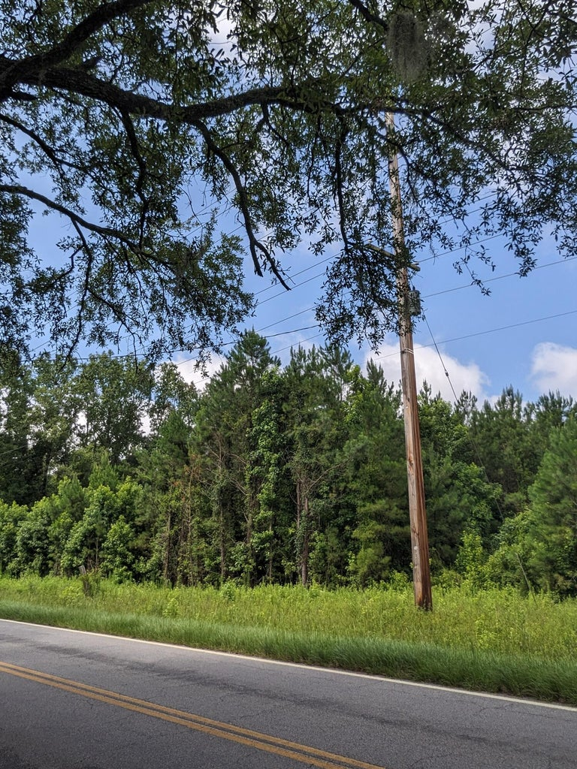
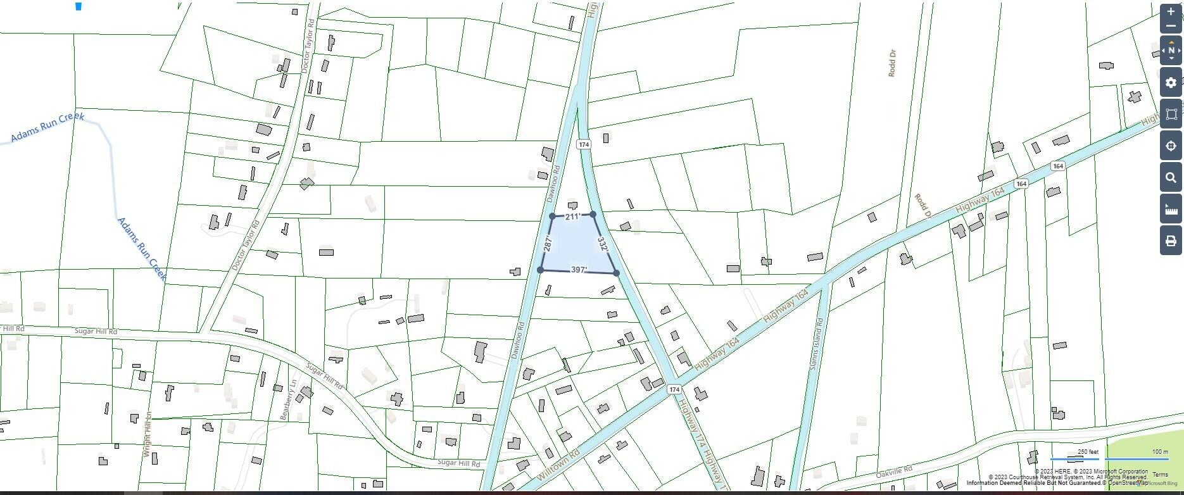
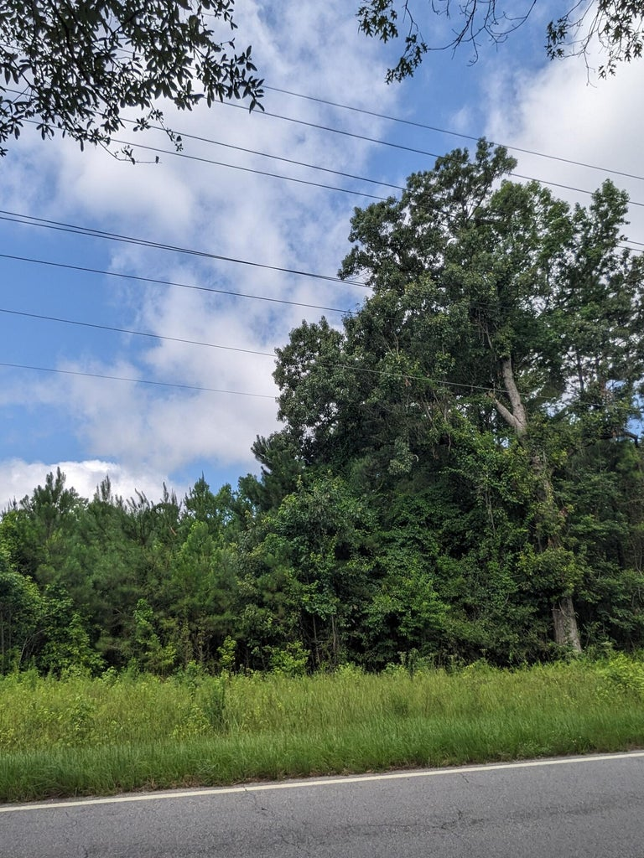

2 Acres in Adams Run
This stunning 5br, 4.5ba low country custom built home by Simonini Home Builders has been meticulously cared for situated on a .60 acre heavily treed lot on large pond in private gated community of Popular Grove. This spacious , two story, 4721 square foot home features master bedroom suite on the first level, full front porch, beautiful heart pine wood flooring, large entry foyer which separates the private study from formal dining room, open gourmet kitchen with Wolf 6 burner gas stove, built in SubZero refrigerator/freezer, dishwasher, microwave oven and large pantry. Half bath/Powder room under stairway and large utility room for washer and dryer and deep sink and built in cabinets off hallway. The smaller den with gas log fireplace opens to kitchen and breakfast room. The larger fireplace opens to kitchen and breakfast room and offers expansive views of the water year-round. The living room with its second gas log fireplace is great for entertaining away from dining areas. The large master bedroom suite is located on the first level and has travertine tile flooring in the master bath, his and hers walk in closets, separate vanities, soaking tub, and a large separate shower. There is a game room with separate stairs over the two-car garage large enough for a pool table. The second level boasts 4 spacious bedrooms and three bathrooms. On the rear of home is a large screened in porch and open deck overlooking firepit and pond. To reduce maintenance the exposed wood decking has been replaced with Trex decking and exposed rail caps with PVC. Yard has irrigation system and 120-gallon buried propane tank. Sellers just replaced roof with 50 year architectural shingles with transferable warranty. The two electric water heaters have been converted to a single LP gas fired tankless water heater. New epoxy coating on floors and newly finished walls now in two car garage. Neighborhood amenities include Privacy gate, Boat Ramp, Dock facilities, Exercise area, Pool, RV/boat storage and walking/jogging trails. Don't forget the fantastic equestrian center for your horses!
0 Highway 174
Washington Park | Adams Run, SC 29426 | MLS# 23016517 | $185,000
Fabulous opportunity to build your dream home. This 2 acre lot has 2 entrances. It sits between Hwy 174 and Dawhoo Rd. This is a prime location that leads to beautiful Edisto. It is just minutes to Hwy 17 to take you into town. Developers! This 2 acres could also be a perfect property to build multiple homes. This is in a flood zone X, no flood insurance required. This property also puts you just minutes from Dawhoo Boat Landing for all you boaters.
4
3
1,844
Shirley Gilbert 843-860-5092 sgilbert@carolinaone.com
Amy Waite 843-224-5092
amy.waite@carolinaone.com
Carolina One Real Estate | 717 Folly Road | Charleston, SC 29412

