Slide 1
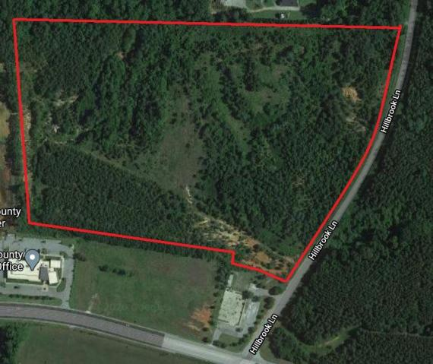
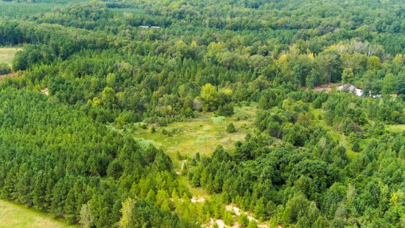
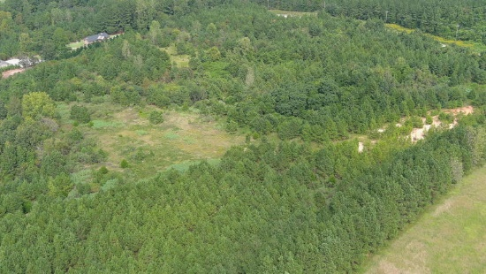
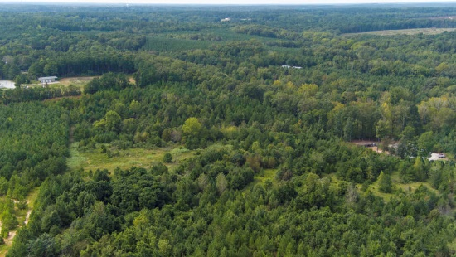


Development Opportunity in Newberry
OVER 50 Home Sites!
0 Hillbrook Lane
Newberry, SC 29108
MLS# 20025736
$700,000
34.96 Acres
Looking for a development opportunity in Newberry or close to Columbia, SC? Well now's your chance! This land was previously rezoned to medium/high density zoning, allowing 8,000sqft Single Family Residence Lots. Owner had done his fair share of due diligence including a sketch from a local engineering company showing a 3-phase neighborhood, with the first 2 phases having 55 single family homes. and the remaining phase with 12 acres of land. There were approvals for getting city sewer and water brought to this property over a decade ago. These will likely have to be reapplied for, but were approved in the past. If you're looking for PRIME LAND, located in the city of Newberry, RIGHT NEXT to Newberry High School, then here it is! Site plan and other documents available upon request.
Nick Mazzilli
(843) 640-5575
nick@nickmcharleston.com
www.nickmcharleston.com
Reside Real Estate LLC
155 Wingo Way Unit 421
Mt. Pleasant, SC 29464

