Slide 1
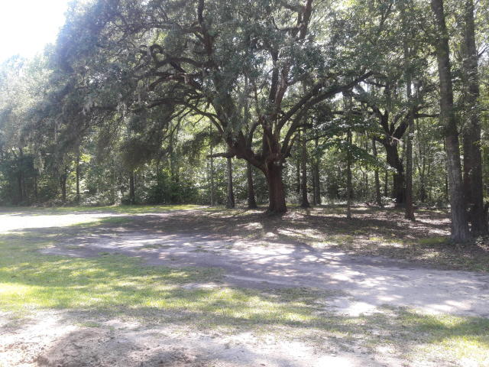
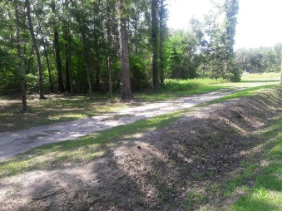
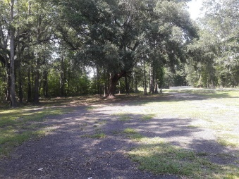
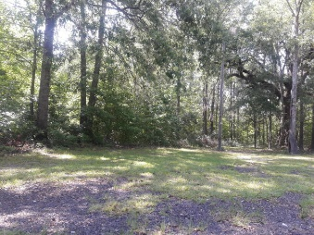
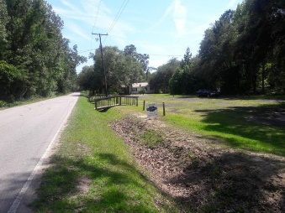

Beautiful Acreage Off Highway 17
6.9 Acres ~ All Offers Considered
Starbucks card to first 10 agents
0 Hope Plantation Lane
Jacksonboro, SC 29452 | MLS# 19029684 | $90,000
Beautiful lot surrounded by homes yet large enough to make private. Located on paved road off Hwy 17. Must see to really appreciate.
Geraldine Sands
(843) 224-1911
gw.sands67@gmail.com
AgentOwned Charleston Group | 902 Savannah Hwy | Charleston, SC 29407-7802

