Slide 1
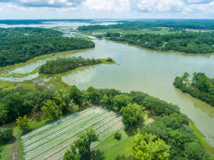
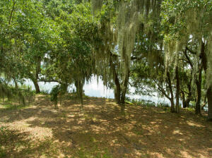
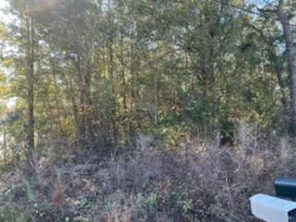
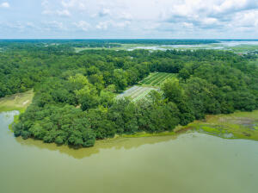


Waterfront Property
Reduced!
0 Hwy 165
Yonges Island · Meggett, SC 29449
MLS# 21021812 · $800,000
Michael Dew
O 843-769-5100
M 843-870-7000
michaeledew@gmail.com
www.michaeldewrealestate.com
22+/- acres with approx 600' water front located on Flounder Lake in the quaint town of Meggett. This beautiful property offers huge old live oaks, pecan trees and all the privacy you would ever want. Approximately 17 acres on high ground. Fish off your bank or build your own personal dock for some of the best fishing around! Enjoy the natural habit of deer, turkeys, white squirrels! Ideal for the horse lover as great pasture is ready for grazing! City sewer and water available. Located within 30 minutes of the Charleston International Airport and Historic down town Charleston.
AgentOwned Charleston Group
902 Savannah Hwy
Charleston, SC 29407
Real Estate ● Mortgage Insurance ● Business Brokerage

