Slide 1
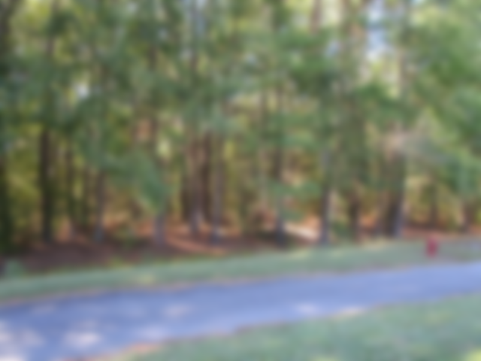
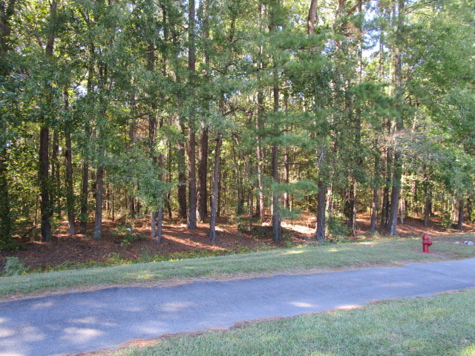
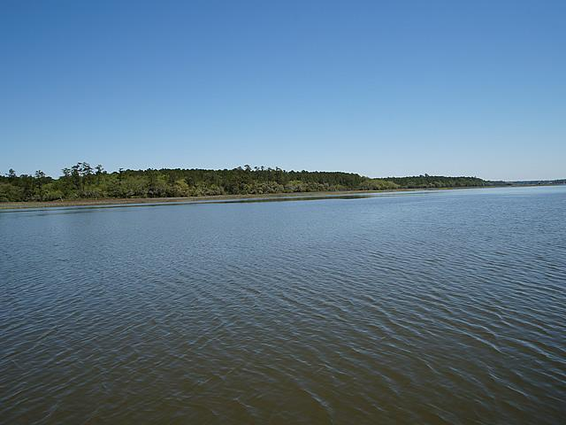
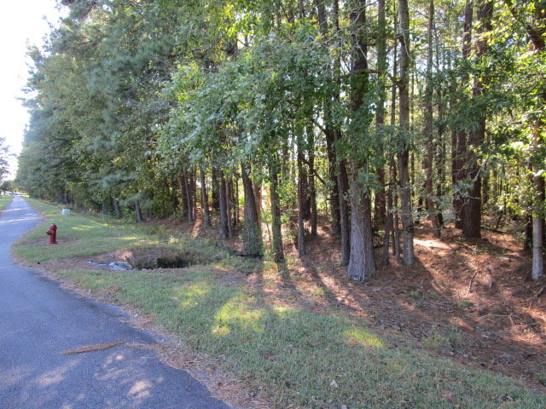
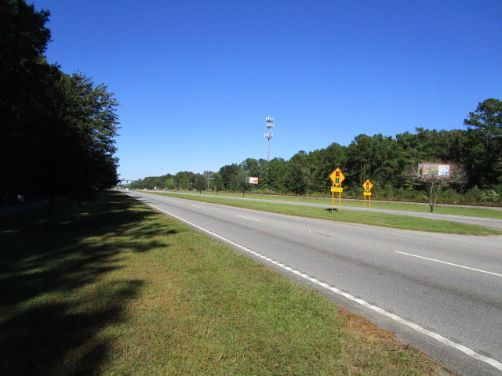
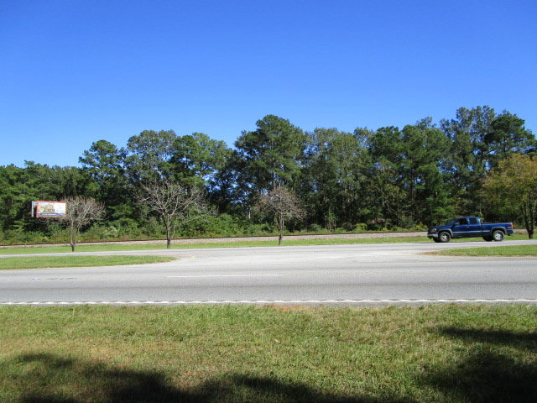
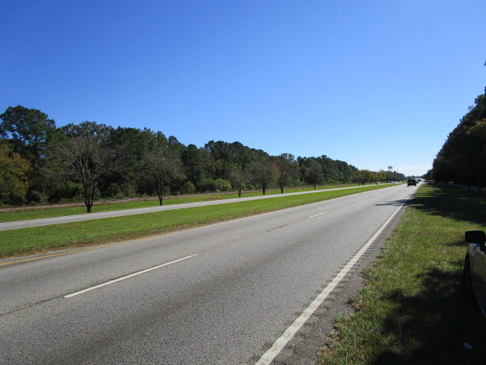
Vacant Lot in High Traffic Area
Owner is Motivated!
Hwy 52
Goose Creek, SC 29445
CMLS# 30345005 | $229,000
1.55 acres of land located off Hwy 52, recently rezoned to GB Professional Offices. Access to lots must be from Hwy 52, & not from Carol Drive as per the Town of Goose Creek Planning & Zoning Department. Perfectly ingresses from northbound on Hwy 52.
Charles Salmonsen
M (843) 224-0300 | O (843) 388-6613 | charles@salmonsen.com
Salmonsen Realty | 864 Lowcountry Blvd Ste B | Mt Pleasant, SC 29464

