Slide 1
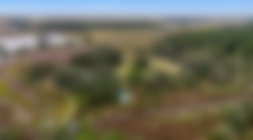
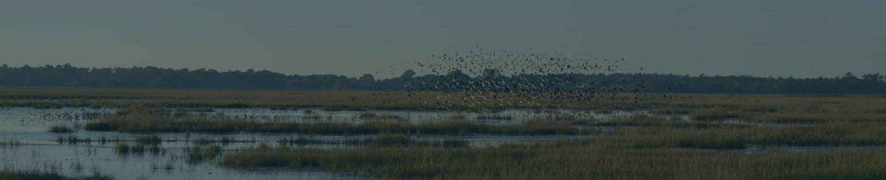

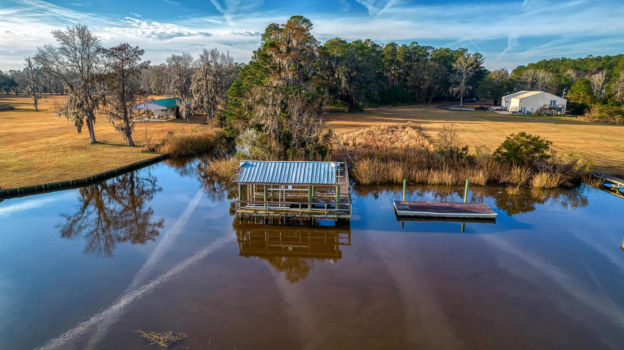
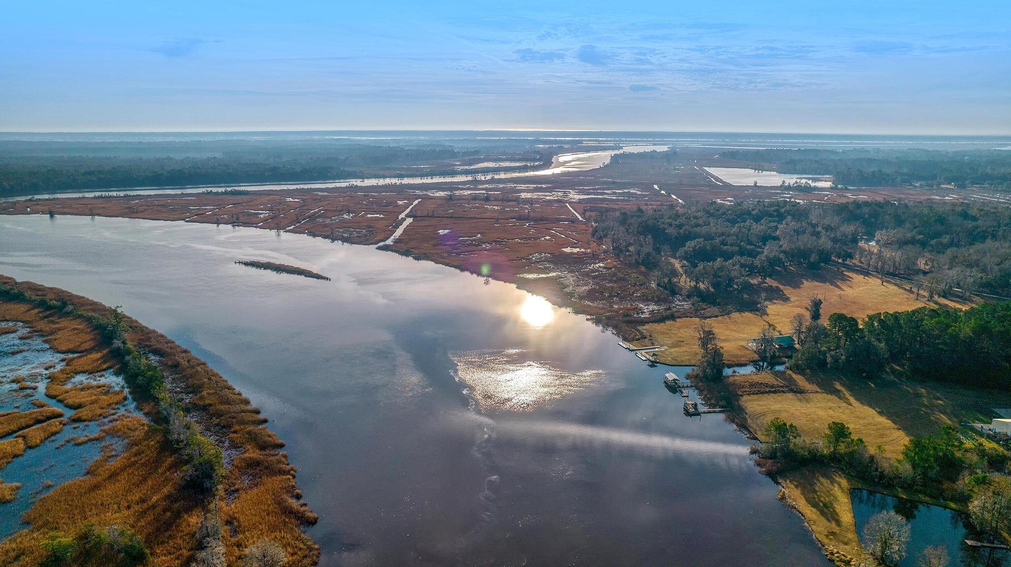
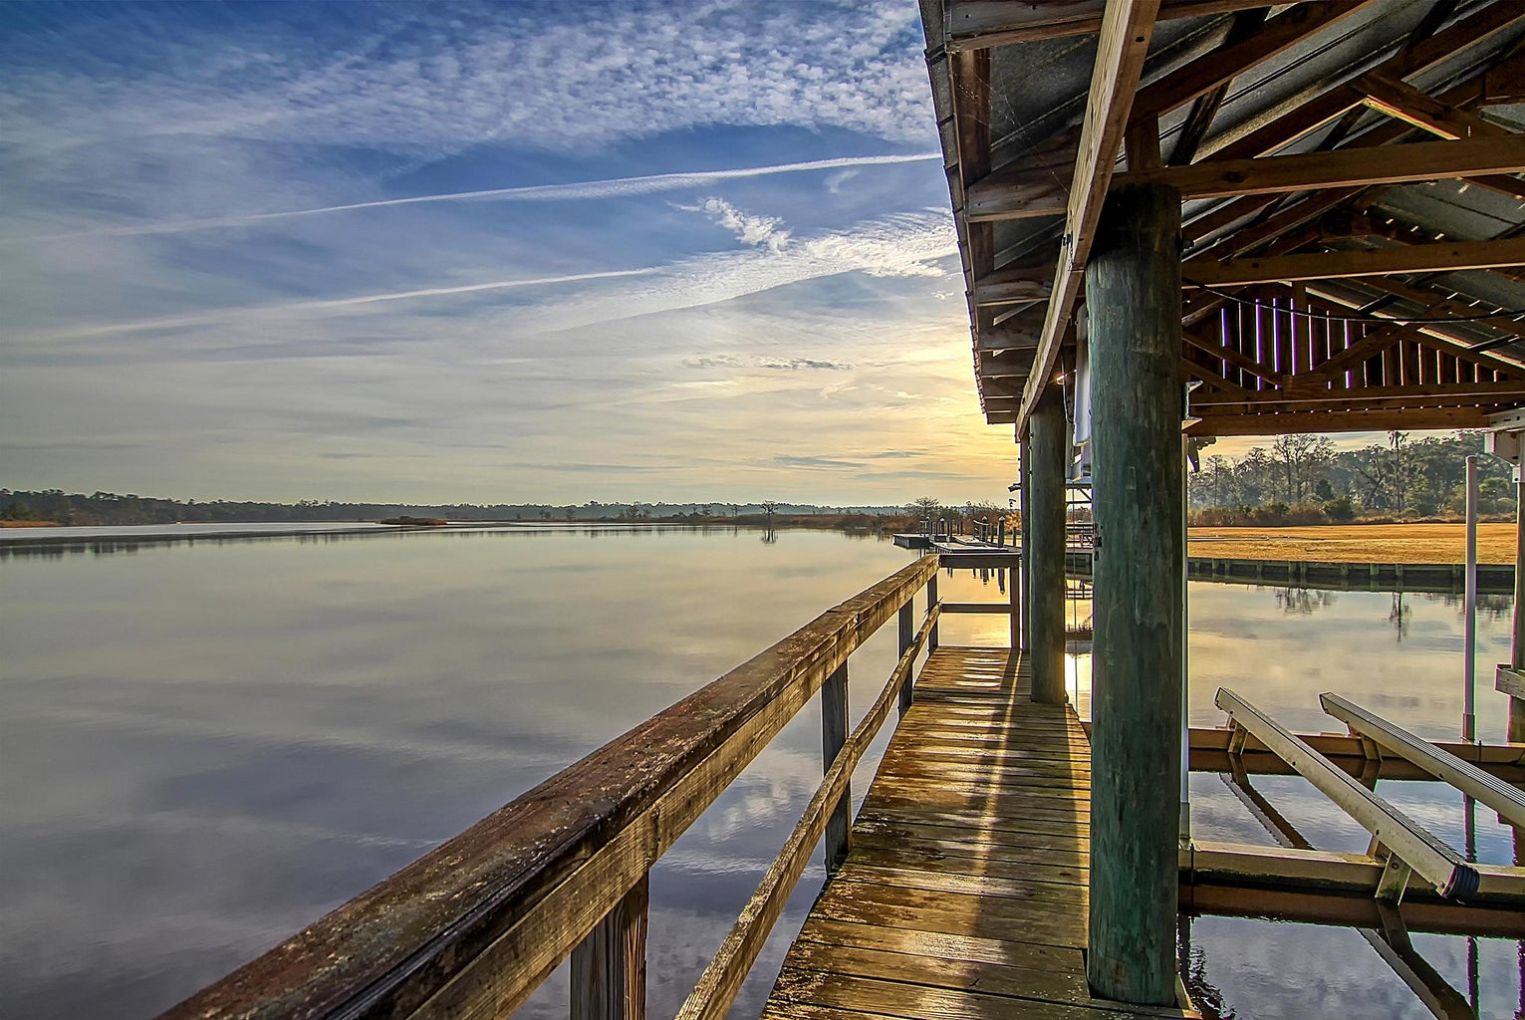
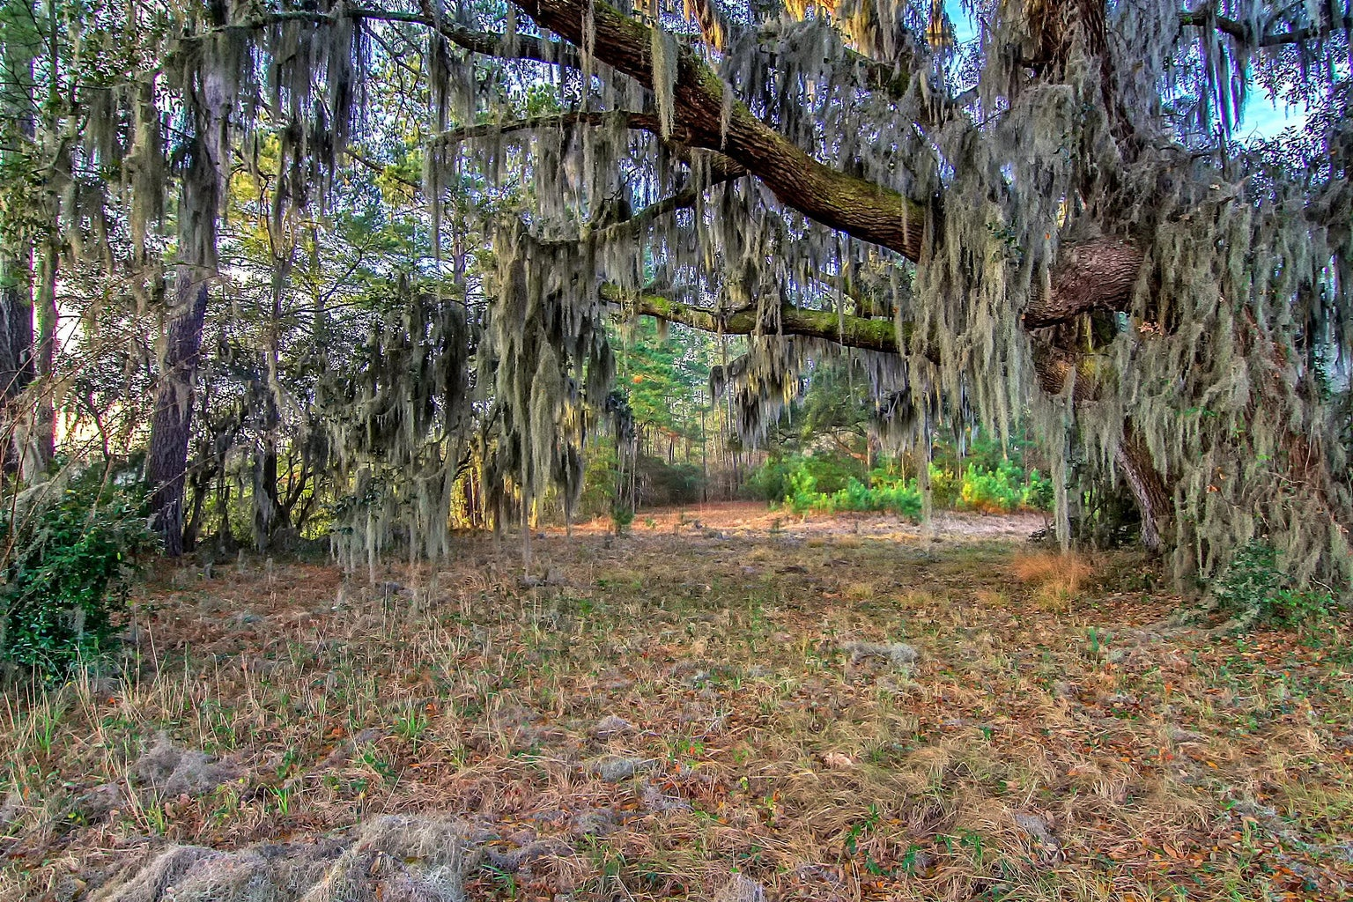
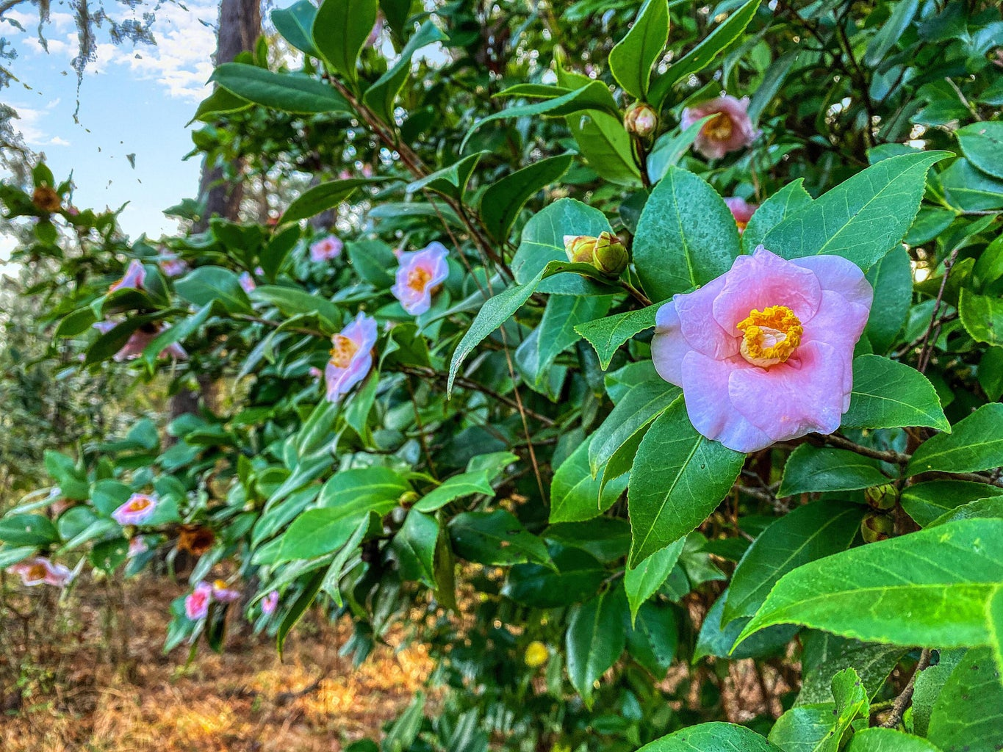
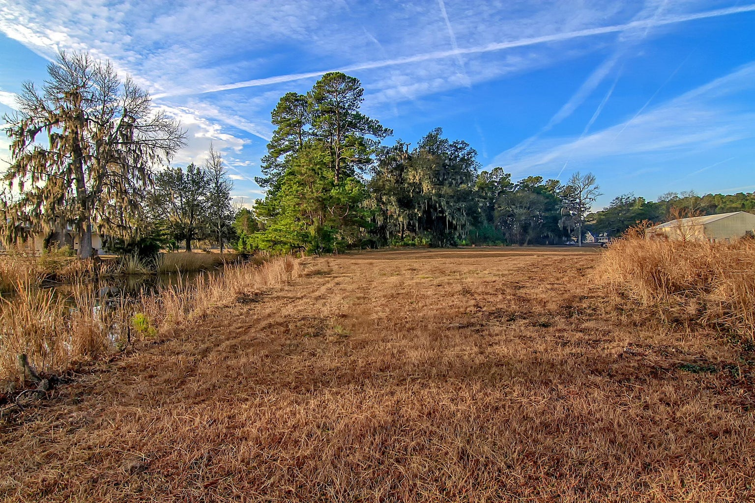
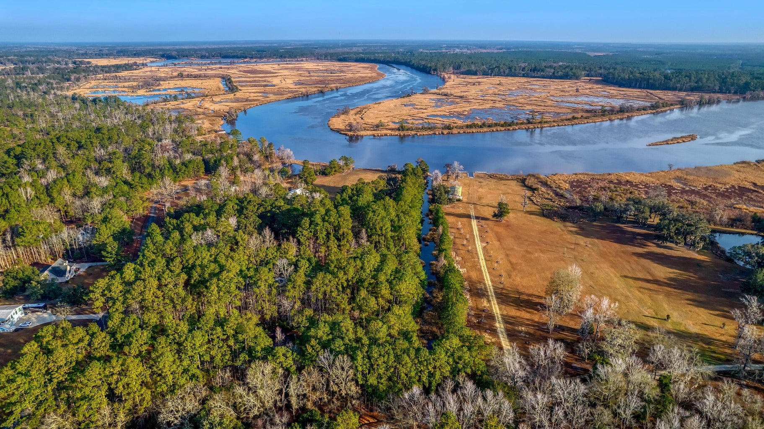
DOUGLAS CUTTING
(843) 534-3911
dcutting2@gmail.com
bluewingproperties.com
0 Kingsbury Place
Waccamaw
Georgetown, SC 29440
MLS# 23001722 | $575,000
This four-acre property on a deep bank of the Georgetown side of Black River is a perfect jump-off to the wild peace of this historic basin. Well within the boating range of Winyah Bay and downtown Georgetown and adjacent to Beneventum Plantation, the lot features an existing covered dock and several attractive homesites within the pines and big live oaks. Views from the dock are expansive and perpetual, as most of the property within sight is protected. This has the potential for a full-time residence, a convenient recreational cabin spot, or some hybrid of the two. Just an awesome fishing and cruising launch to fresh and salt water destinations.

