Slide 1
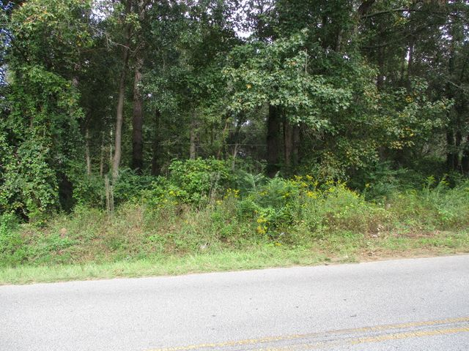
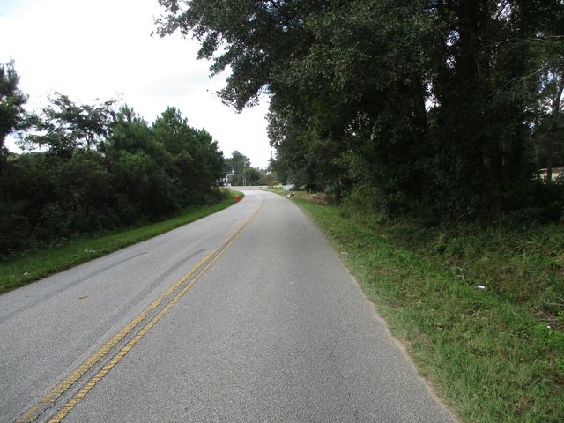
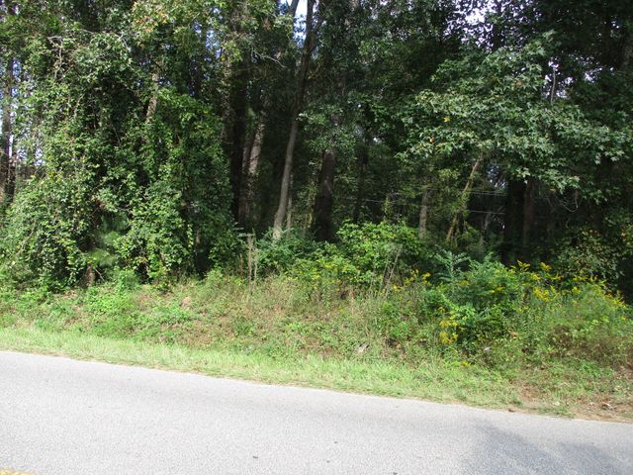
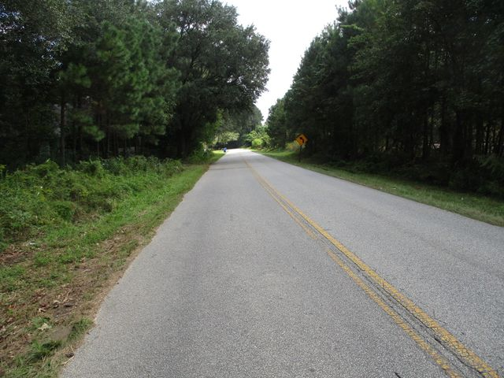
Owner is Motivated!
0 Koester Road
Ladson, SC 29456
MLS# 20028733 | $249,900
Lot is currently zoned CC (community commercial). Lot is zoned X. No wetlands. The wetland delineation has been submitted for approval by the Army Corps of Engineers. Public water & sewer at the street. Water & sewer are at the site. Zoning information is detailed in the documents section. Conveniently located to Palmetto Commerce Pkwy, Boeing, Bosch, Trident Regional Hospital, Charleston Southern, Volvo, & I-26.
Charles Salmonsen
M (843) 224-0300 | O (843) 388-6613 | charles@salmonsen.com
Salmonsen Realty | 864 Lowcountry Blvd Ste B | Mt Pleasant, SC 29464

