Slide 1
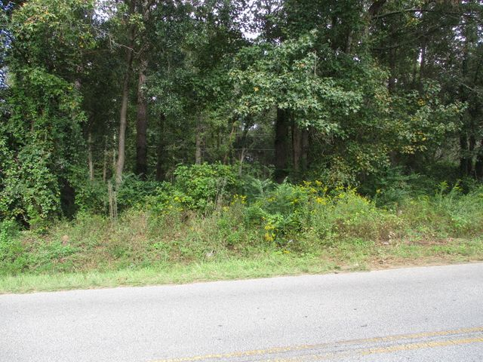
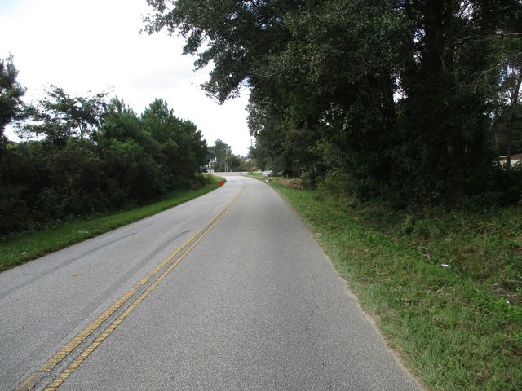
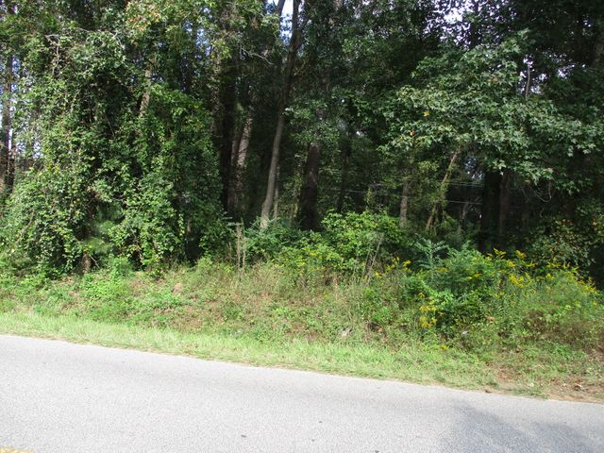
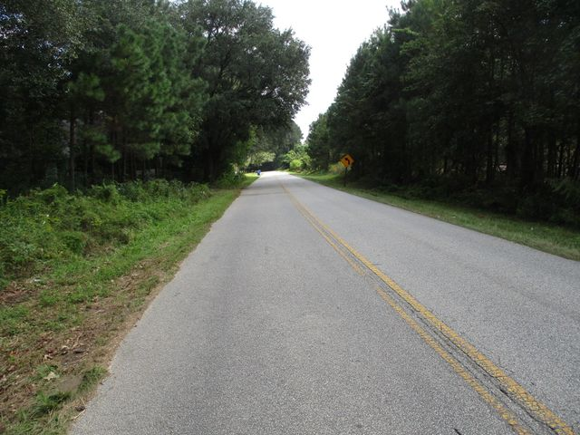
Commercial Sale
0 Koester Road
Ladson, SC 29456
MLS# 30664730 | $249,900
Vacant Lot is currently zoned CC (community commercial). Lot is zoned X. No wetlands. The wetland delineation has been submitted for approval by the Army Corp of Engineers. Public water & sewer at the street. Zoning information is detailed in the documents section. Conveniently located to Palmetto Commerce Pkwy, Boeing, Bosch, Trident Regional Hospital, Charleston Southern, Volvo, & I-26.
Charles Salmonsen
M (843) 224-0300 | O (843) 388-6613 | charles@salmonsen.com
Salmonsen Realty | 864 Lowcountry Blvd Ste B | Mt Pleasant, SC 29464

