Slide 1

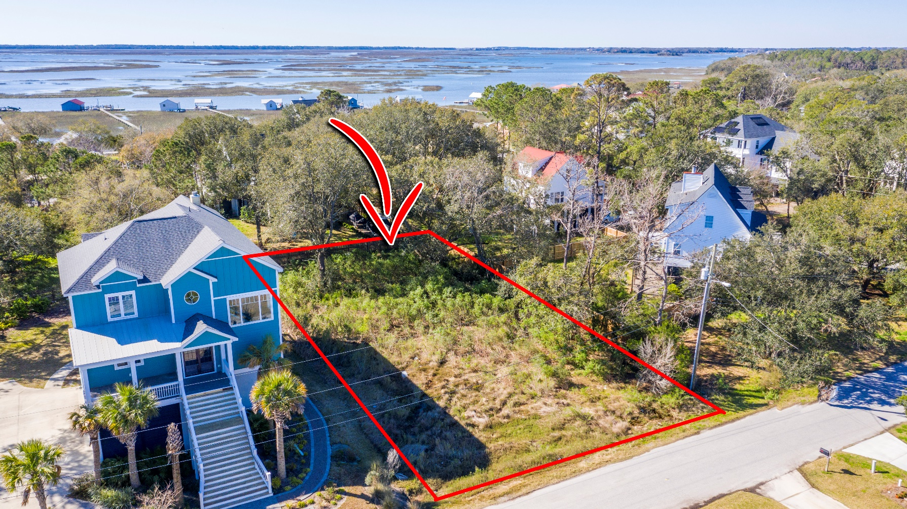
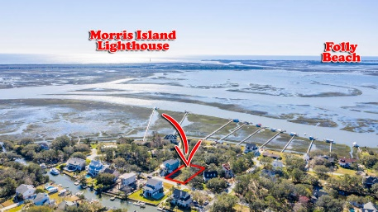
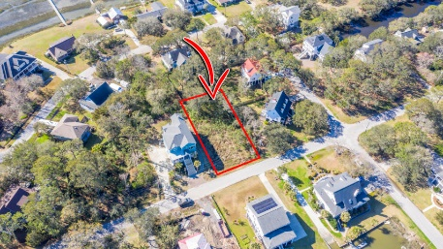
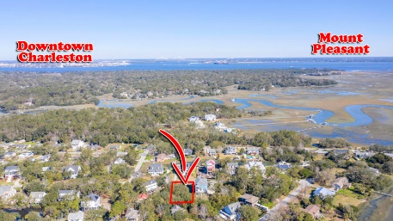
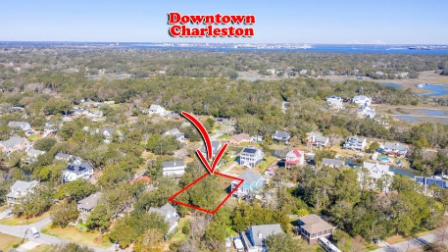


Dream Lot For Your Dream Home!
0 Lynne Avenue
Lighthouse Point | Charleston, SC 29412 | MLS# 20006112 | $130,000
Build your dream home on this amazing lot that offers views of both Morris and Sullivan's Island lighthouses. Don't miss this opportunity to be part of this quaint section of James Island; only 7 miles from Folly Beach and 6 miles to downtown Charleston.
Marian Kilpatrick
(843) 633-1164
marian.kilpatrick@carolinaone.com
www.mariankilpatrick.com
Carolina One Real Estate
2713 Highway 17 North
Mt. Pleasant, SC 29466

