Slide 1
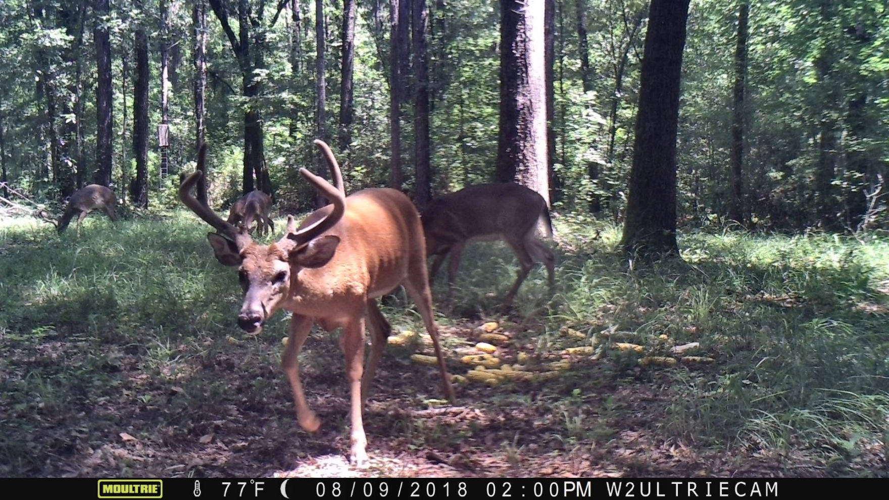
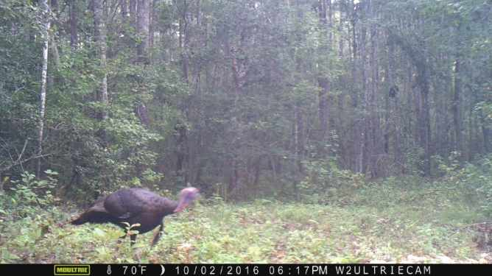
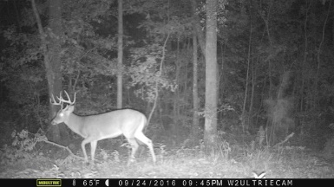
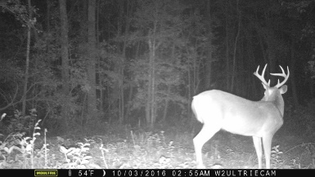
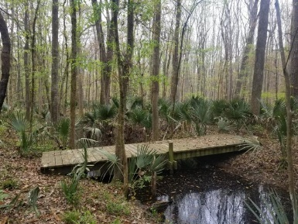


0 Magwood Bryant Road
Green Pond, SC 29446
MLS# 19008194 :: $148,000
29.9 Acres
Hunters Paradise!
New Price!
Seller is willing to walk the land with your buyer. He has cameras in place, deer stands and has cut roads/paths within the property. The acreage is maintained for easy driving and walking. Seller hunts deer, hog and turkey on the property. Seller built a walking bridge over a running stream with a camera in place to show wild life that walk across the bridge.
Call listing agent for details on how to access the property. Seller has to be notified because he currently hunts the land so I have to let him know when someone will want to view for safety.
Connie White, Broker
843-532-3356
connie@chrepros.com · conniewhiterealestate.com
Charleston Homes · 597 Old Mt. Holly Road · Suite 301 · Goose Creek, SC 29445

