Slide 1
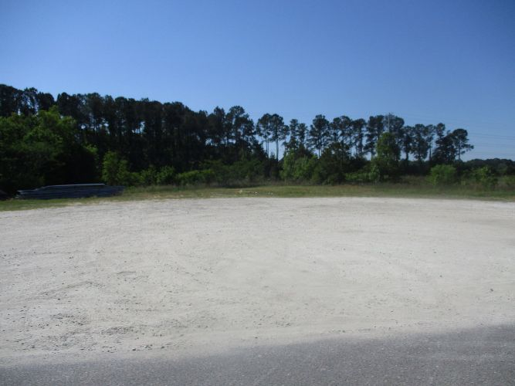
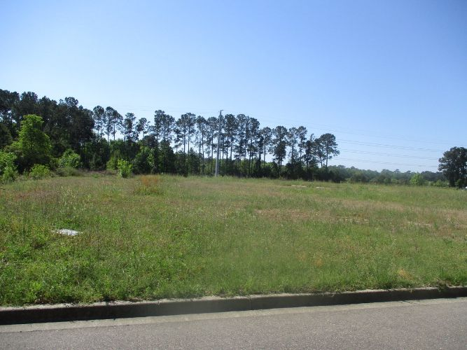
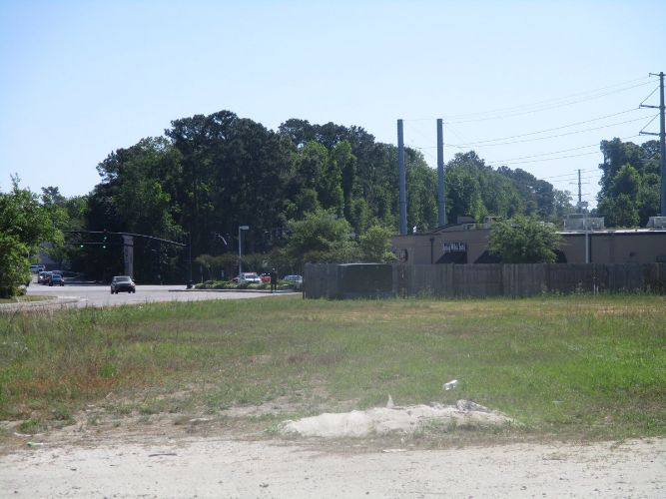
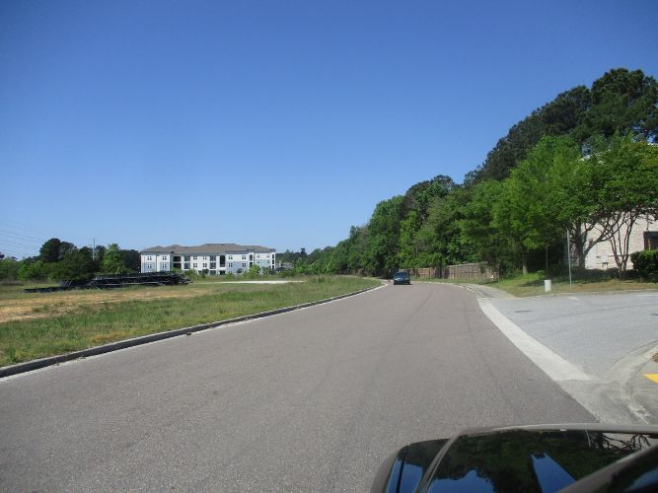
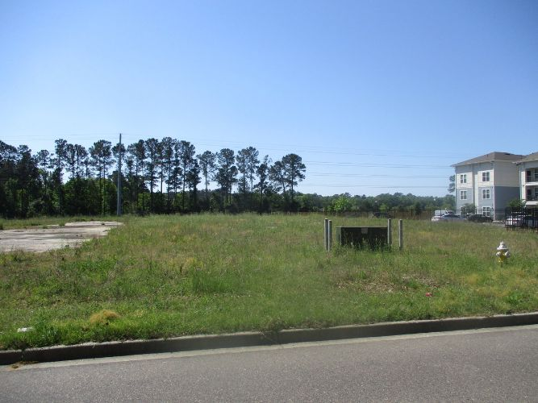
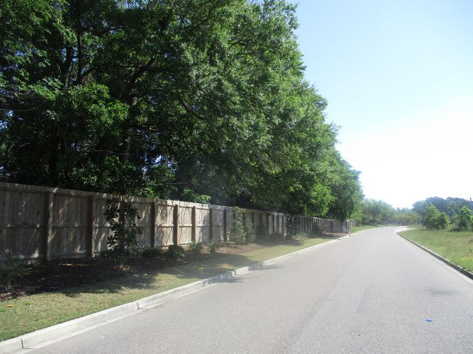
Commercial Land - Off Rivers Ave
Morris Baker Blvd
North Charleston, SC 29406
MLS# 30726279
$2,150,000
Approximately 5.35 acres of land located on Morris Baker Blvd/Rivers Ave behind Raisin Canes restaurant & a traffic light with good ingress/egress. Approximately 1-2 blocks from Ashley Phosphate & Rivers Ave. Next door to Rick Hendrick Toyota & backs up to Carolina Memorial Park.
Charles Salmonsen
M (843) 224-0300 | O (843) 388-6613 | charles@salmonsen.com
Salmonsen Realty | 864 Lowcountry Blvd Ste B | Mt Pleasant, SC 29464

