Slide 1
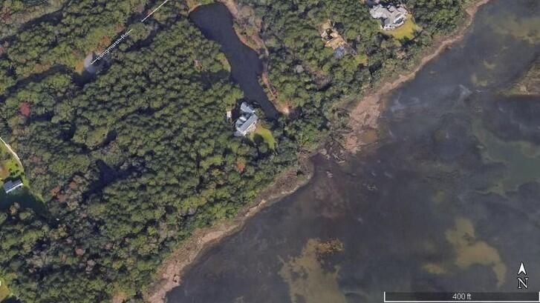
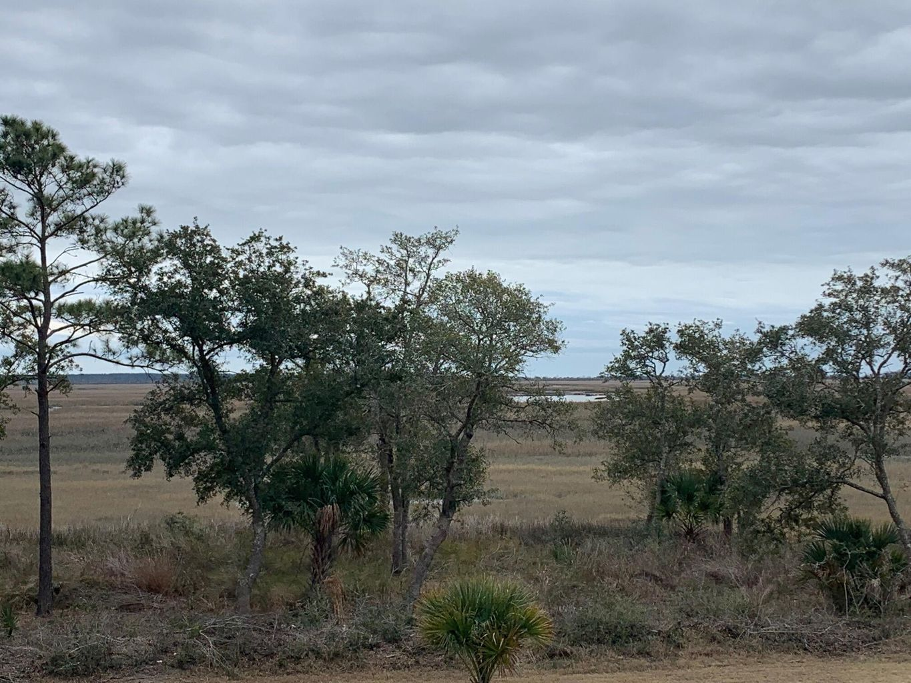
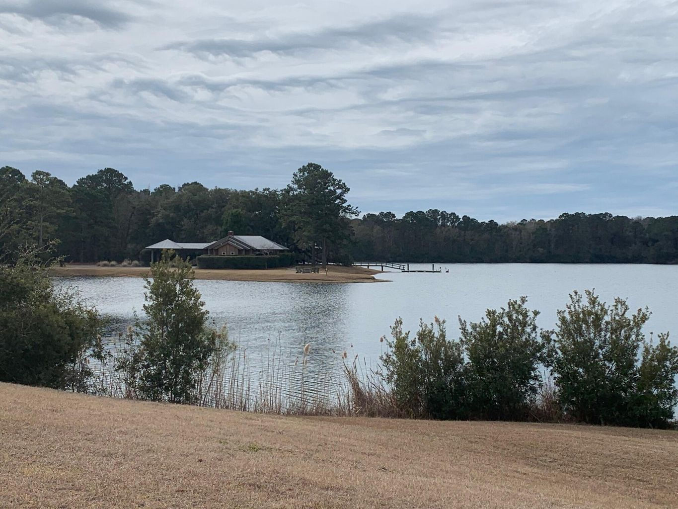
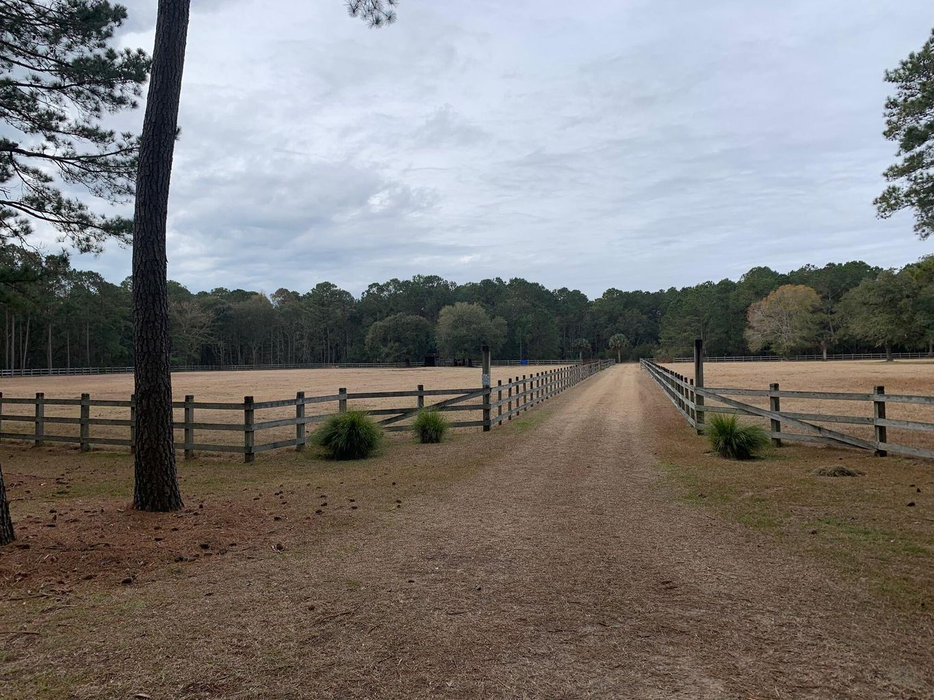
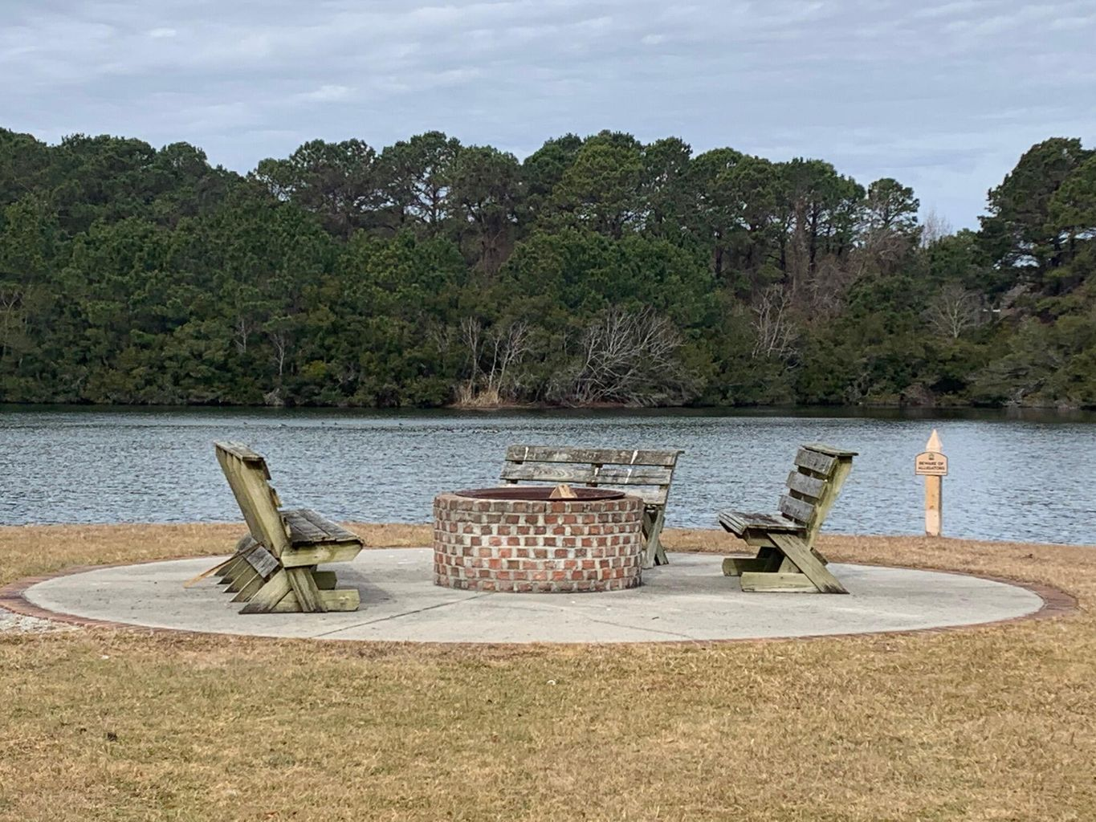
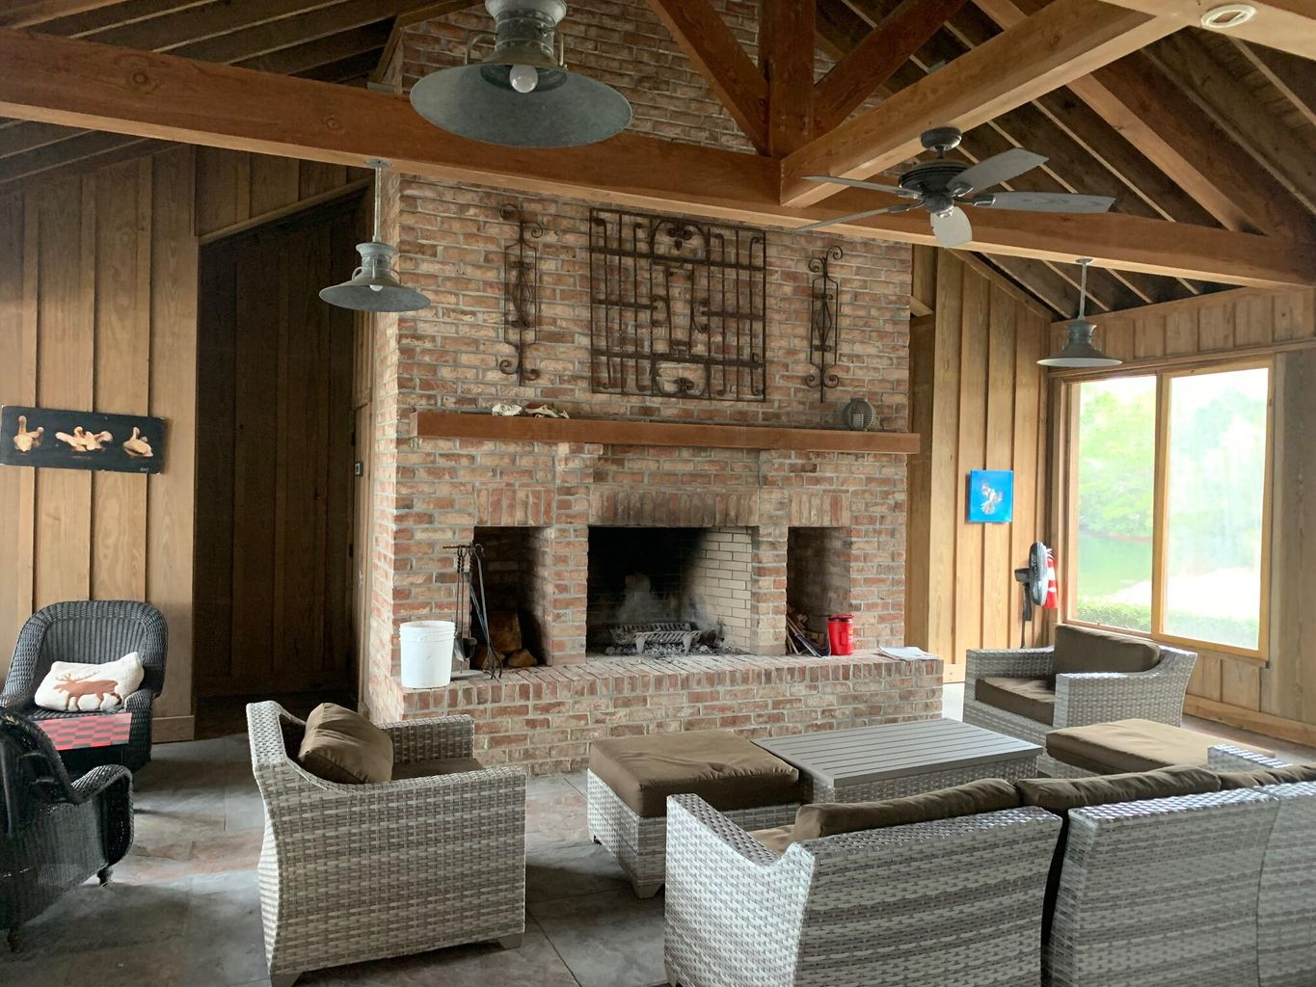
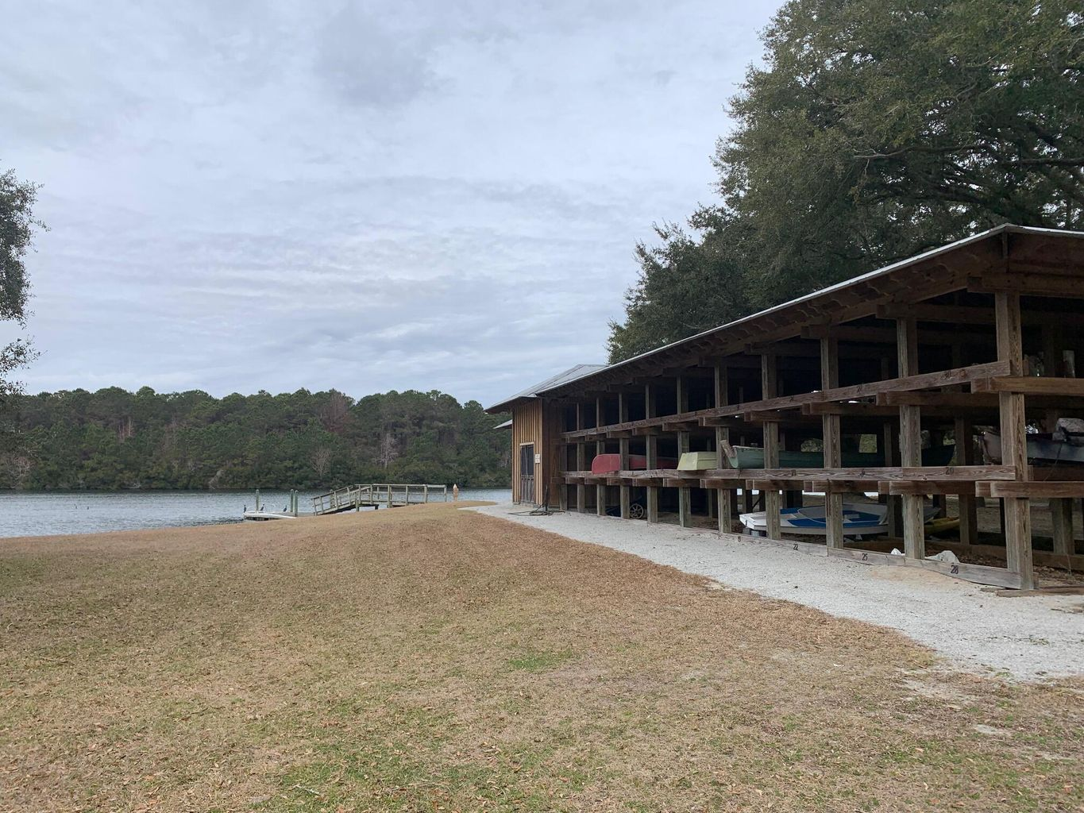
475 Acre Playground
0 N Hwy 17
Sewee Preserve
Awendaw, SC 29429
MLS# 22001907
$1,175,000
This beautiful 2.49 acre lot is located in Sewee Preserve with a 400+ acre conservation easement & only 30 homesites* all owners have access to that property * this includes equestrian facilities, the farm, the 75 acre lake, clubhouse and boat storage * there is a shared salt water dock with easy access to Capers Island and nearby beaches * lot overlooks Capers and Dewees Island with breathtaking views * enjoy your future home in this private, quiet setting * this location is only 1 mile outside of Mt Pleasant and close to Roper Hospital, Costco and schools * one of the last remaining lots – if not the last * come and take a look, ride the miles of trails and enjoy the saltwater dock PLUS all of the wildlife * property is 10 1/2 miles from Ravenel Bridge *call LA for gate access
Joe Strickland
843-345-6100
strico61@att.net
Fudgy Brabham
843-884-2826
fudgy@hbrtwn.com
Harbourtowne Real Estate | 672 Marina Drive, Ste 110 | Daniel Island, SC 29492

