Slide 1
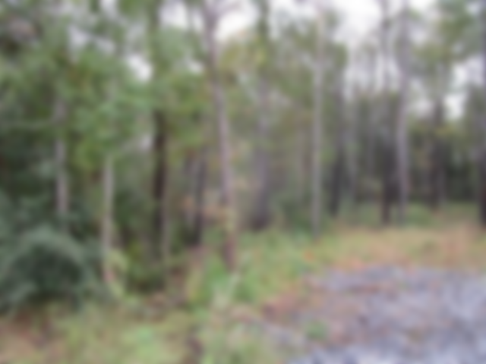
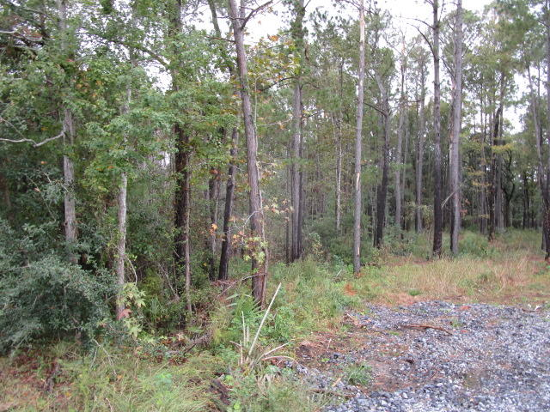
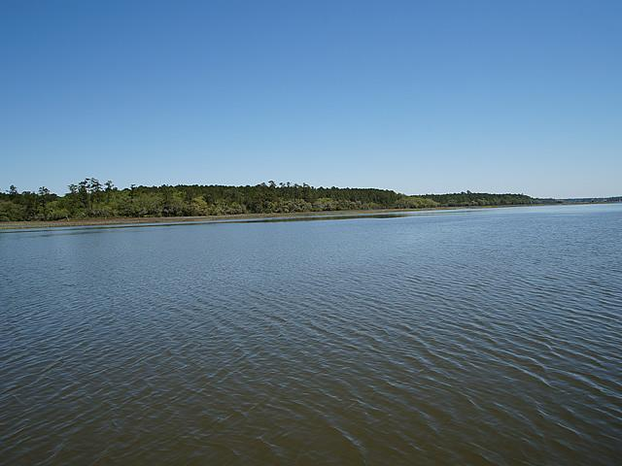
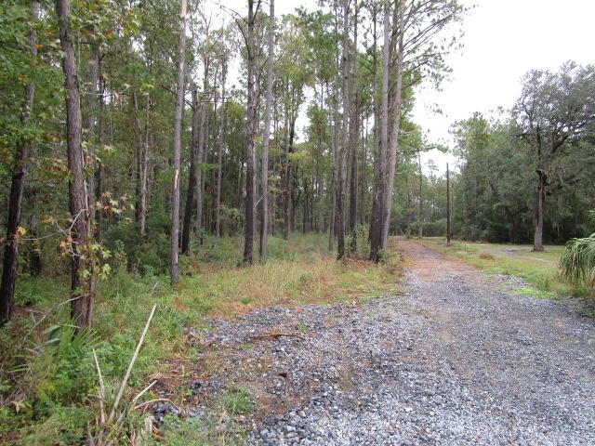
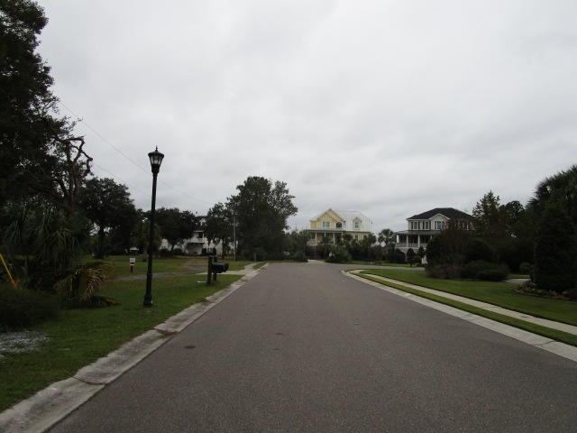
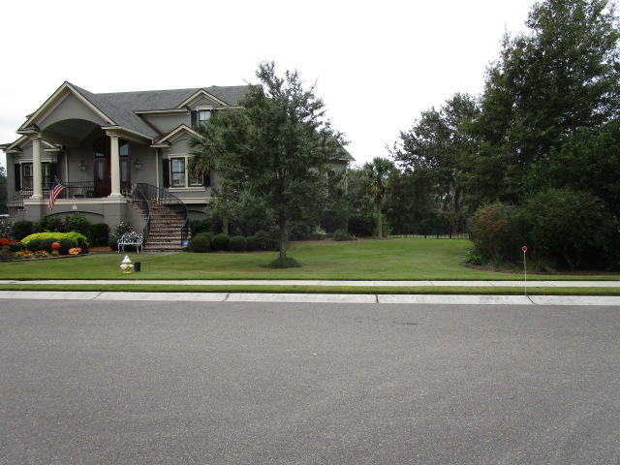
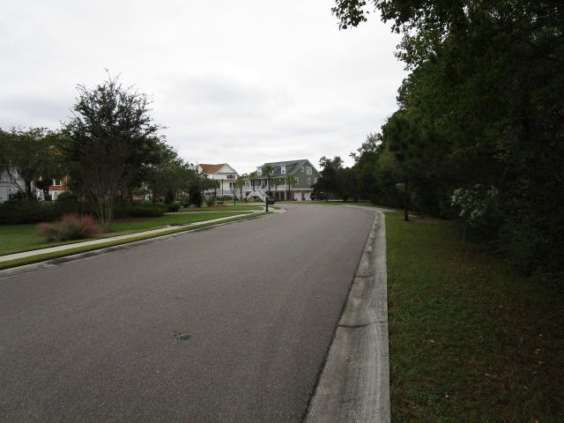
Vacant Lot ~ Owner is Motivated!
0 Newport Court
Beresford Creek Landing | Charleston, SC 29492
MLS# 18030832 | $149,900
This property is currently in the process of being subdivided, & will consist of 3 parcels on this tract. There is a $7500 assessment if you would like to join the Beresford Creek Landing HOA, optional...not mandatory.
Charles Salmonsen
M (843) 224-0300 | O (843) 388-6613 | charles@salmonsen.com
Salmonsen Realty | 864 Lowcountry Blvd Ste B | Mt Pleasant, SC 29464

