Slide 1
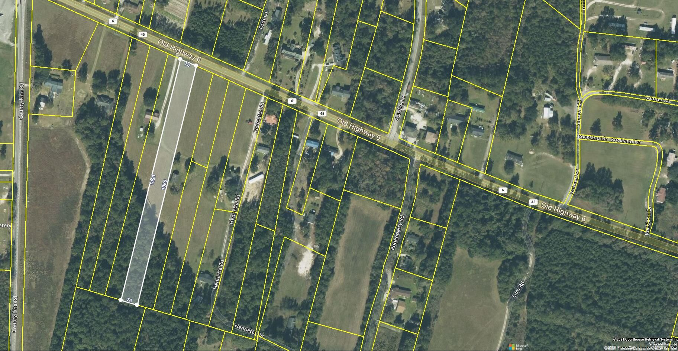
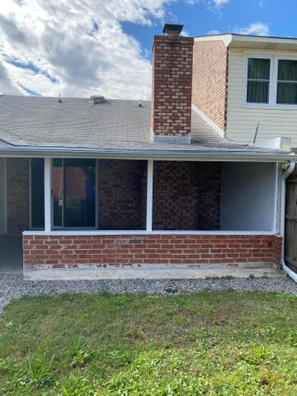
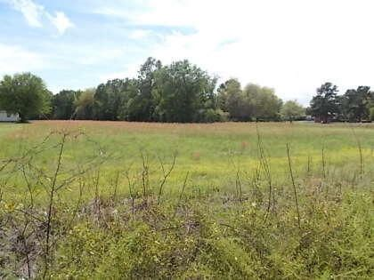
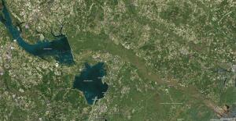
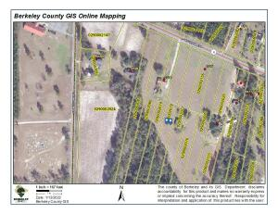


0 Old Highway 6
Cross, SC 29436 | MLS# 21032876 | $47,600
Open House Saturday
12:00 until 4:00
Wonderful Lot ~ Perfect For Your New Home
Open House Saturday 8/24/19
12:00 until 4:00
Wonderful lot, nice convenient 1.87-acre tract on Old Highway 6.
Perfect for your new home. The property is approximately 20 minutes to access to Lake Marion and 30 minutes to Lake Moultrie.
James Hopkins
(843) 708-5930
James.Hopkins@AgentOwnedRealty.com
AgentOwned Premiere Group
1800 Trolley Rd
Summerville, SC 29485

