Slide 1
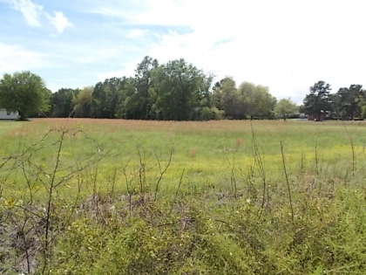
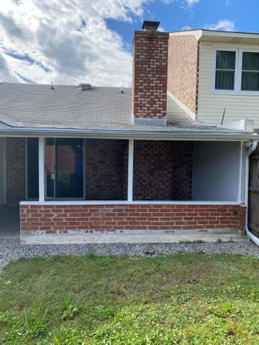
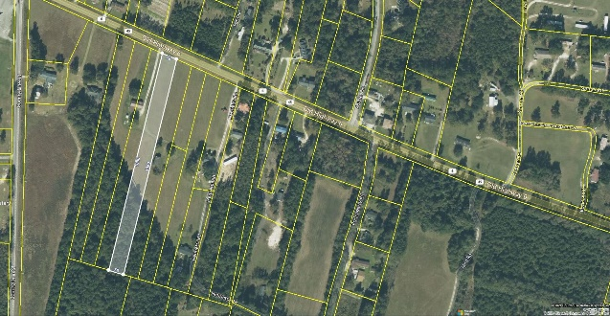
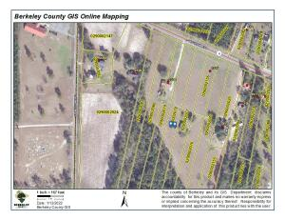
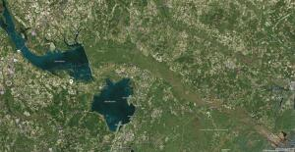


0 Old Highway 6 Cross, SC 29436 | MLS# 21032876 | $39,600
Open House Saturday
12:00 until 4:00
Wonderful Lot ~ Perfect For Your New Home
Open House Saturday 8/24/19
12:00 until 4:00
Growing area, spacious deep clear lot, nice convenient 1.87-acre tract on Old Highway 6. Perfect to build your new home or set a mobile home. Two Beautiful Lakes are not far away. The property is approximately 20 minutes to access to Lake Marion and 30 minutes to Lake Moultrie. Volvo Car Factory & Operations 30 minute drive.
James Hopkins
(843) 708-5930
James.Hopkins@AgentOwnedRealty.com
AgentOwned Premiere Group
1800 Trolley Rd
Summerville, SC 29485

