Slide 1
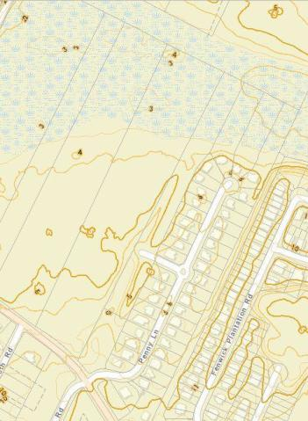
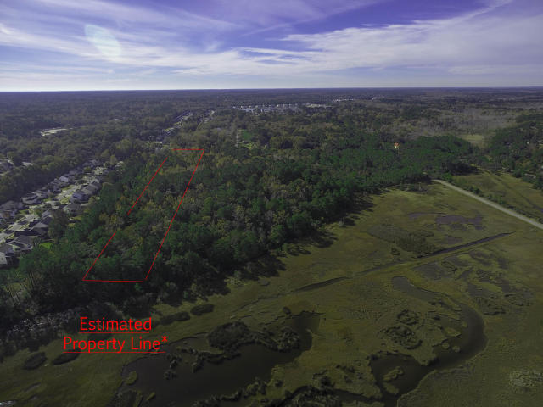
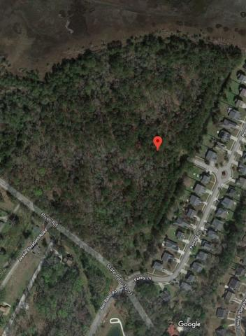
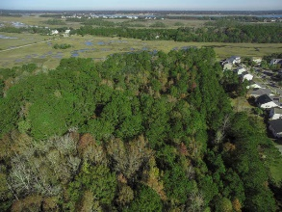
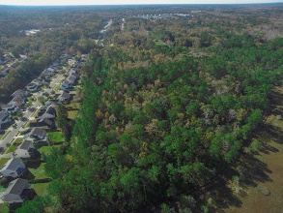
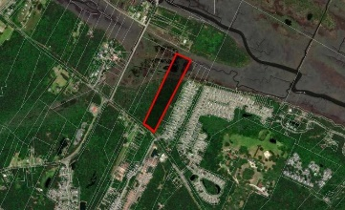
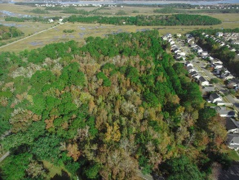
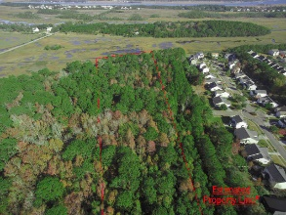
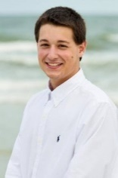

Phase II of 'The Bend' For Sale
0 River Road Rushland ~ Johns Island, SC 29455 ~ MLS# 18032245 ~ $600,000
This parcel totals 10.5 acres and has over 300ft of marsh-front at the back side of the lot! This property contains a few gorgeous Oaks that would look great for anyone looking to build a home or subdivision! Sewer is at the site. Attention Developers and Builders: This lot is annexed into the City of Charleston and is zoned SR-1, meaning 4.8 dwellings per acre OR 24 dwellings per 5 acres. This would make a great second phase of ''The Bend'' subdivision. The adjacent 4.6 acre parcel is also for sale and listed in the MLS.
Nick Mazzilli (843) 640-5575
nick@nickmcharleston.com www.nickmcharleston.com
Reside Real Estate LLC
155 Wingo Way Unit 421 Mt. Pleasant, SC 29464

