Slide 1
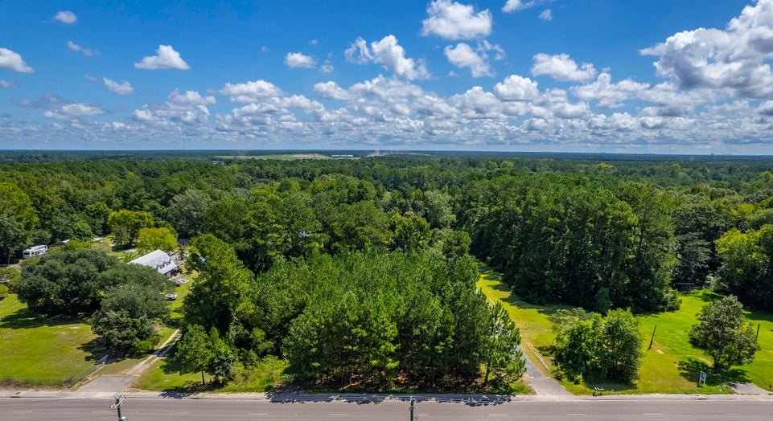
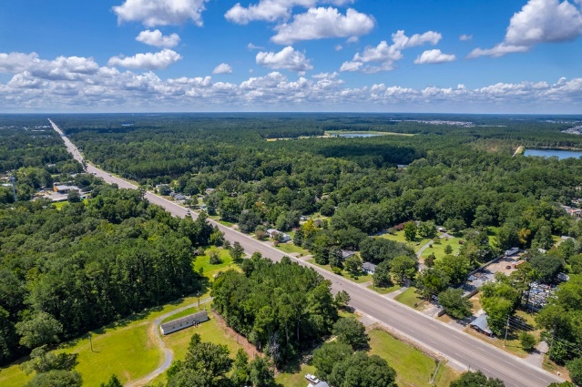
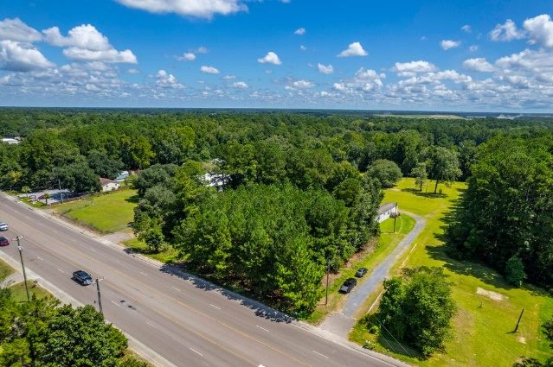
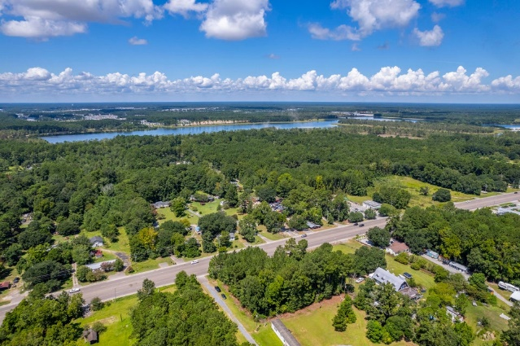


TBD S Live Oak Drive
Moncks Corner, SC 29461 | MLS# 24021224 | $166,250
Moncks Corner! Road Frontage! Commercial Use!
Close to an acre of raw land on the Hwy 17A Corridor (aka S. Live Oak Dr) between Carnes Crossroad and Moncks Corner. Great traffic count and over 200 feet road frontage with curb already cut for driveway. Zoned General Commercial. County says water is available but please verify.
Kelly Rozier
(843) 209-3129
kellywrozier@gmail.com
Brand Name Real Estate
4 Carriage Lane Suite 106
Charleston, SC 29407

