Slide 1
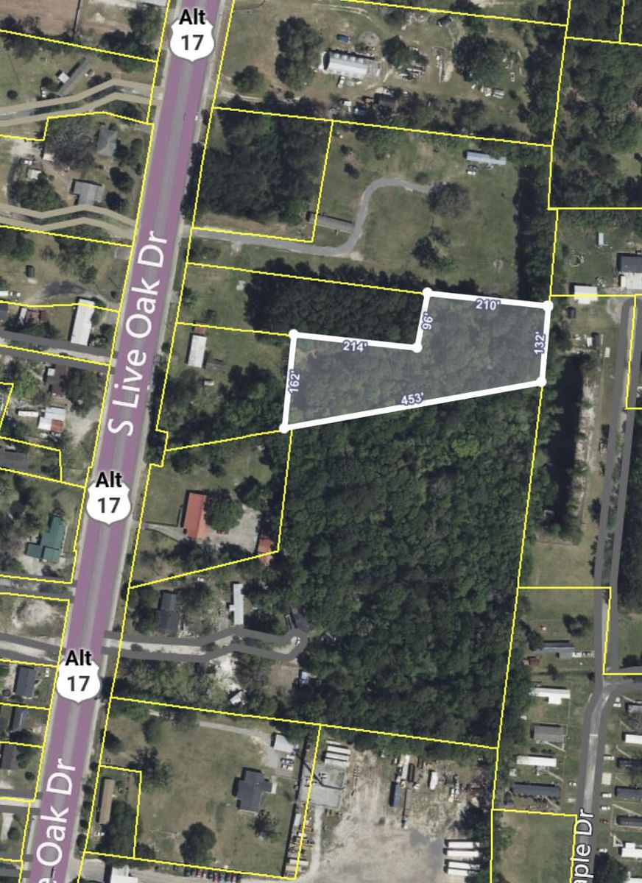


0 S Live Oak Drive
Moncks Corner, SC 29461 | MLS# 23028018 | $225,000
Commercial Property
Almost 1.5 acres zoned commercial that is tucked away for some privacy for your business. Property is wooded. There is an opportunity to purchase additional property.
Kelly Rozier
(843) 209-3129
kellywrozier@gmail.com
Brand Name Real Estate
4 Carriage Lane Suite 106
Charleston, SC 29407

