Slide 1
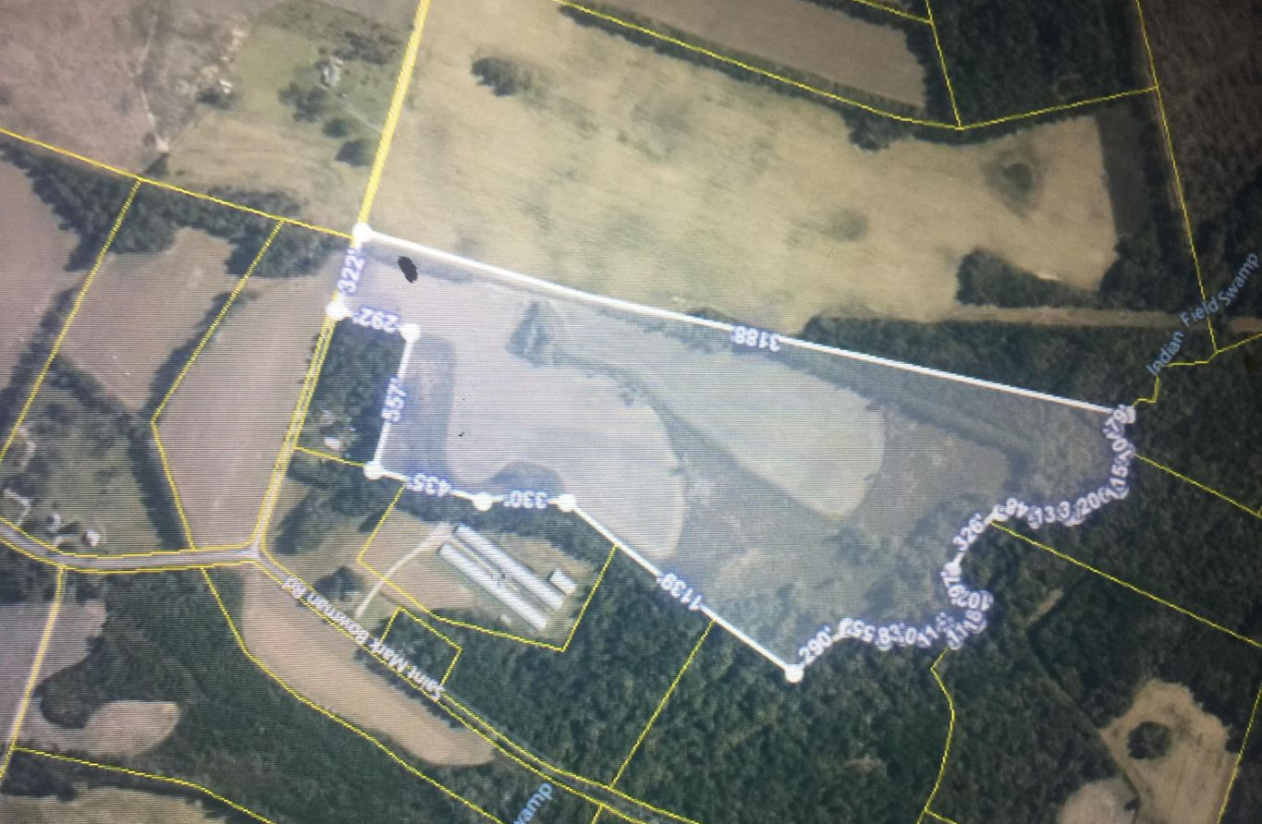


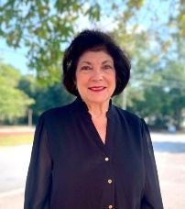
0 Westfield Road
Saint George, SC 29477 | MLS# 21021384 | $400,000
Pristine Land in Beautiful Dorchester County
Over 62 acres of pristine land in beautiful Dorchester County!
Close to Volvo, central to Charleston and Columbia, this represents a true opportunity. Perfect for a farm, equestrian facility, family compound or that dream home getaway. While the possible uses are many, the opportunity to own land like this is very limited.
Listed at under $7,000 per acre, don't miss it!
Roy Oglesby
843-478-9515
roy.oglesby@carolinaone.com
Cathy Marshall
843-609-5788
cmarshallcatherine@gmail.com
Carolina One Real Estate
900 N Main St.
Summerville, SC 29483-6633

