Slide 1
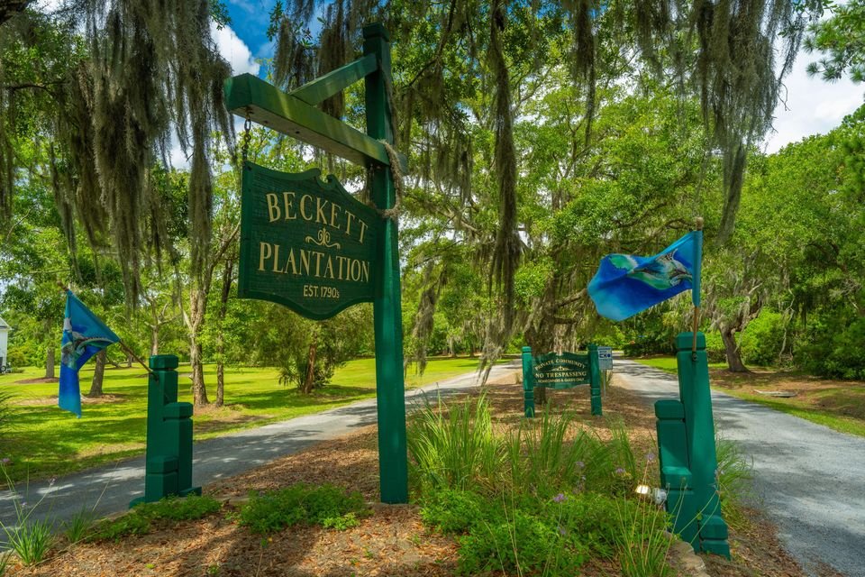
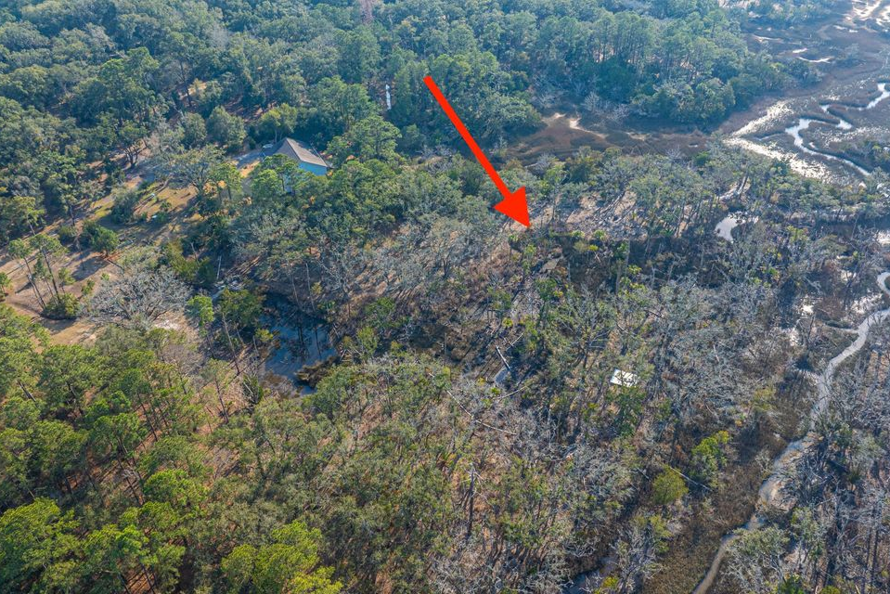
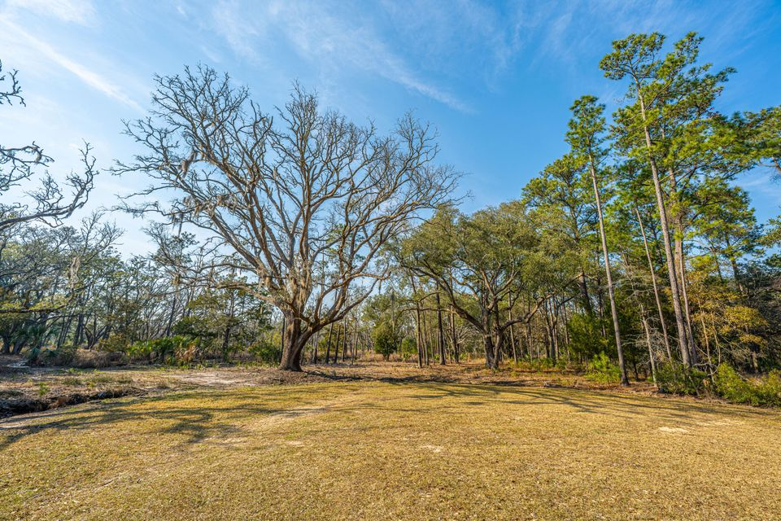
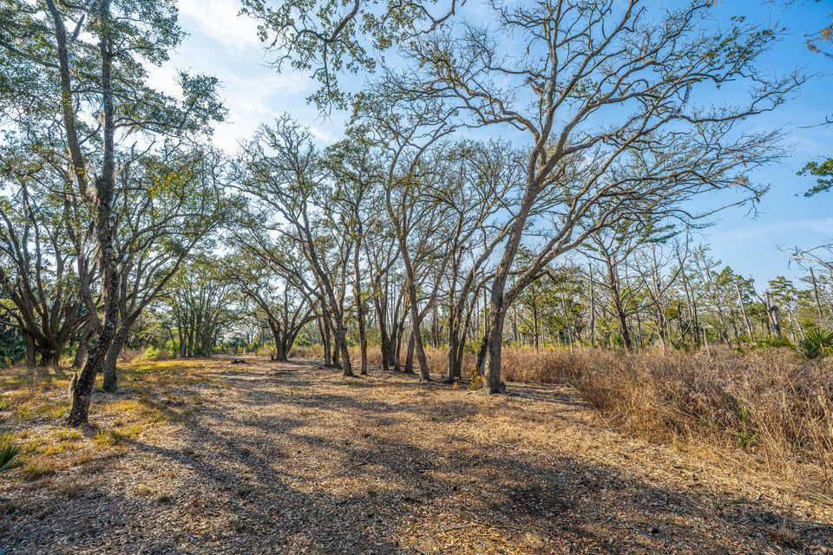
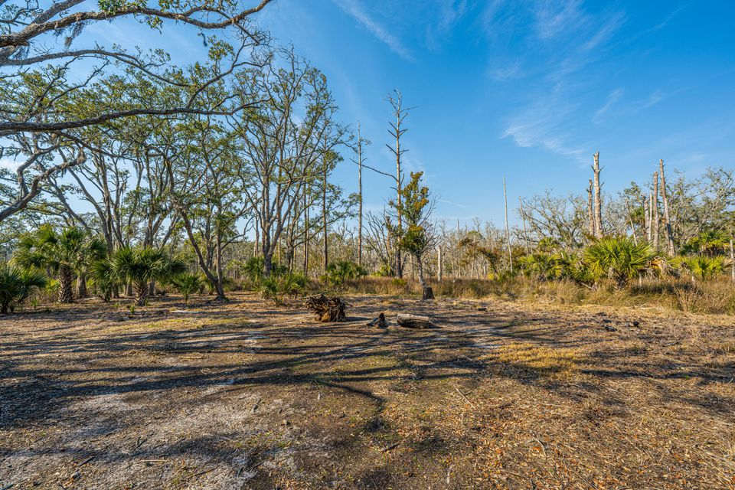
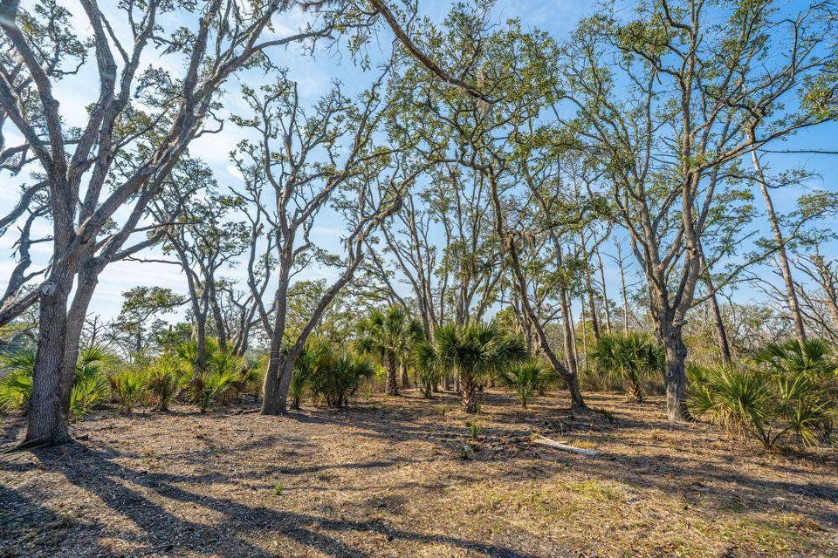
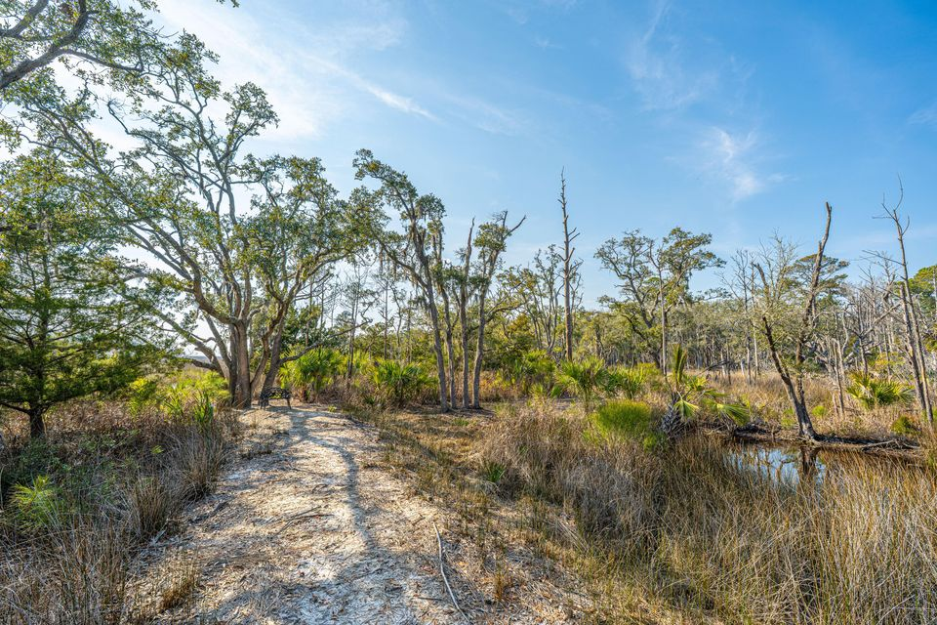
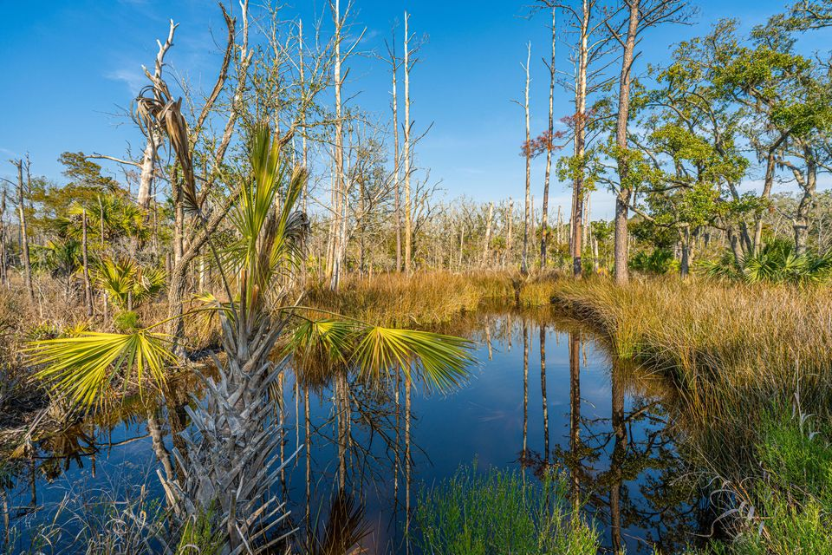
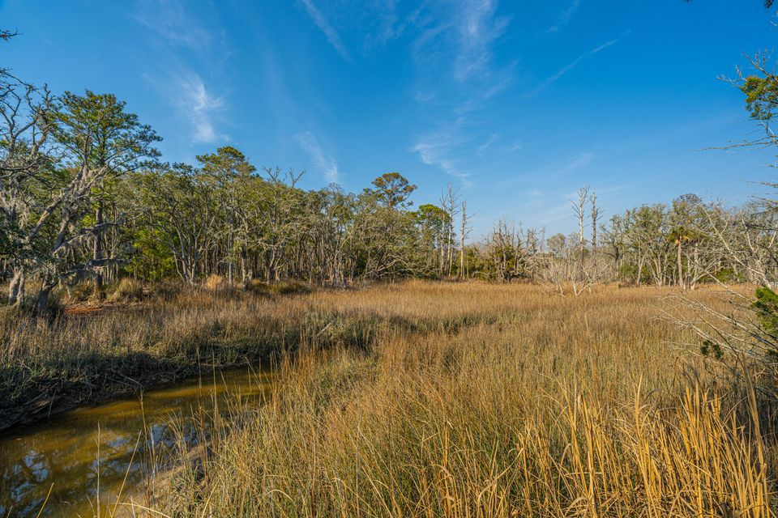
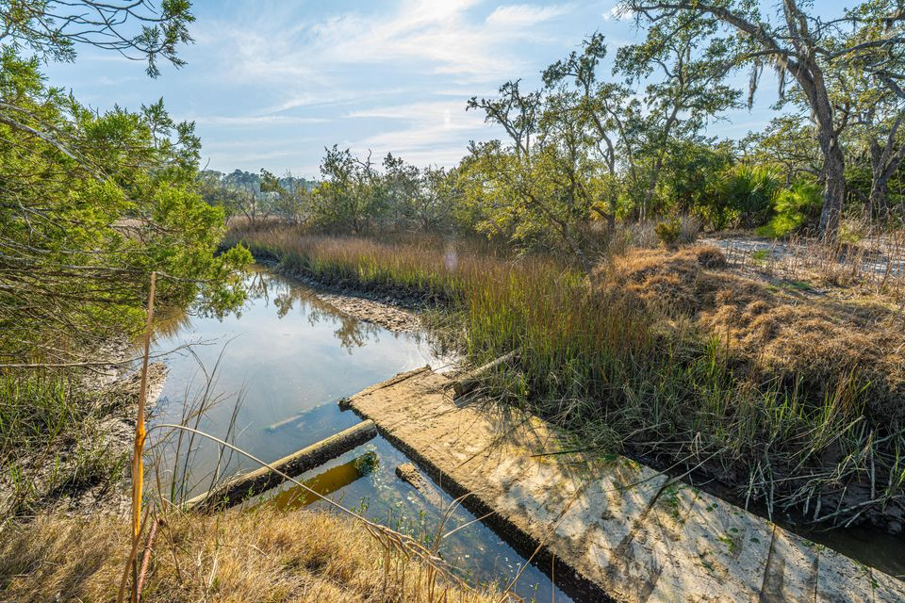

9.59 ACRES ON EDISTO ISLAND!
0 Whooping Island Creek Drive
Beckett Plantation | Edisto Island, SC 29438 | MLS# 25005422 | $474,000
9.59 Acres of Lowcountry Paradise on Edisto Island! Discover the beauty and serenity of Edisto Island with this stunning 9.59-acre property, offering breathtaking marsh views and a tranquil tidal creek. Nestled in the heart of the Lowcountry, this peaceful retreat provides the perfect setting to build your dream home and embrace the coastal lifestyle. With the option to subdivide and approved access, this property presents incredible flexibility and opportunity. Enjoy exclusive access to a community dock, perfect for fishing, kayaking, or simply soaking in the serene waterfront views. Surrounded by nature, you'll experience breathtaking sunsets, abundant wildlife, and the soothing sounds of the marsh—all while being just a short drive from Edisto Beach and Charleston.
Whether you're looking for a private getaway or a forever home site, this property offers endless possibilities.
Don't miss this rare opportunity to own a slice of Lowcountry paradise!
Jenny Siggelkow
843-901-3494
jcsiggelkow@gmail.com
ERA Wilder Realty | 537 Folly Road | Charleston, SC 29412

