Slide 1
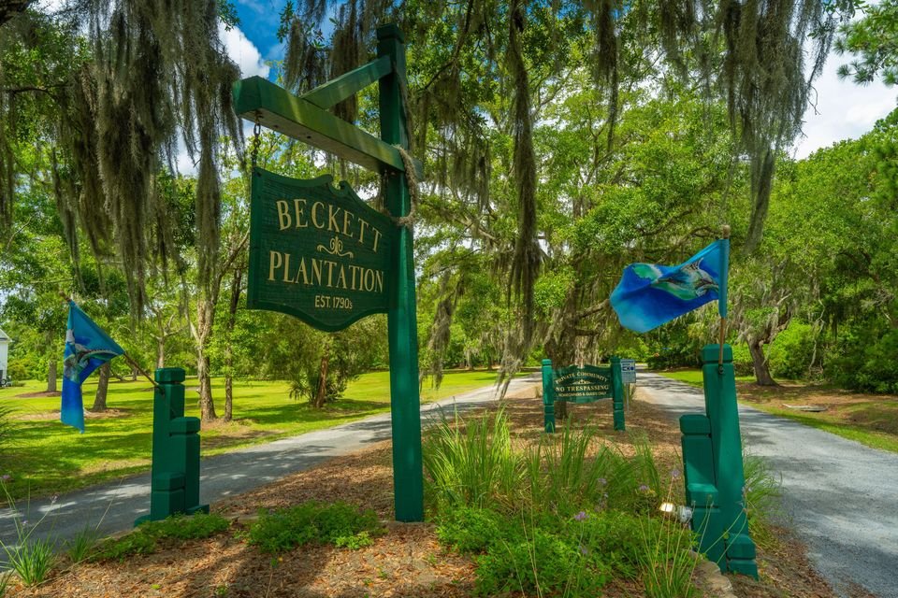
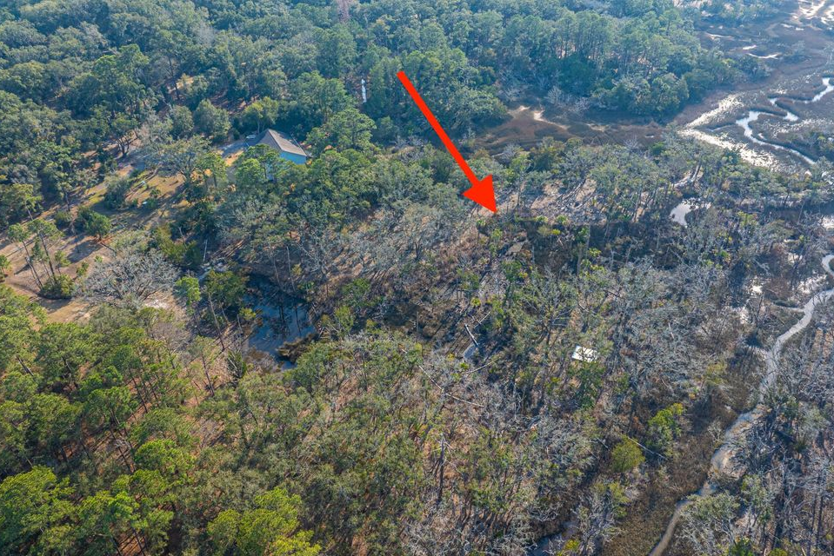
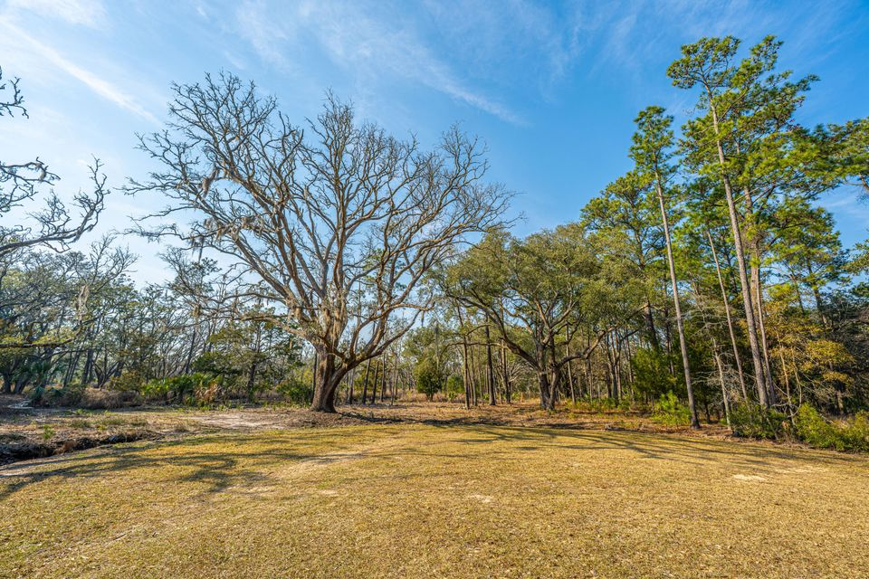
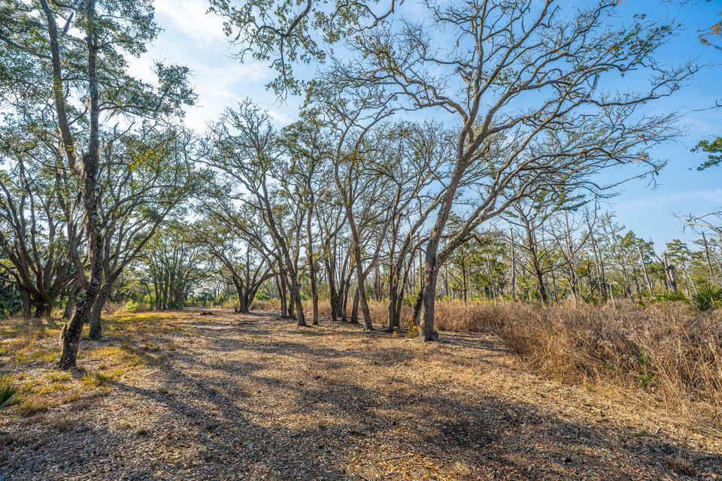
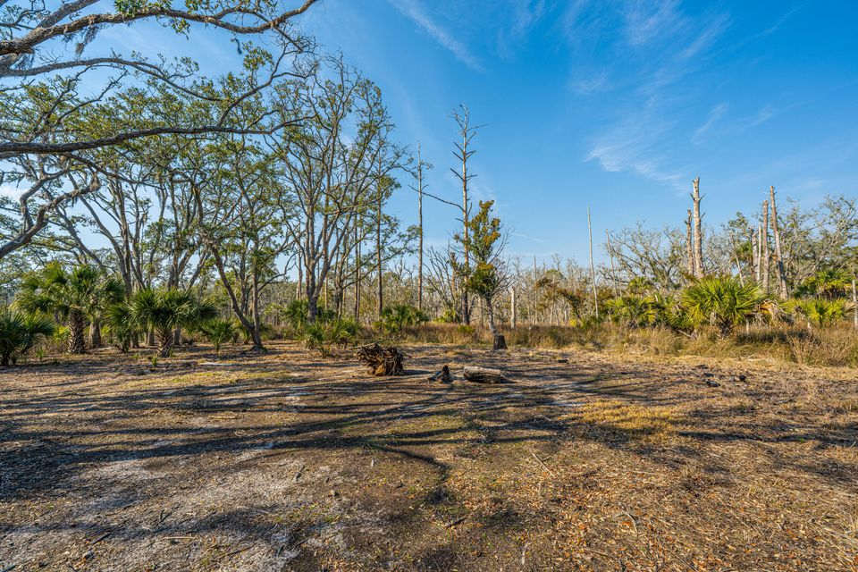
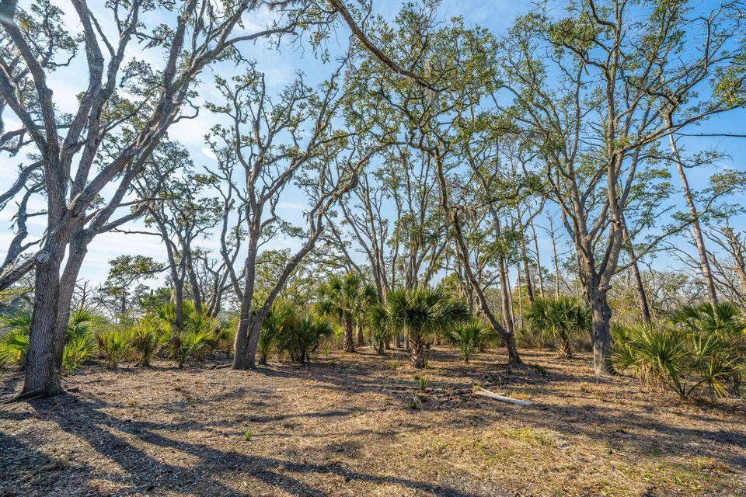
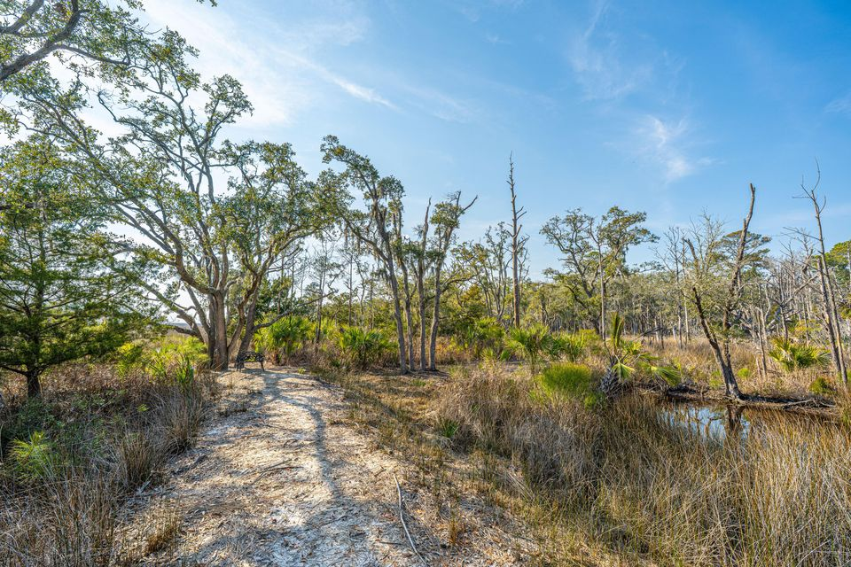
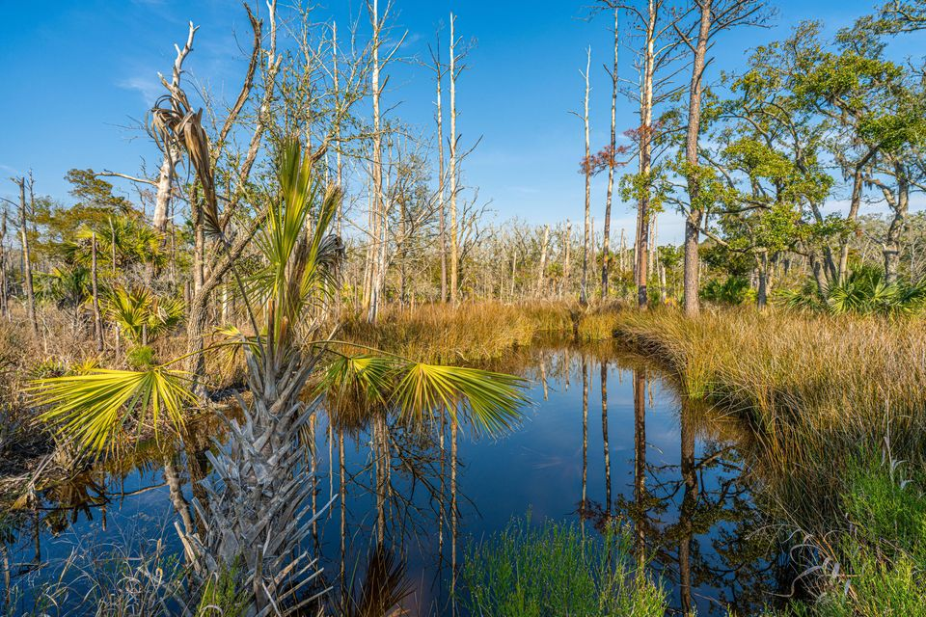
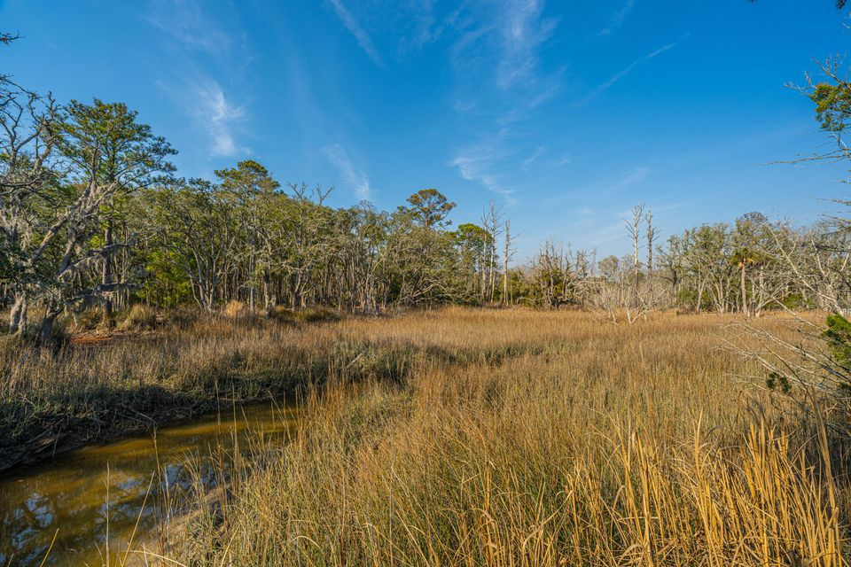
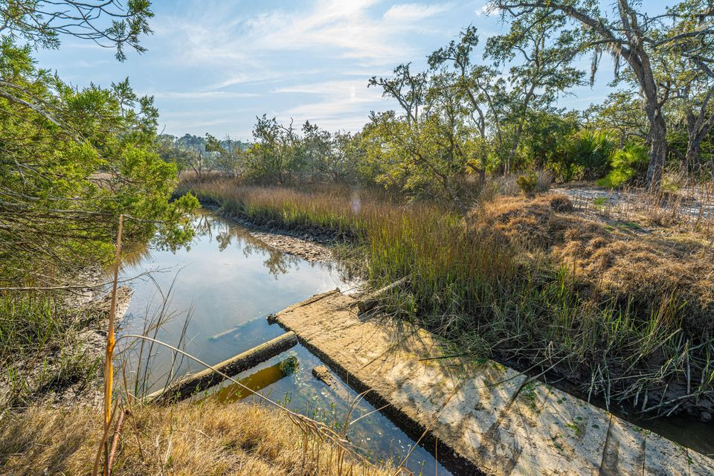

9.59 ACRES ON EDISTO ISLAND!
0 Whooping Island Creek Drive
Beckett Plantation | Edisto Island, SC 29438 | MLS# 25005422 | $395,000
$35K BELOW APPRAISED VALUE!
Subdividable 9.59-acre parcel with deep-water community dock access on Edisto Island—Lowcountry living at its finest! This expansive property offers stunning marsh views, a peaceful tidal creek, and the rare opportunity to build one or two custom homes. Located just minutes from Edisto Beach and within easy reach of Charleston, the setting provides tranquility, abundant wildlife, and unforgettable sunsets. A truly turnkey opportunity, the sale includes a DHEC septic permit, Army Corps of Engineers report, encroachment permit for a second driveway and approved architectural house plans—everything you need to start building your ideal coastal retreat.
Jenny Siggelkow
843-901-3494
jcsiggelkow@gmail.com
Robyn Lane
843-222-5599
robynlane01@icloud.com
ERA Wilder Realty | 802 Johnnie Dodds Blvd | Mt. Pleasant, SC 29464

