Slide 1
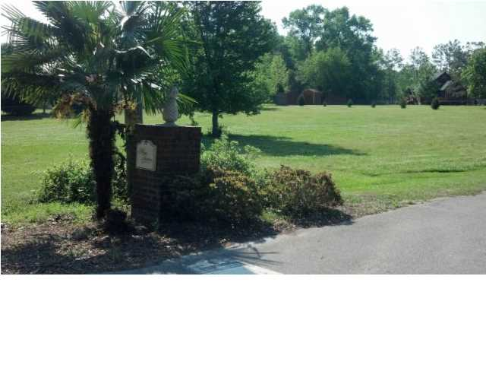

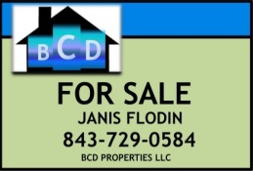
Summerville, SC MLS# 1415046 Just Reduced to $59,000
1000 MOSS HAVEN LN, SUMMERVILLE, SC 29483
A Contractor’s Dream
Price Reduction on a cleared vacant lot!
Offered at $49,900
MLS# 1415046
Owner Financing Available
Bring All Offers!
A new reduced price. This is a serene and spacious lot in a quaint cul-de-sac, already cleared and ready to build. 6.5 miles from downtown Summerville. The Owner has obtained septic permit and city water is available. An HOA exists but no HOA collections are taken. The covenants and restrictions are attached, not overly extensive. Road egress exists from both Embassy Drive and Moss Haven Lane. A beautiful house plan was previously chosen for this lot, plan and elevation photo is available by email just to give buyer ideas. Buyer to verify schools, lot size. Bring any offer.
B C D Properties LLC
123 Piccadilly Loop
Summerville, SC 29483
Janis Flodin
843-729-0584 M
jflodin.bcd@gmail.com

