Slide 1
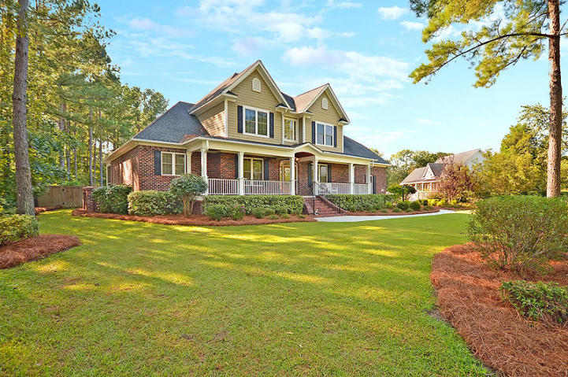
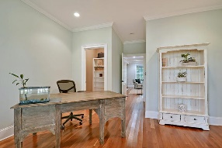
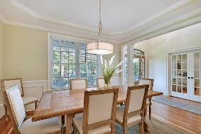
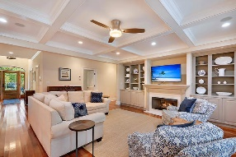
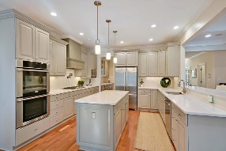
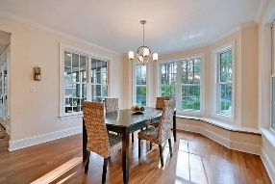
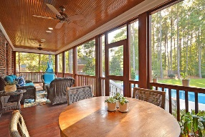
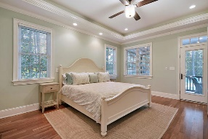
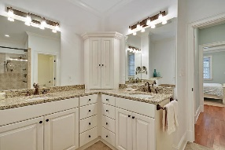
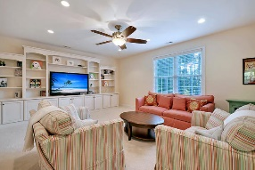
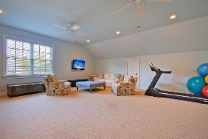
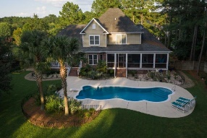
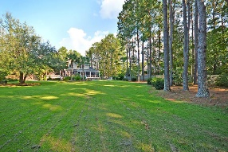


One Acre Lot, In-Ground Pool!
1000 Mt Whitney Drive
The Summit
Summerville, SC 29483
MLS# 19025935
$649,900
5 Bedrooms | 4½ Baths | 4,410 sf
Get ready to fall in love with this DREAM HOME!! Located in the established neighborhood of The Summit, just three miles from downtown Summerville, this custom beauty sits on almost an acre lot! You'll be wowed from the moment you pull up and see the full front porch with its beaded wood ceiling! Upon entering, you'll immediately notice the natural light of the two story foyer and the beautiful cherry floors, which are throughout the first floor. No detail was missed on this home! To your left, through the French doors, is the home office or formal living room. This room has a large closet as well as access to the family room and could be used as a bedroom if needed. To your right is the dining room. which is a great size for entertaining! From the dining room, walk through the butler's pantry and you'll see an ice machine and wet bar as well as additional cabinet storage. The kitchen is a chef's delight! Custom cabinetry, island, breakfast bar, double ovens, large eat in area as well as a gas cooktop with a pot filler above! All of this overlooking the family room which has coffered ceilings, recessed lighting, tons of built in cabinetry and shelves and a gas fireplace! The master bedroom is also located on the first floor and has back porch access. The master also offers two large walk in closets with built ins and a large master bath. The bathroom has dual vanities, a large jetted tub as well as a huge master shower with multiple shower heads and jets. Your own home spa! It's amazing! Finishing off the first floor is a storage room off of the kitchen, a full bathroom and access to the massive laundry room! Here you'll find a sink and cabinetry, access to outside and an awesome built in storage area. You'll never be lacking for storage space in this home!! Head back in the house and check out the finished room over the garage. This flex space has attic storage off of it and is a great size for a media room, man cave, workout room...you name it! Head upstairs from the foyer and get ready to be impressed! The first of the upstairs bedrooms offers a large closet as well as its own full bath! Perfect for guests! Two more large bedrooms share a jack and jill bath. No more fighting over the bathroom, everyone has their own bathroom space! Back out in the hall, in the back of the home, you'll find another HUGE bonus room. This room has built in cabinetry and storage. Access the walk in attic space from this room. Never ending storage here! If need be, this room can be a 5th bedroom! As if this house couldn't get any better, head out to the backyard! Off the family room and master is a very large screened in porch. A great place to kick back and relax! Off the kitchen is another deck with a gas hook up for your grill! Both of these areas overlook the amazing backyard! You never need to go on vacation living in this home! The stunning saltwater in-ground pool awaits you! Swim year round as this pool has a heater! The backyard is completely fenced in and offers tons of privacy. Don't miss out on this opportunity to live in a house that has it all! Dorchester District 2 schools, minutes to shopping and the interstate, low HOA fees, and a backyard oasis! Come see this home today!
Larry & Kathy Mazalatis
Larry Cell 843-693-0529
Kathy Cell 843-693-0159
Office 843-871-9133
AGENTOWNED PREMIERE GROUP | 1800 TROLLEY RD | SUMMERVILLE, SC 29485

