Slide 1
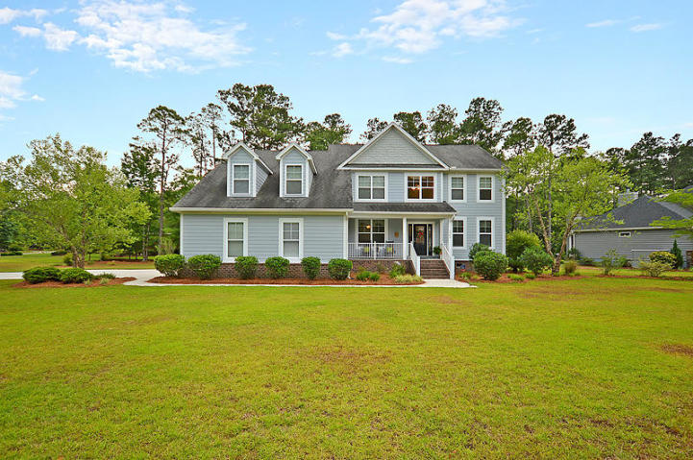
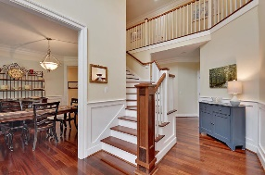
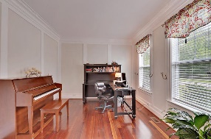
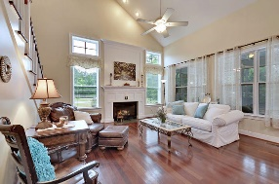
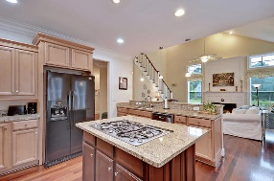
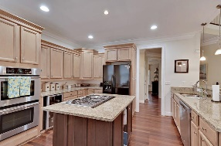
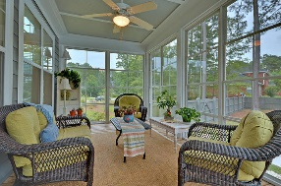
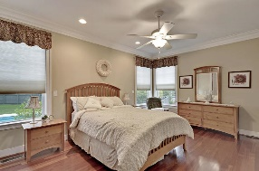
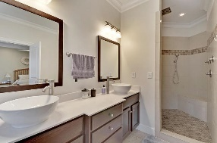
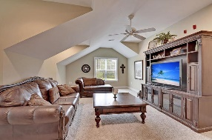
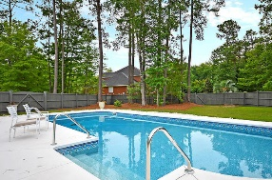
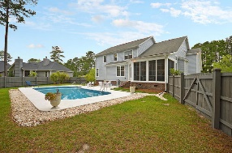
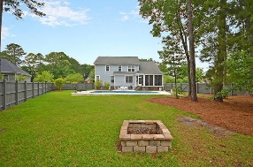


Pool - Large Lot - Close to Downtown Summerville
1000 Poconos Court
The Summit
Summerville, SC 29483
MLS# 19016978
$525,000
5 Bedrooms | 3½ Baths | 3,700 sf
This is the house you've been waiting for! Over a half an acre, in an established neighborhood just five minutes from downtown Summerville! This stunning home sits on a corner lot and has a built-in pool! From the moment you arrive at the house, you feel welcomed! The front porch is the perfect place to sit and have a cup of sweet tea. Upon entering, you'll immediately notice the gorgeous Brazilian cherry hardwood floors and all the natural light! From the welcoming foyer, you can make your way to the formal living area that can also be used as an office. Great trim work throughout this room, as well as the dining room, which is a perfect size for entertaining. The great room, located in the rear of the home, has a vaulted ceiling with a gas fireplace, a second staircase and is open to the kitchen. The kitchen is a chef's delight! Granite countertops, stainless steel appliances, island with gas cooktop and large eat in area. Off the kitchen is a very large pantry as well as the laundry room with a utility sink and cabinetry. Step outside the kitchen and you are in a wonderful sunroom that can be used year-round and offers great views of the pool and large backyard. Enjoy cooler nights around the fire pit! Back inside, you'll also find the master bedroom which is located on the first floor. The beautiful wood floors are on the entire first floor, including the master. The master bath has dual vanities, a separate tub and shower and a huge walk in closet!! The closet has built in shelving and drawers! Head upstairs from either of the two staircases and you'll find four great sized bedrooms, one with its own en suite bathroom, plus another full-sized bathroom in the hall with dual vanities. The bonus room offers so many options. Great flex space that you can use any way you see fit! This home has plenty of attic storage as well as a garage that has ceiling to floor built in shelving! This home has it all and is move in ready! Very low HOA fee!! Located in Dorchester District 2 schools and just minutes to all the shopping of downtown Summerville, this oasis awaits you! Come see it today!
Larry & Kathy Mazalatis
Larry Cell 843-693-0529
Kathy Cell 843-693-0159
Office 843-871-9133
AGENTOWNED PREMIERE GROUP | 1800 TROLLEY RD | SUMMERVILLE, SC 29485

