Slide 1
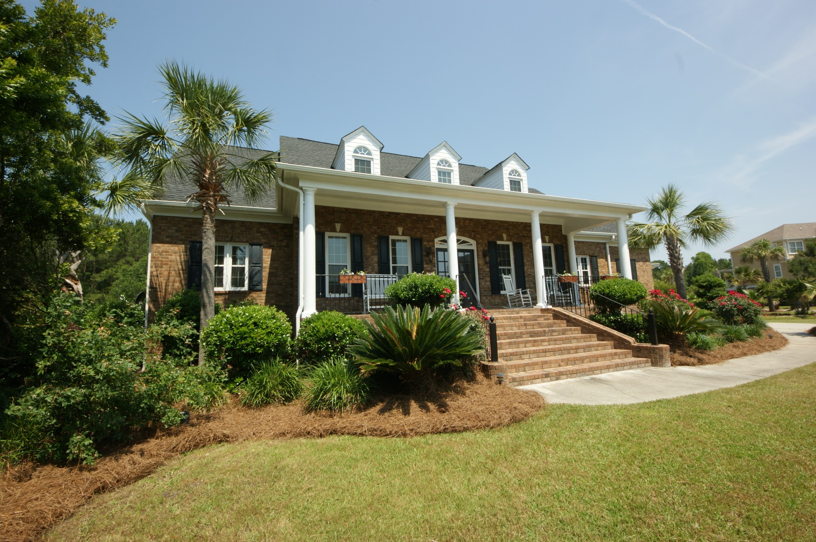
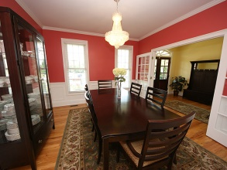
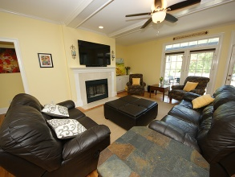
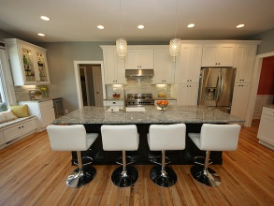
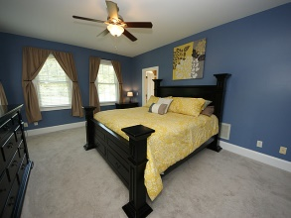
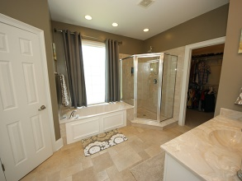
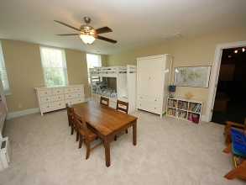
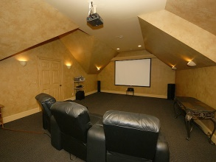
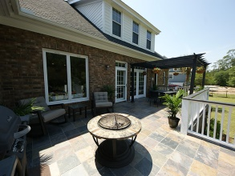
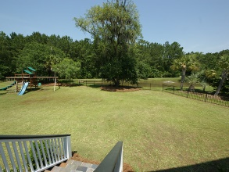

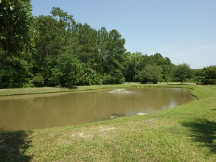
1000 Rivershore Rd
Beresford Creek Landing
Charleston ~ MLS# 1414006
Reduced to $649,900
Location, the one thing you can't change when buying a house. 1000 Rivershore Road has the location and style you'll love in your next home. Tucked away on a cul-de-sac this stately brick home is unique within the prestigious custom home community of Beresford Creek Landing. The community is a favorite of folks who like the Daniel Island lifestyle, schools and amenities. The larger lots in Beresford Creek allow for more elbow room and larger homes. Commuters love Beresford Creek for the location. Only a minute from I-526 which provides easy access to everything in the area. Charleston International airport is 12 minutes away. Fun and sun at the beach is only 18 minutes away, and historic downtown Charleston a short drive of 19 minutes. If you're a boating enthusiast, fisherman or kayaker you'll love the location of Beresford Creek Landing for the convenience of having Daniel Island marina nearby. Minutes from either the Wando or Cooper River makes this an ideal water lover's home. The house has magnificent features. From a newly remodeled kitchen with top of the line appliances, soft close cabinets and farm sink to a movie theater / media room upstairs. Beautifully appointed dining room, coffered ceilings in the family room, a 27' x 12' elevated stone decked patio for grilling and entertaining, a full 8 foot wide front porch built for rocking chairs and tea tables. Sitting on a 1/2 acre of land the fenced backyard is very large.

