Slide 1
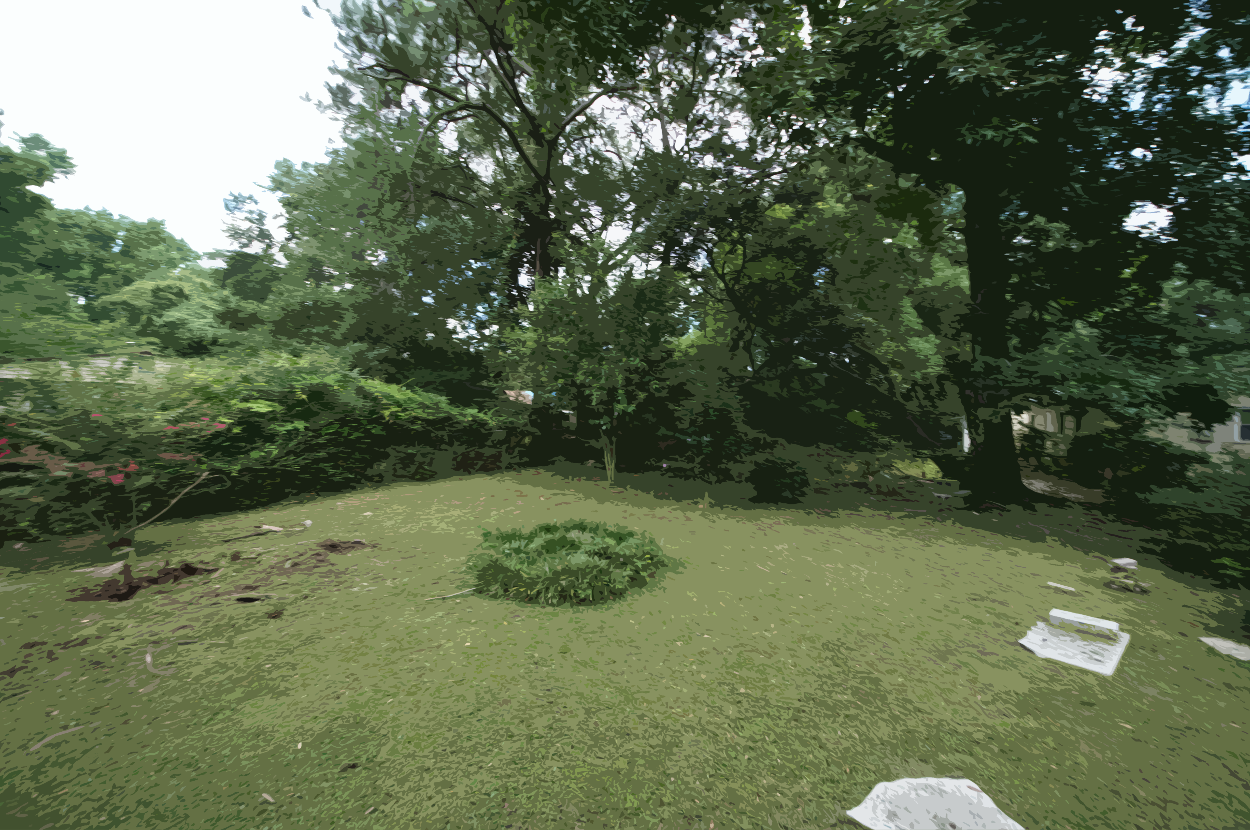
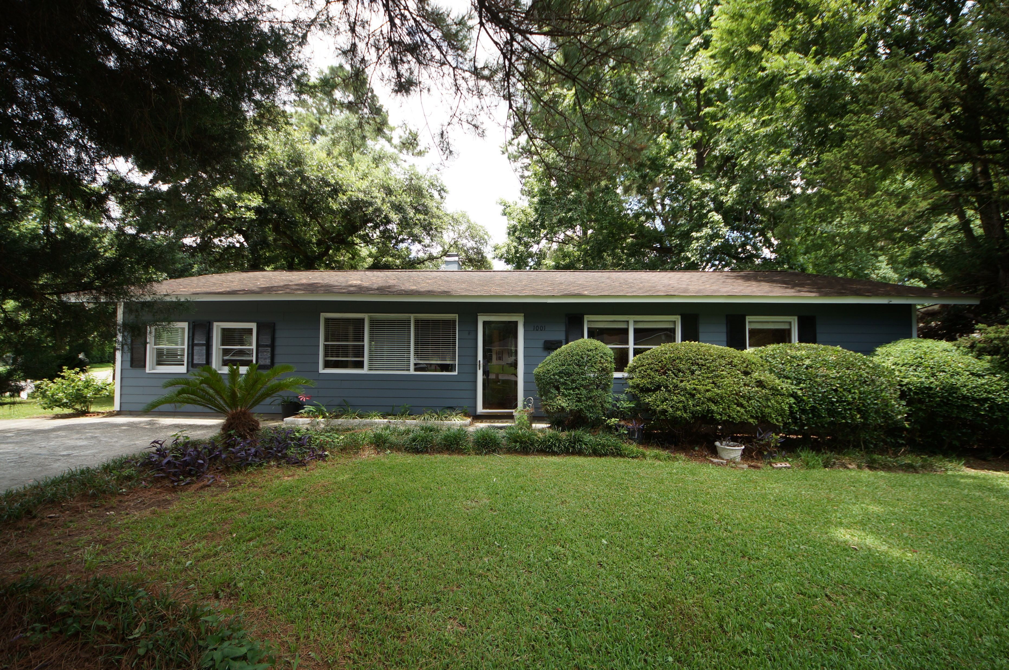
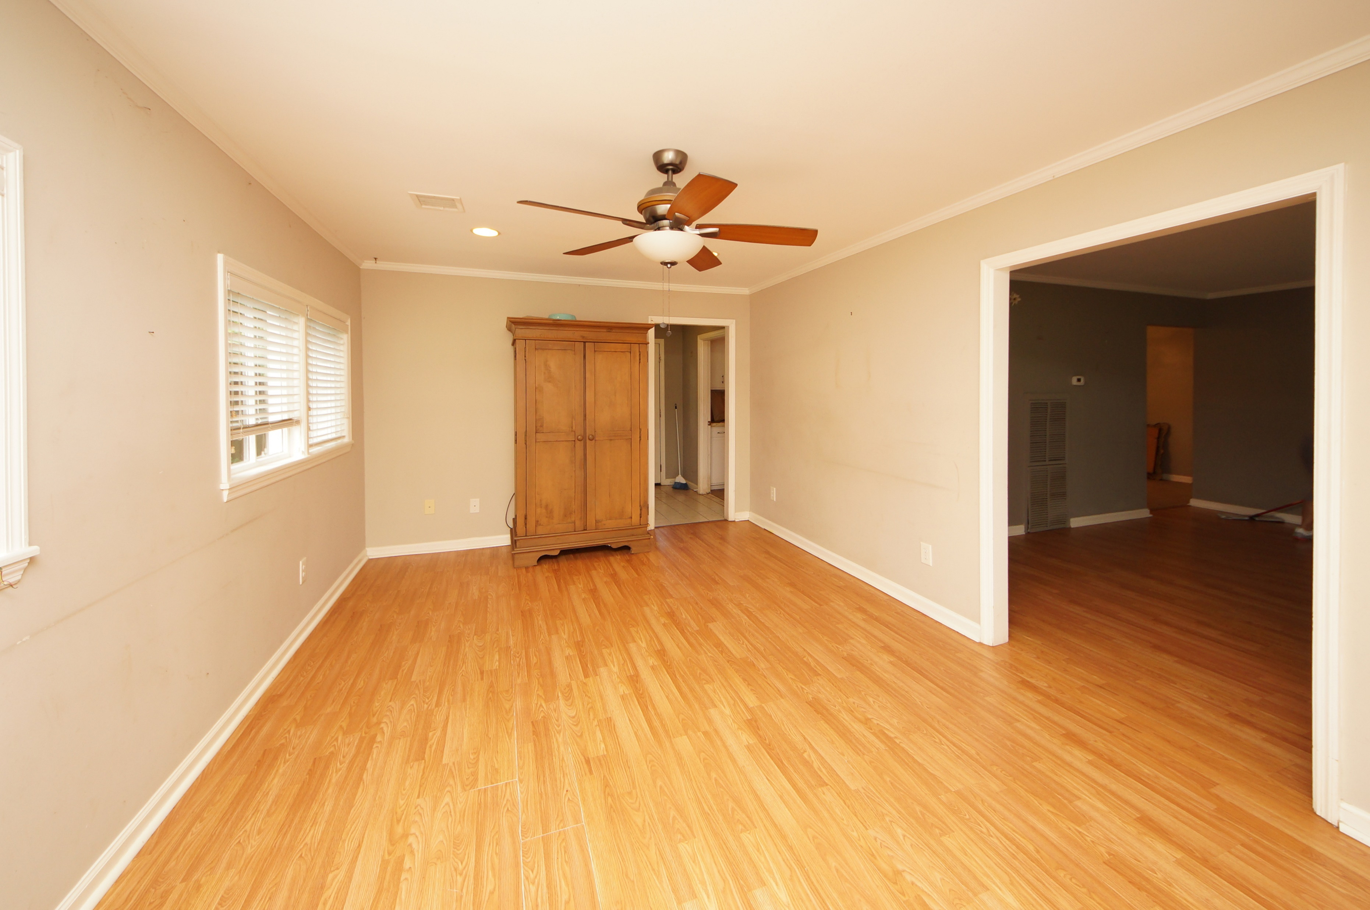
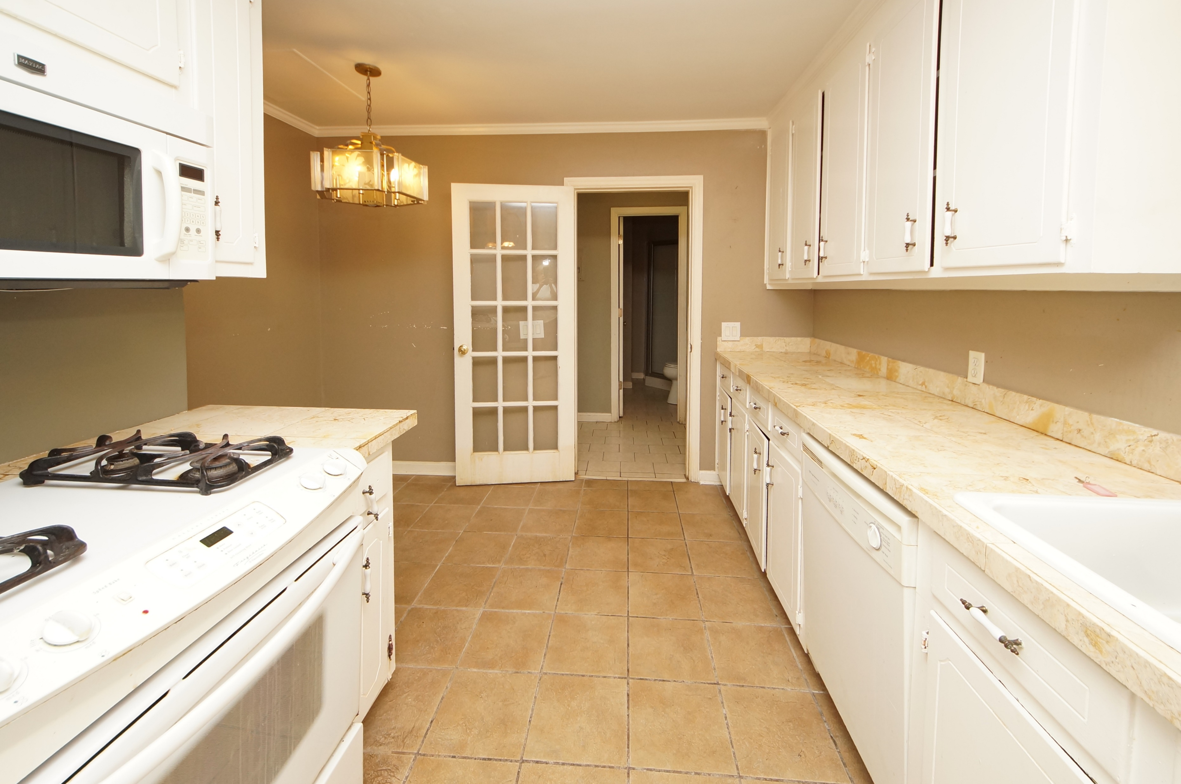
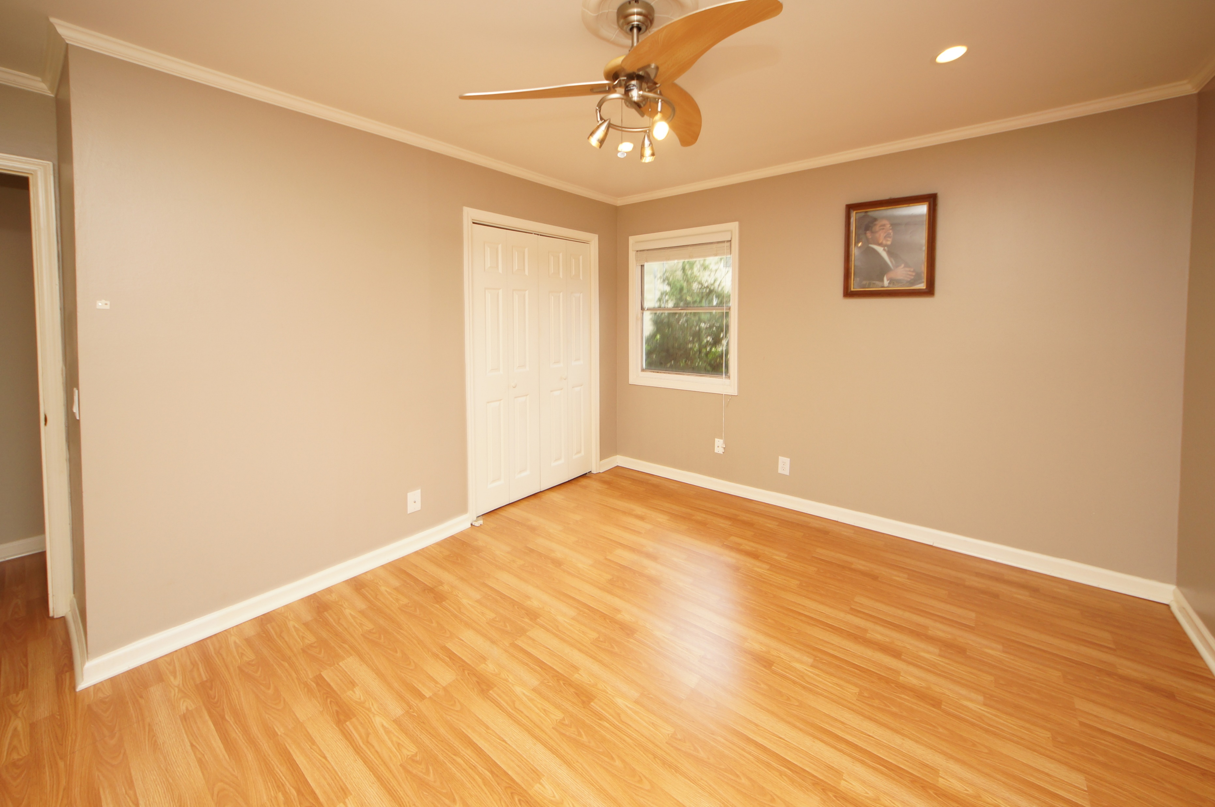
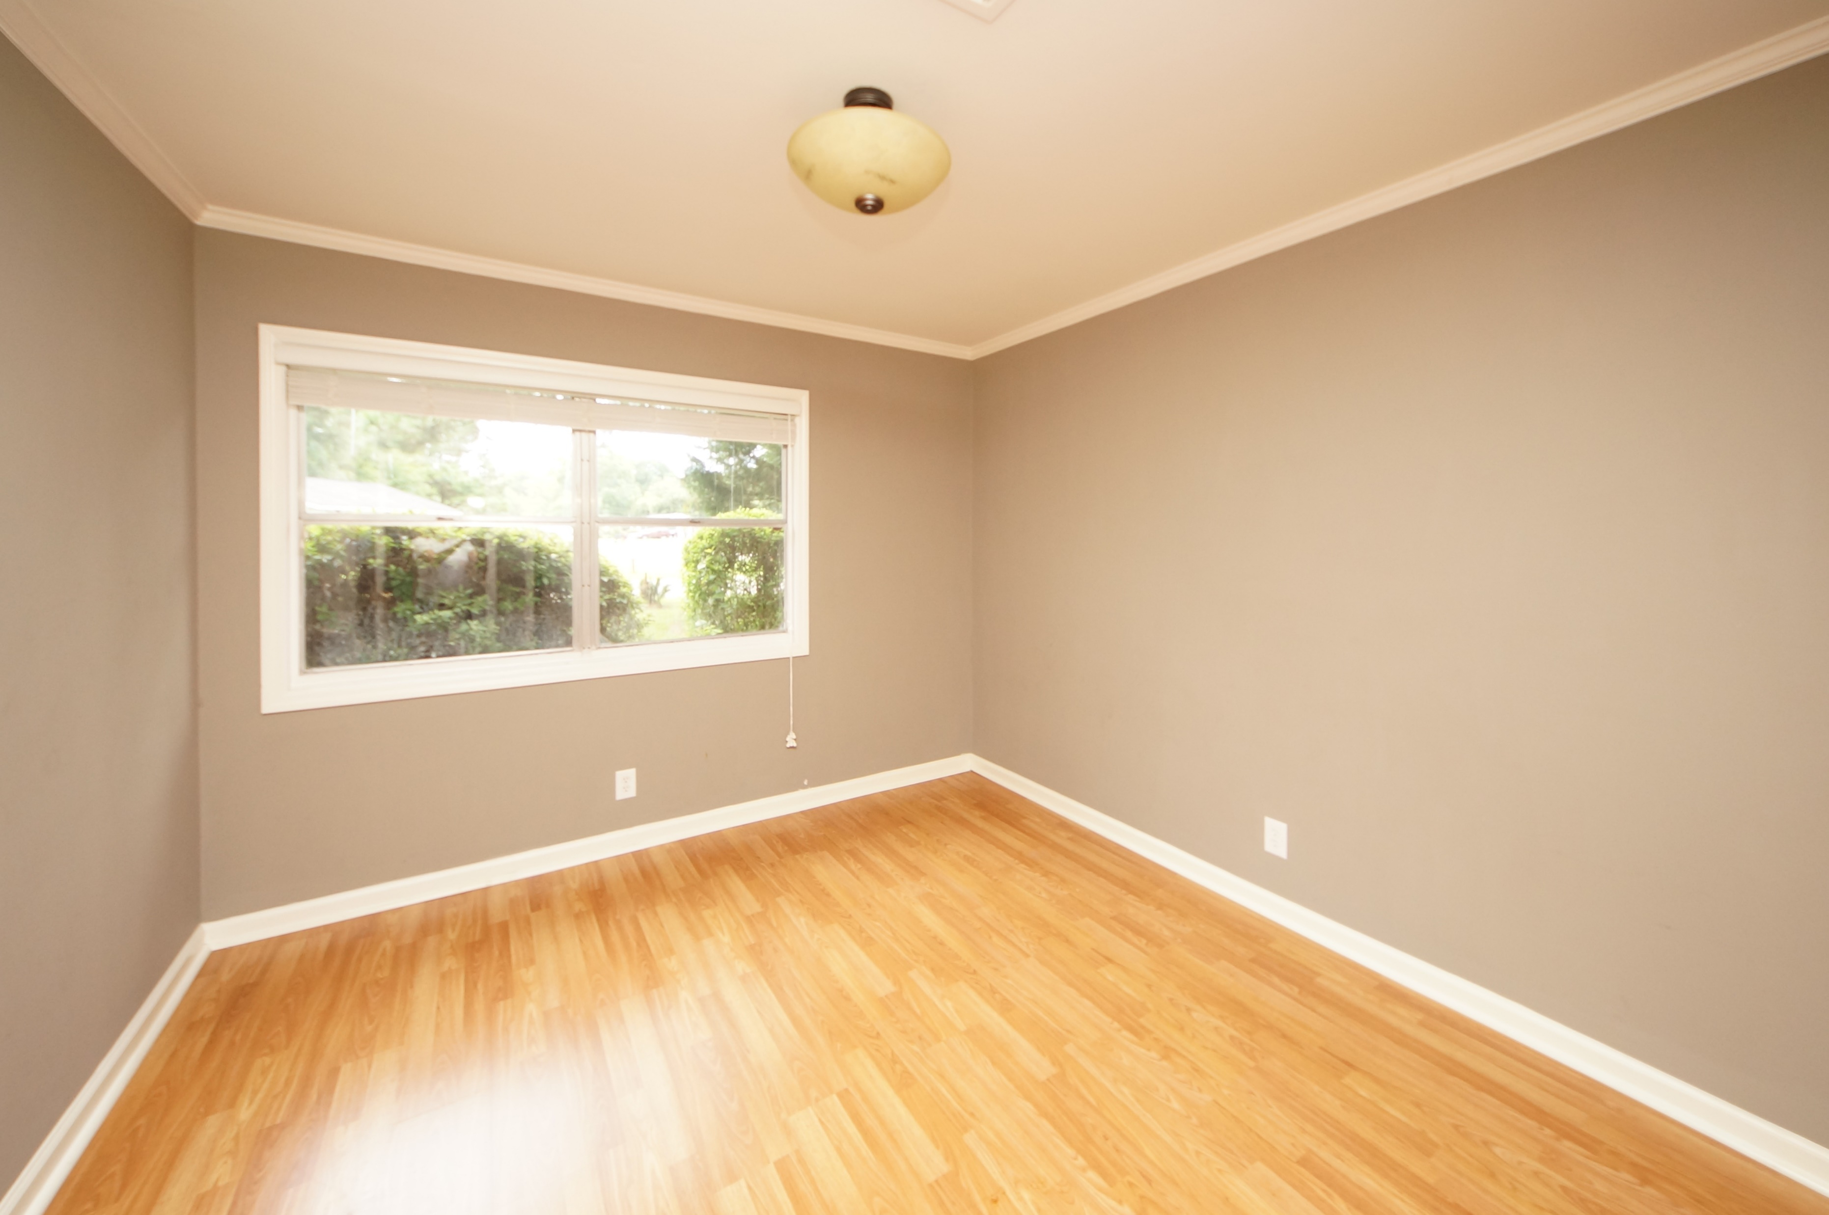
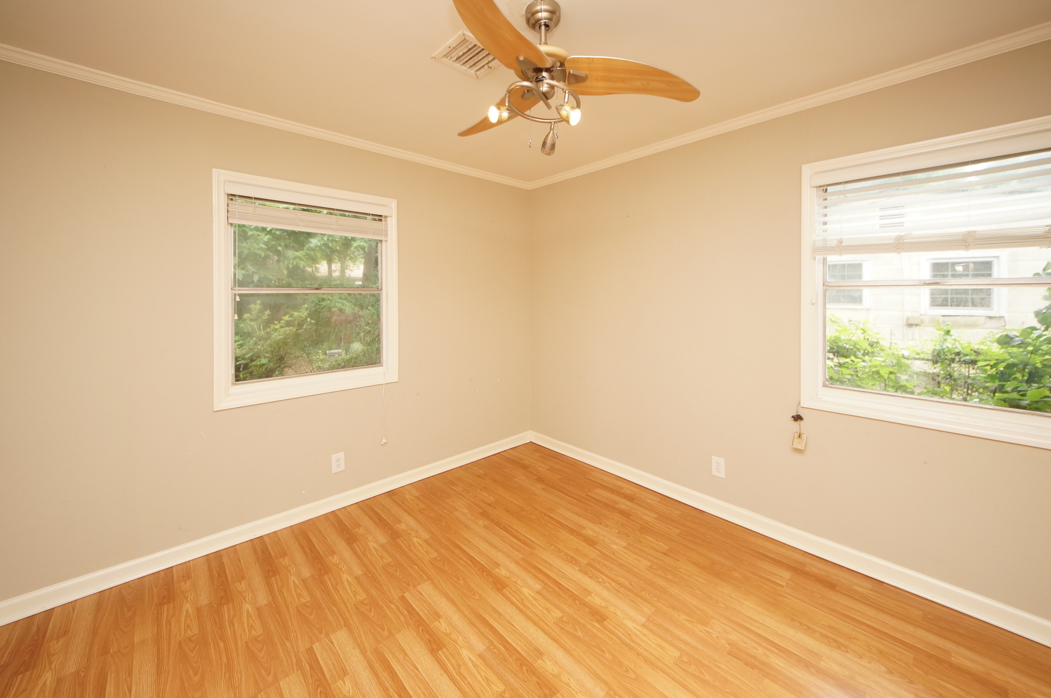
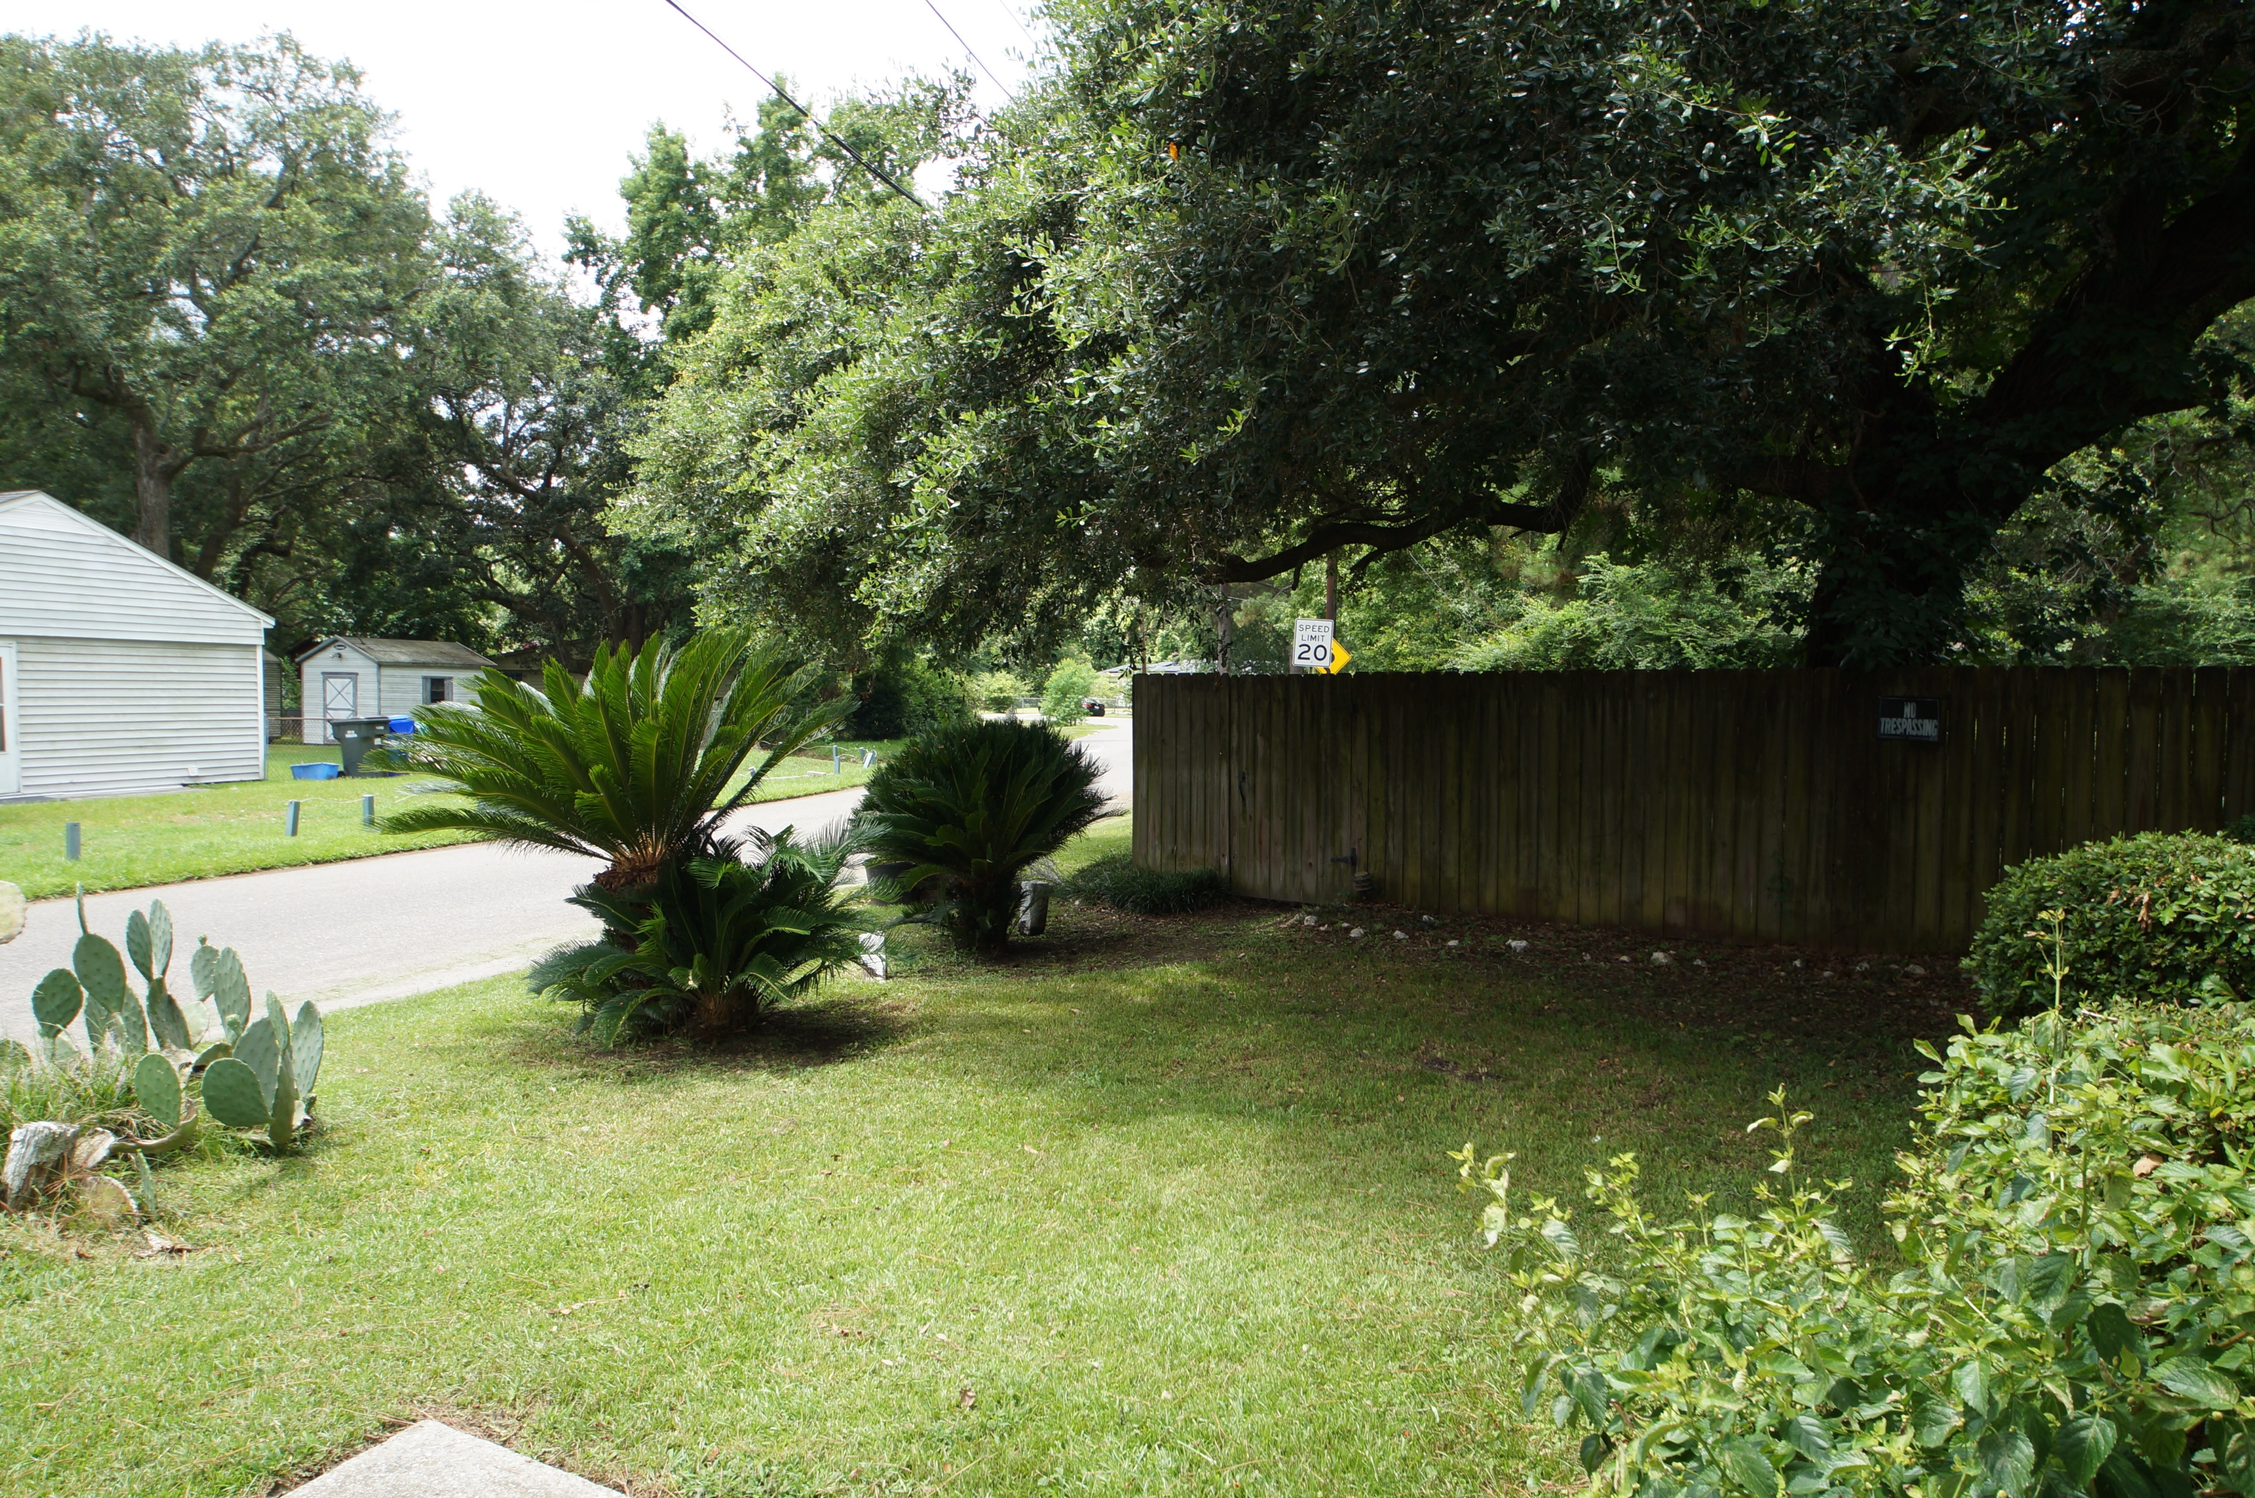
Owner is Ready to SELL!
1001 Nottingham Drive
Sherwood Forest | Charleston, SC 29407
MLS# 18019462 | $229,000
Great starter home!
Updated ranch home 3 bedrooms 1 full bath, hardwood floors & ceramic tile throughout & fenced in yard.
Convenient to houses of worship, schools, shopping, employment, restaurants.
Charles Salmonsen
M (843) 224-0300 | O (843) 388-6613 | charles@salmonsen.com
Salmonsen Realty | 864 Lowcountry Blvd Ste B | Mt Pleasant, SC 29464

