Slide 1
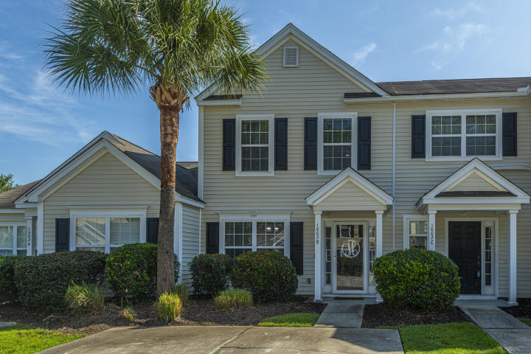
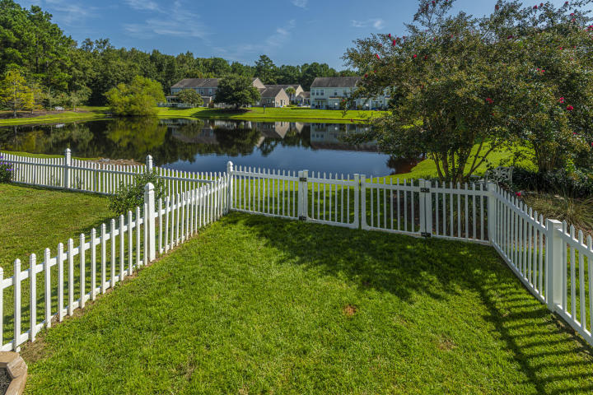
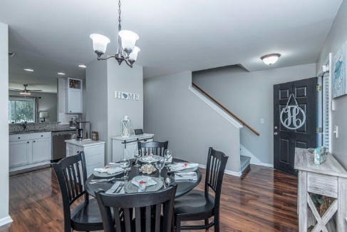
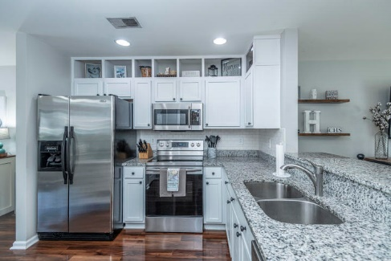
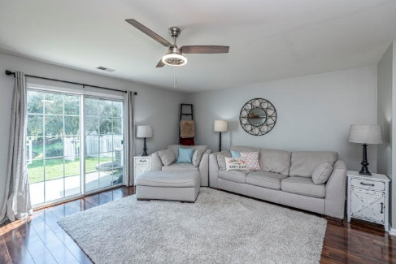
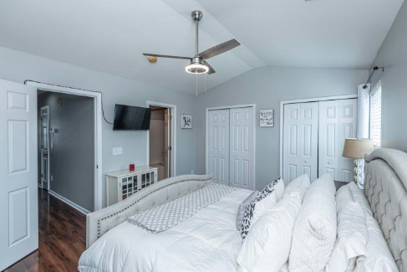
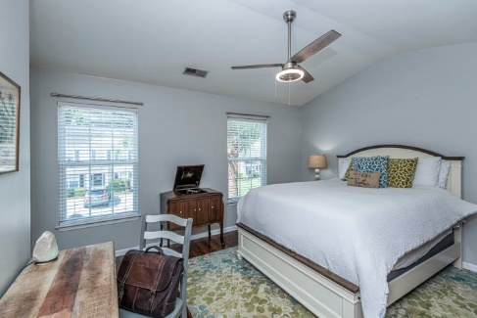
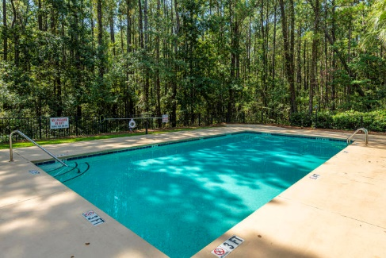



Why wait for new construction? This Park Circle area home is LESS THAN 2 YEARS!
Updated Townhouse on a Pond
1002 Marsh Grass Way B The Peninsula ~ Charleston, SC 29492 ~ MLS# 20024568 ~ $249,000
Welcome to 1002B Marsh Grass Way! This totally updated 2 bedroom, 2.5 bath home is an oasis that you will love to come home to or work from home in. Do you want a view? This townhouse backs up to a beautiful pond with benches and wildlife to enjoy. The inside boasts all the best finishes from granite countertops in kitchen and bathrooms, subway tile backsplash, stainless steel appliances, exquisite lights, faucets, toilets. The photos give you a glimpse into this masterpiece but take the next step and come see it for yourself...
Del Shaffer
843.408.6821
dshaffer@carolinaoneplus.com
2713 Highway 17 North
Mt. Pleasant, SC 29466

