Slide 1
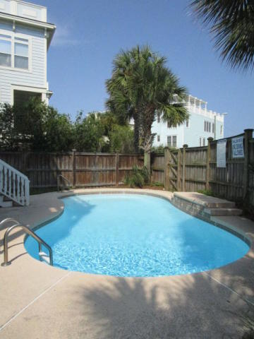
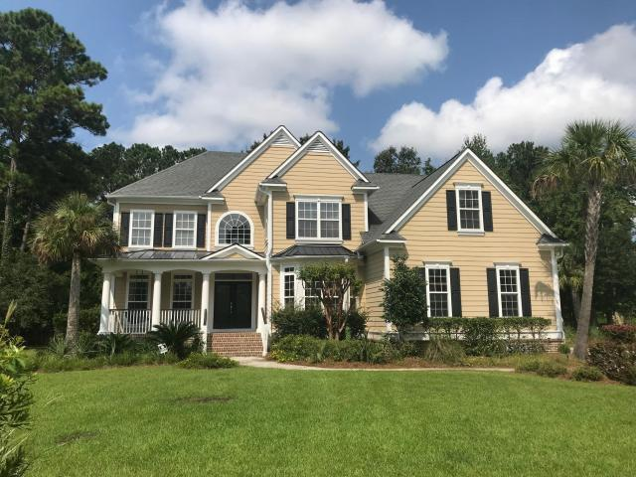
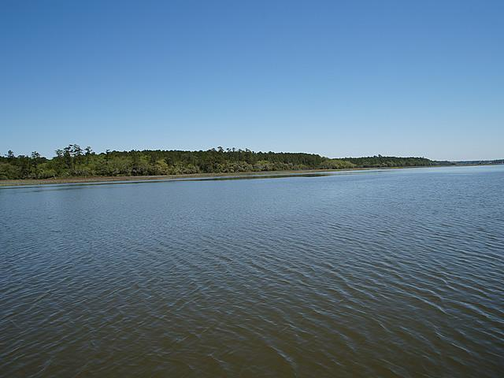
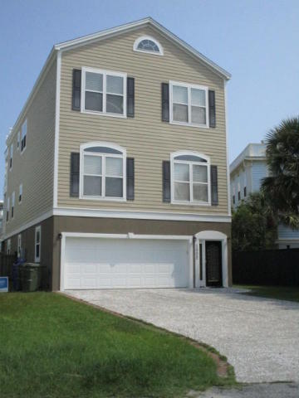
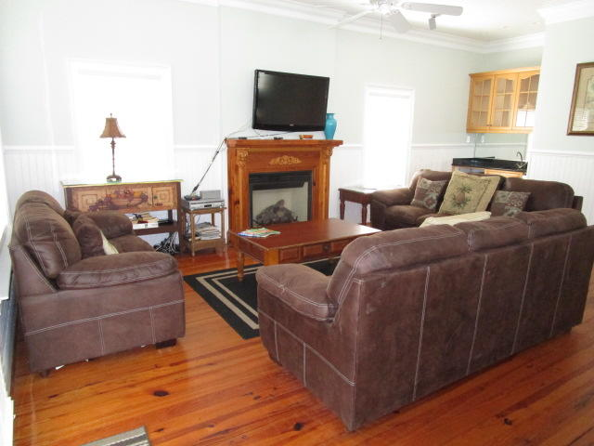
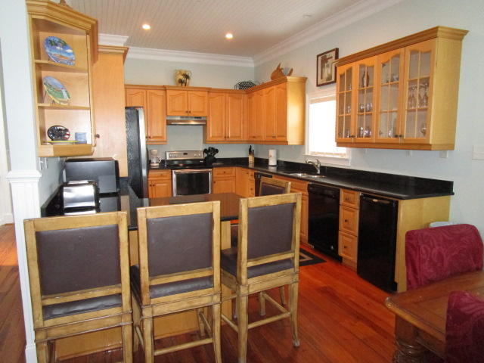
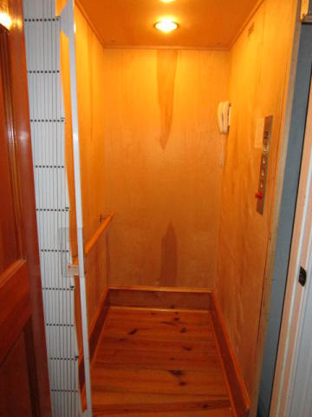
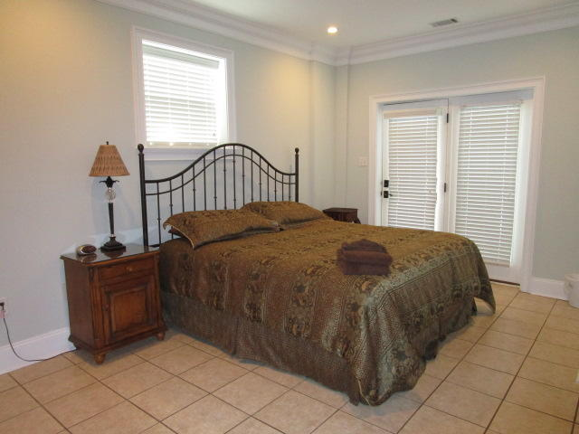
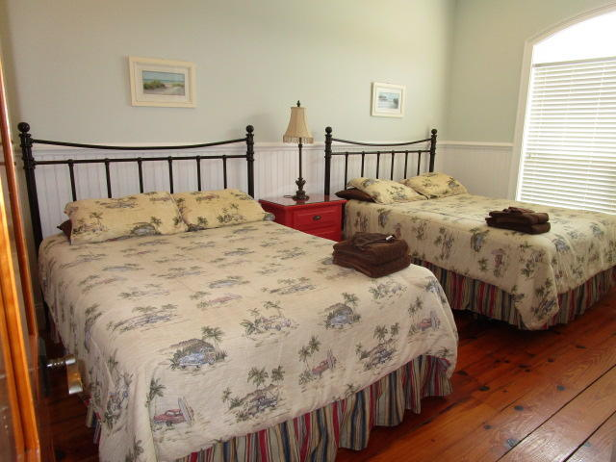
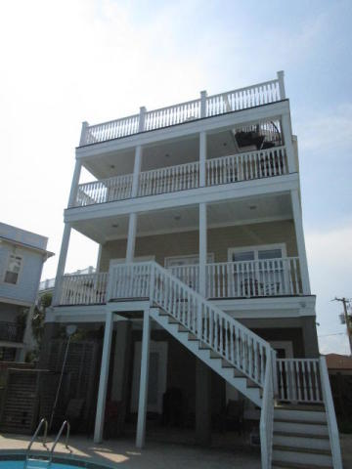
Owner is Motivated!
1002 Carolina Boulevard
Isle of Palms, SC 29451
MLS# 18011746
$1,749,900
This is a fantastic beach house that also has great rental history. The home has 8 bedrooms, & 8 full baths. The 3rd floor master bathroom suite has a jacuzzi bath tub. There is a 3 stop elevator in the home as well. The pool has just been completely re-finished as of Spring 2015. Exterior paint, interior paint, new light fixture in dining room, all new LED can lights throughout, all completed in 2018. Location is walking distance to the beach, shops, restaurants, & nightlife.
Charles Salmonsen
M (843) 224-0300 | O (843) 388-6613 | charles@salmonsen.com
Salmonsen Realty | 864 Lowcountry Blvd Ste B | Mt Pleasant, SC 29464

