Slide 1

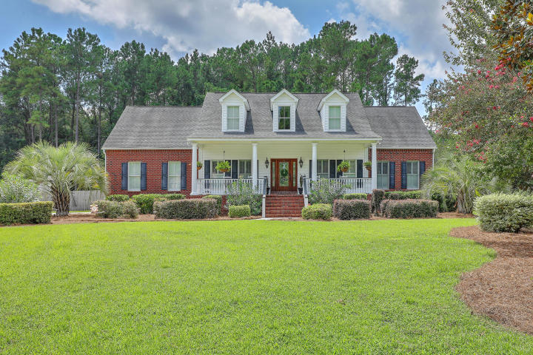
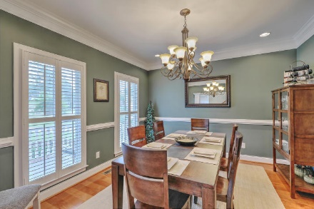
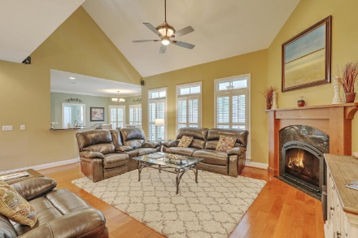
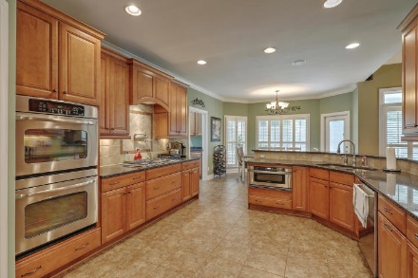
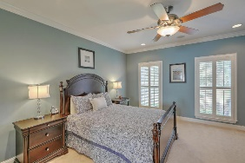
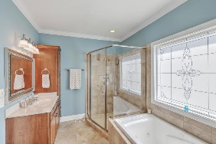
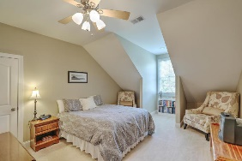
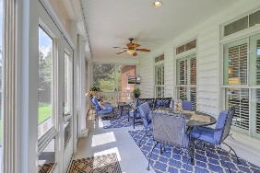
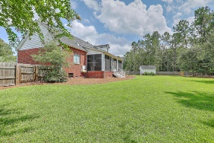
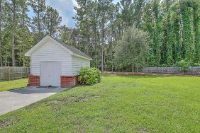

Agent Luncheon
Wednesday Nov 1st ~ 11:30a-1:30p
Giving Away $25 Gift Card
Pam Bass Realtor
M 843-259-4926 | O 843-277-6677
pam@pambassproperties.com
www.pambassproperties.com
1002 Denali Court | The Summit | Summerville | MLS# 17023864 | $534,900
Beautiful custom built home with upgrades throughout! This executive home sits on a .86 acre wooded lot. It has an open floor plan with a formal dining room, office and a huge 1st floor Master Suite. The Master Bath features a separate shower and jetted tub, dual vanities and a his and hers walk-in closets. The open kitchen is perfect for entertaining and features 42'' cabinets, top of the line stainless steel appliances, including dual built-in ovens, microwave drawer, gas cook top and a pot filler, granite counter tops, under cabinet lighting, walk-in pantry, tile back splash, central vac system with a floor sweep in the kitchen. 5'' plank wood floors are in the dining room, family room, foyer, downstairs hallway, and stairs. Home features Anderson windows and solid core doors. The family room boast high ceilings, built-in entertainment center with /storage drawers, and a gas fireplace. Upstairs are 2 additional bedrooms and a huge bonus room and full bath with a surround sound system - Perfect for a 5th bedroom, kids playroom, or a Mother-in-Law Suite. There are tons of upgrades in this home including crown molding, chair rail molding, 2" plantation blinds, and even a dumbwaiter from the laundry room to the bonus room. There is an alarm system, upgraded light fixtures, custom paint colors, tons of storage, tank less water heaters and an irrigation system. The owners added a nice sun porch on the back of the home. It overlooks the huge backyard that is wooded and surrounded by a 6' privacy fence. There is also a 12x16 storage shed that would be a great workshop. This is an immaculate and well-kept home that is in move in condition! Located in desirable Dorchester 2 school district, close to shopping and restaurants and only a 30 minute drive to historic Charleston.
Coldwell Banker Residential Brokerage | 4969 Centre Pointe Dr. Ste 203 | Charleston, SC 29418

