Slide 1
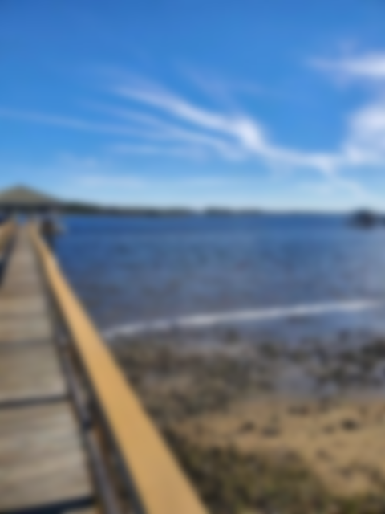
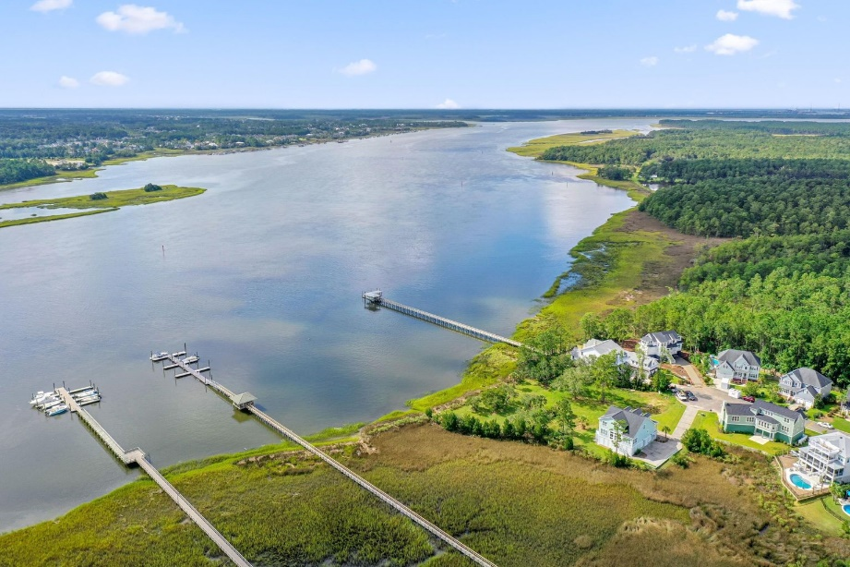
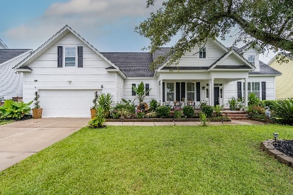
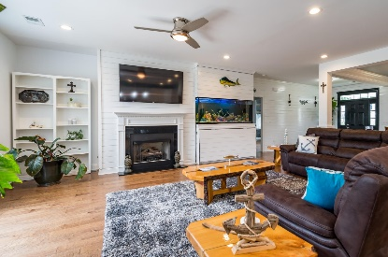
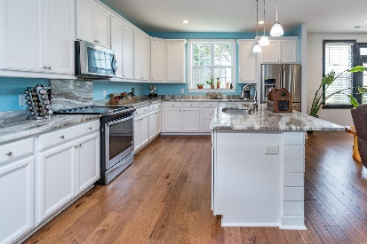
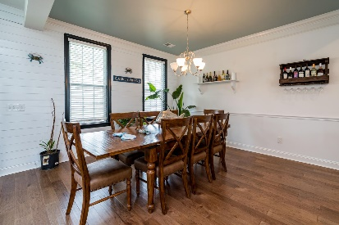
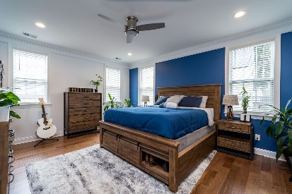
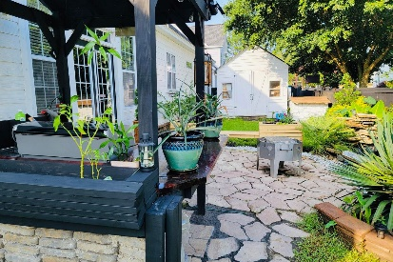
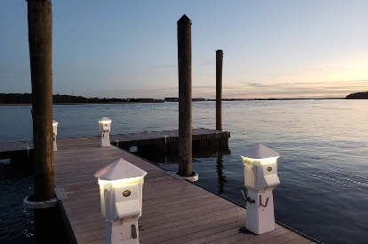
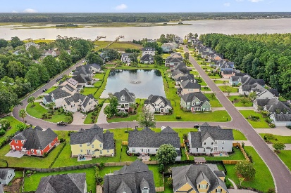


Open House Sat. and Sun. 12:00-4:00pm $865,000 ~ Deepwater Access!!
1002 Jervey Point Road
River Reach Pointe
Charleston, SC 29492
MLS# 21020996
$865,000
4 Bed | 2½ Bath | 2,721sf
Take a Tour of this One Level Home w/frog centrally located near Point Hope Commons Shopping Center, and just minutes to Daniel Island and Mt. Pleasant!! This property has deep water access to the wider part of the Wando River reaching the Harbor in just minutes!!! Owners can Dock and Store their boat on the 24ft Deeded Boatslip!! Feel the coastal vibe of this well planned, move-in ready home!! This home features a chef's gourmet kitchen with a huge 7ft x 4ft island, tall custom cabinetry, granite counters, ss appliances, and shiplap accents throughout the home. A cozy family room right off the kitchen and dining room features shiplapped walls, built-ins, and a lovely fireplace. This open floorplan with plenty of coastal charm, ample space and natural light is perfect for a growing family who loves boating! Wait until you enter the gigantic Master Suite fit for a king, sure to impress! 2 additional spacious bedrooms on the main level with a large guest bath w/dual vanities nestled close by. Explore the backyard in this tranquil, private escape from reality. Custom built bar and grill with seating, surrounded by nature's beauty, is found near the water garden! Unique Plants, herbs, vegetables, and fruit trees abound throughout, all just steps away from your back door! Come by and tour this home this weekend!! Call Megan with any questions or for info.
Megan Maarouf 843-801-7777
meganmaarouf@gmail.com
megansellscharleston.com
Reside Real Estate LLC
155 Wingo Way Unit 421 Mt. Pleasant, SC 29464

