Slide 1
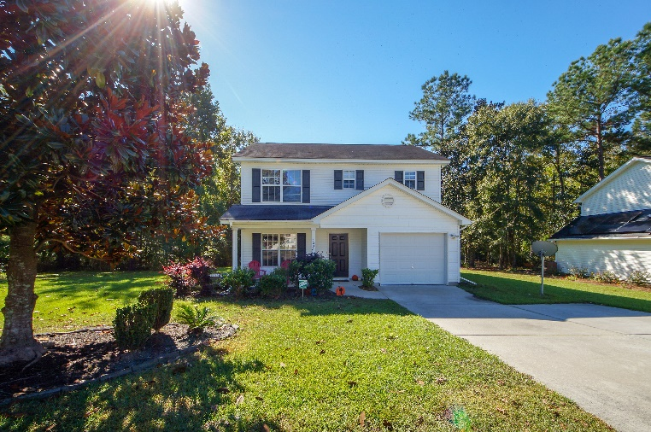
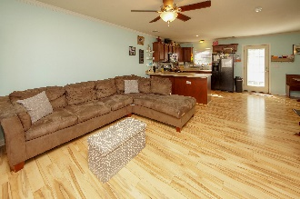
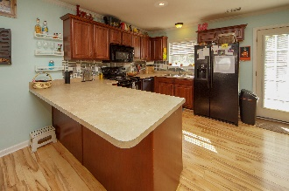
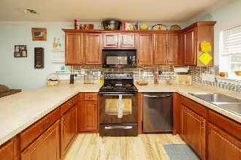
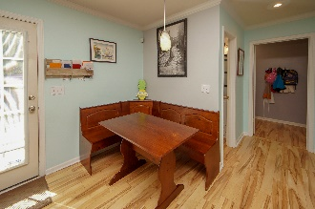
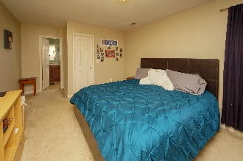
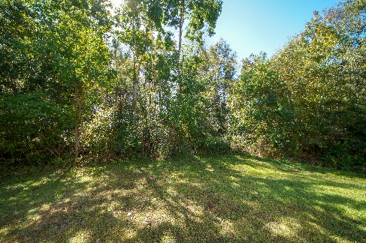
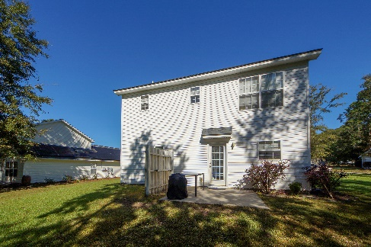
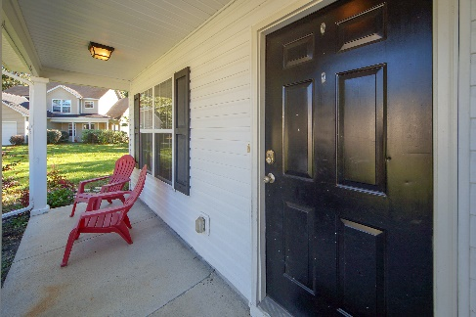



1003 Steelechase Lane
Carlton Place
Hanahan, SC 29410
MLS# 18029559
3 Bed / 2½ Bath
Just Reduced in Hanahan ~ $229,000
Two story, 3 bedroom, 2.5 baths
This adorable, two story has 3 bedrooms, 2.5 baths and is located on a quiet cul-de-sac. Home has an inviting front porch, perfect for relaxing at the end of a long day and located on a large pie-shaped lot that is wooded for lots of privacy. The first floor has beautiful Pergo flooring throughout with an open design between the living room and eat-in kitchen for easy entertaining. Kitchen has plenty of cabinets, a breakfast bar, and opens to a back patio overlooking the backyard. Downstairs also offers a powder room, a spacious laundry room and a one car garage for tons of storage. Upstairs is a master suite with walk-in closet and a master bath. Two additional bedrooms and a second full bathroom with tub shower combo. Home is located in Hanahan School District with new Bowens Corner Elementary School and conveniently located to Bilo grocery store and restaurants!
Steps to the Beach!
Jennifer Nipper, Realtor®
(843) 478-1800 | jen@AgentOwned.com
www.AgentOwned.com
The AgentOwned Realty Co | 824 Johnnie Dodds Blvd | Mt. Pleasant, SC 29464
Real Estate • Mortgage • Insurance

