Slide 1
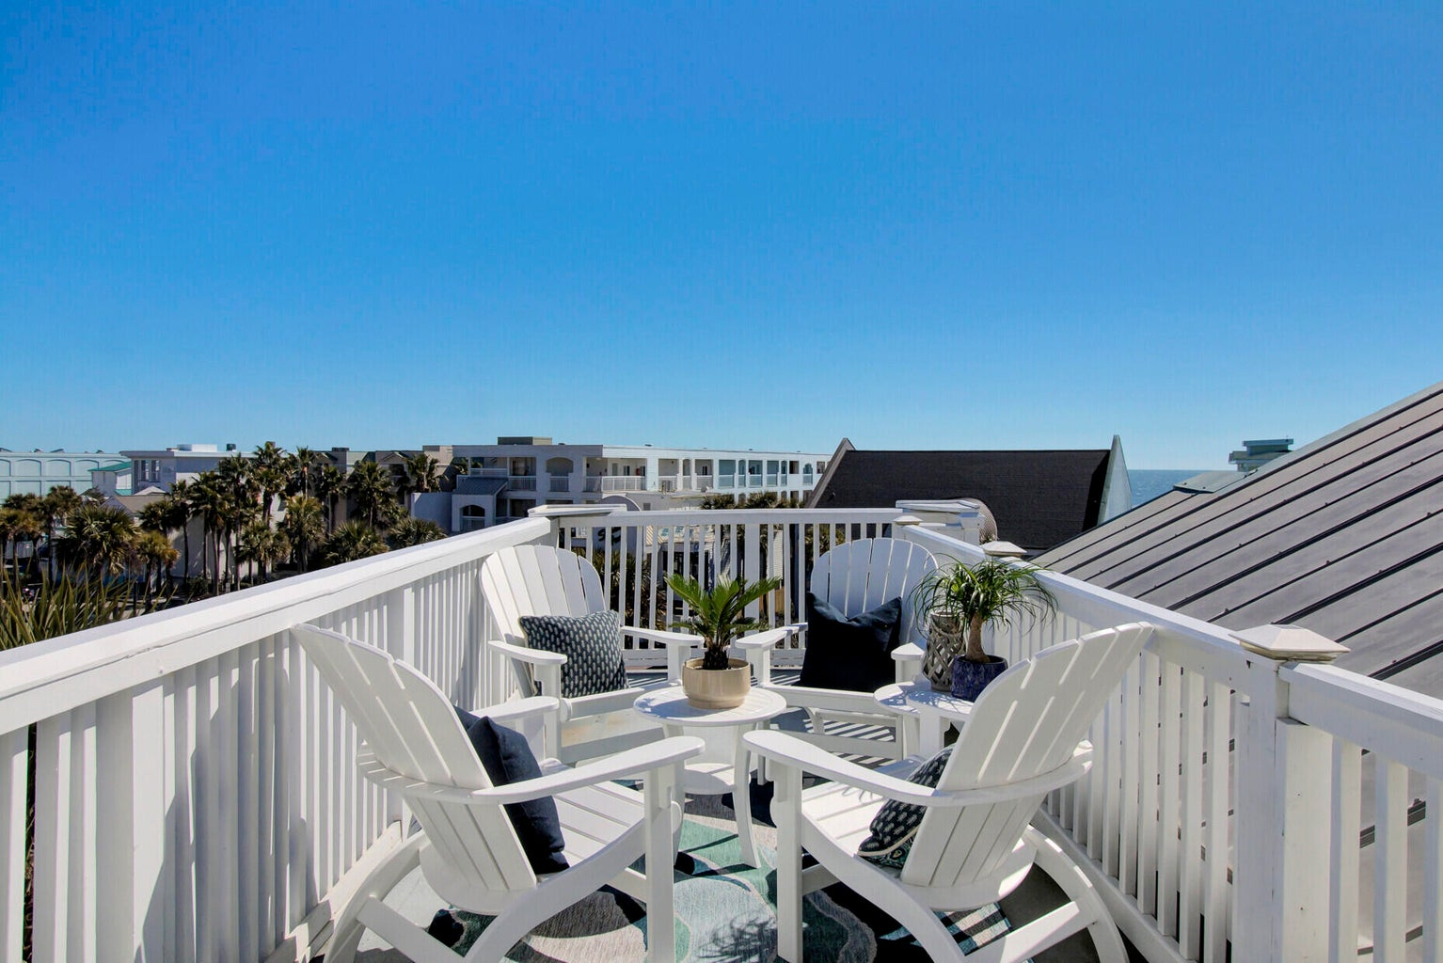
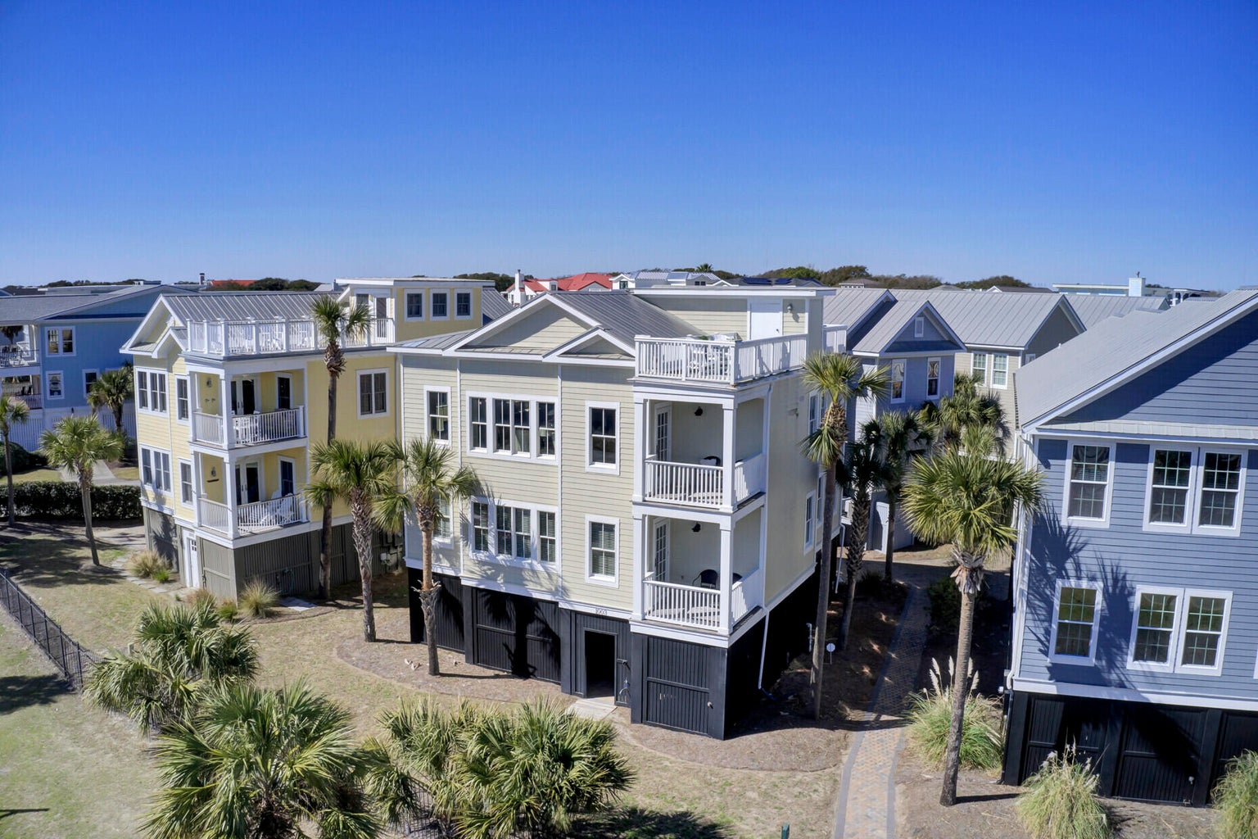
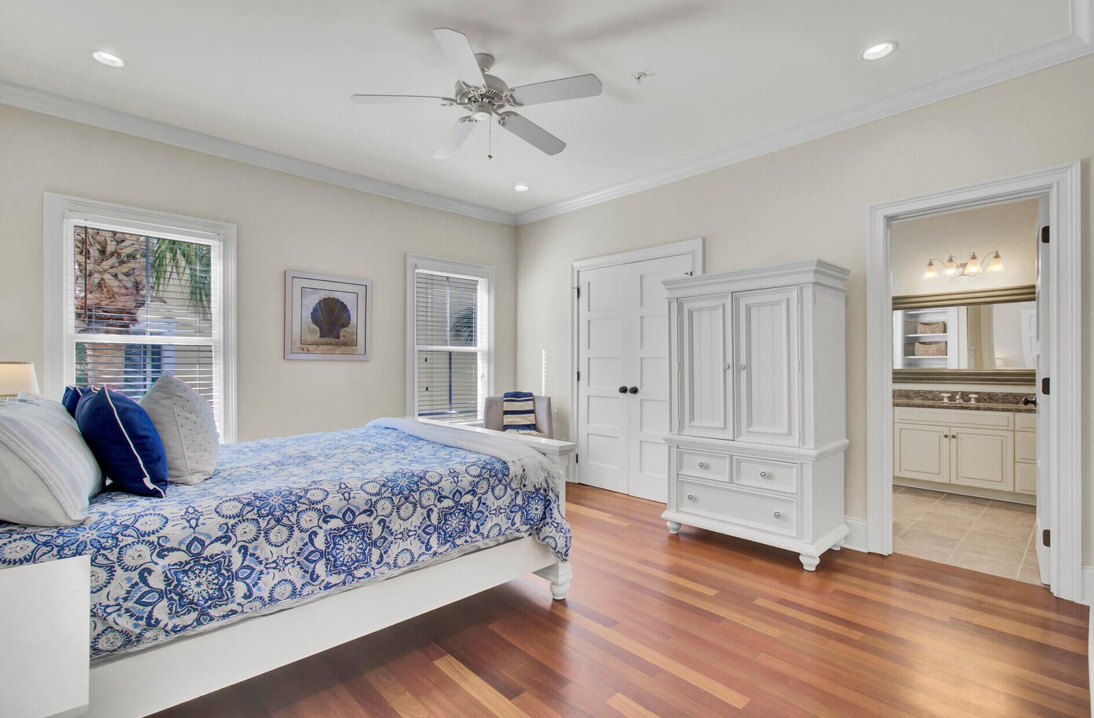
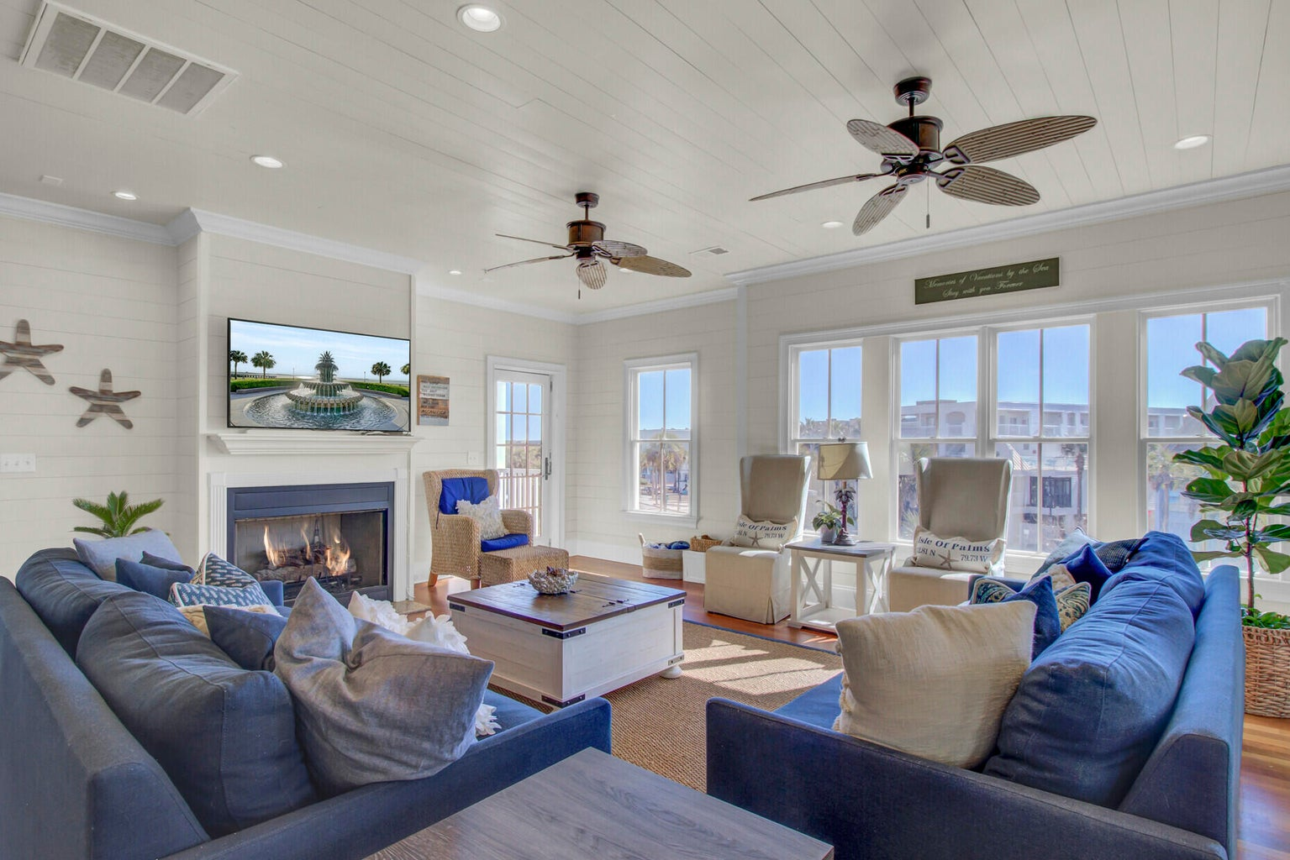
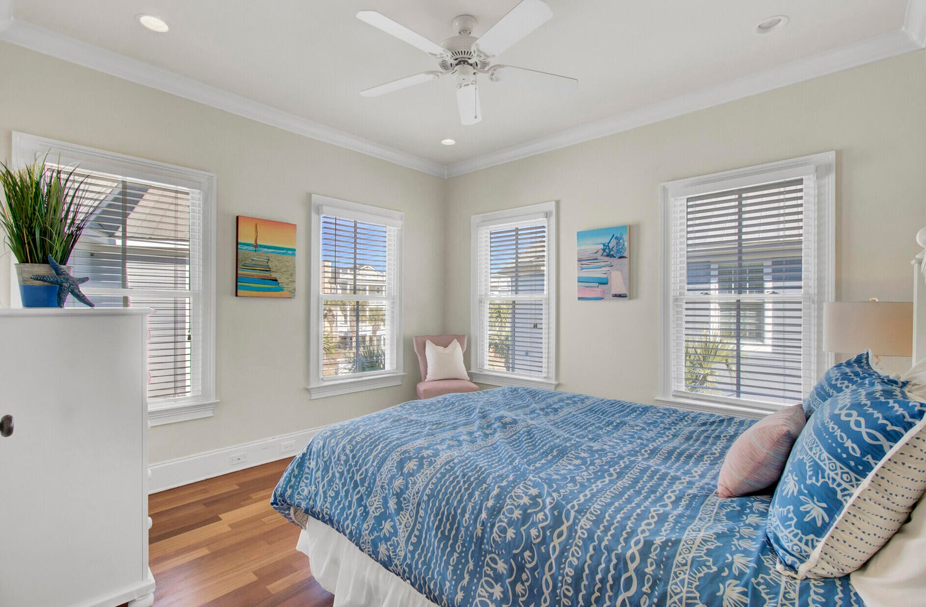
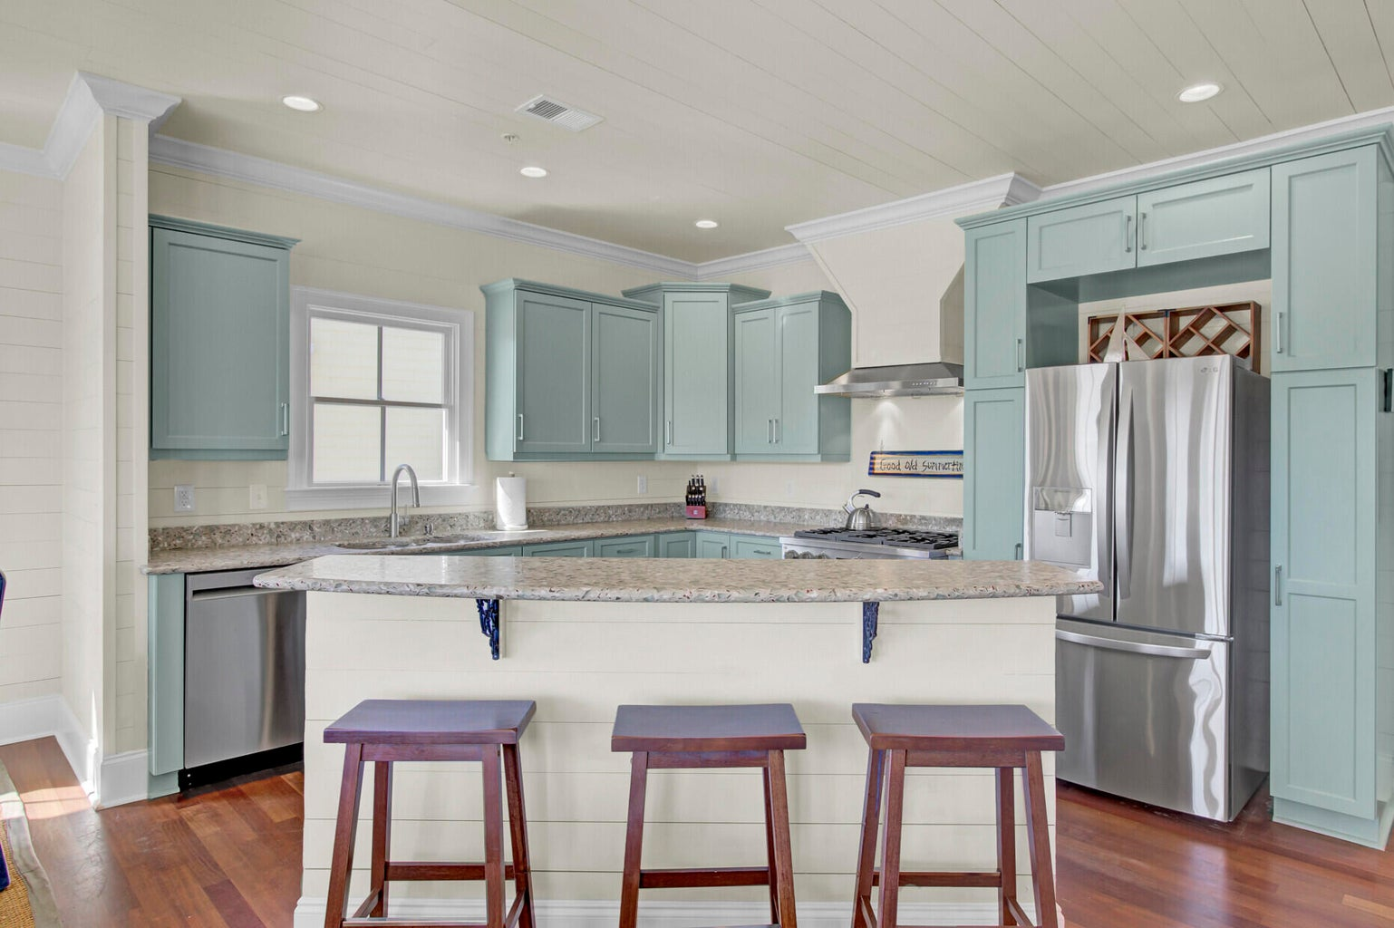
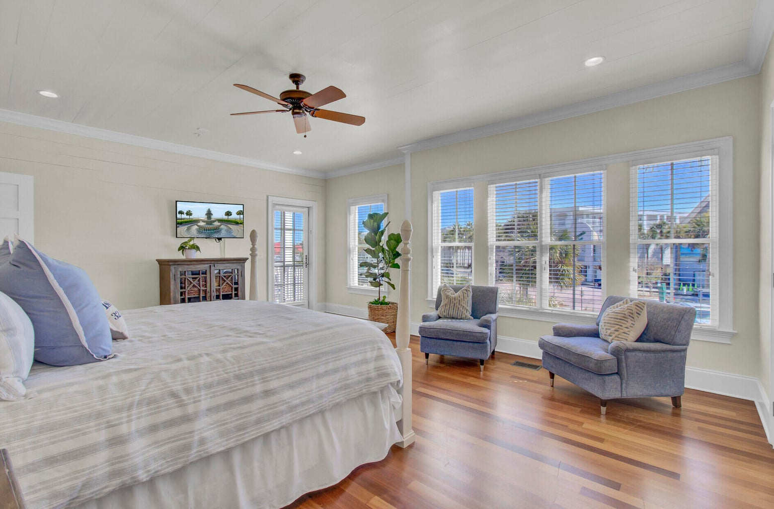
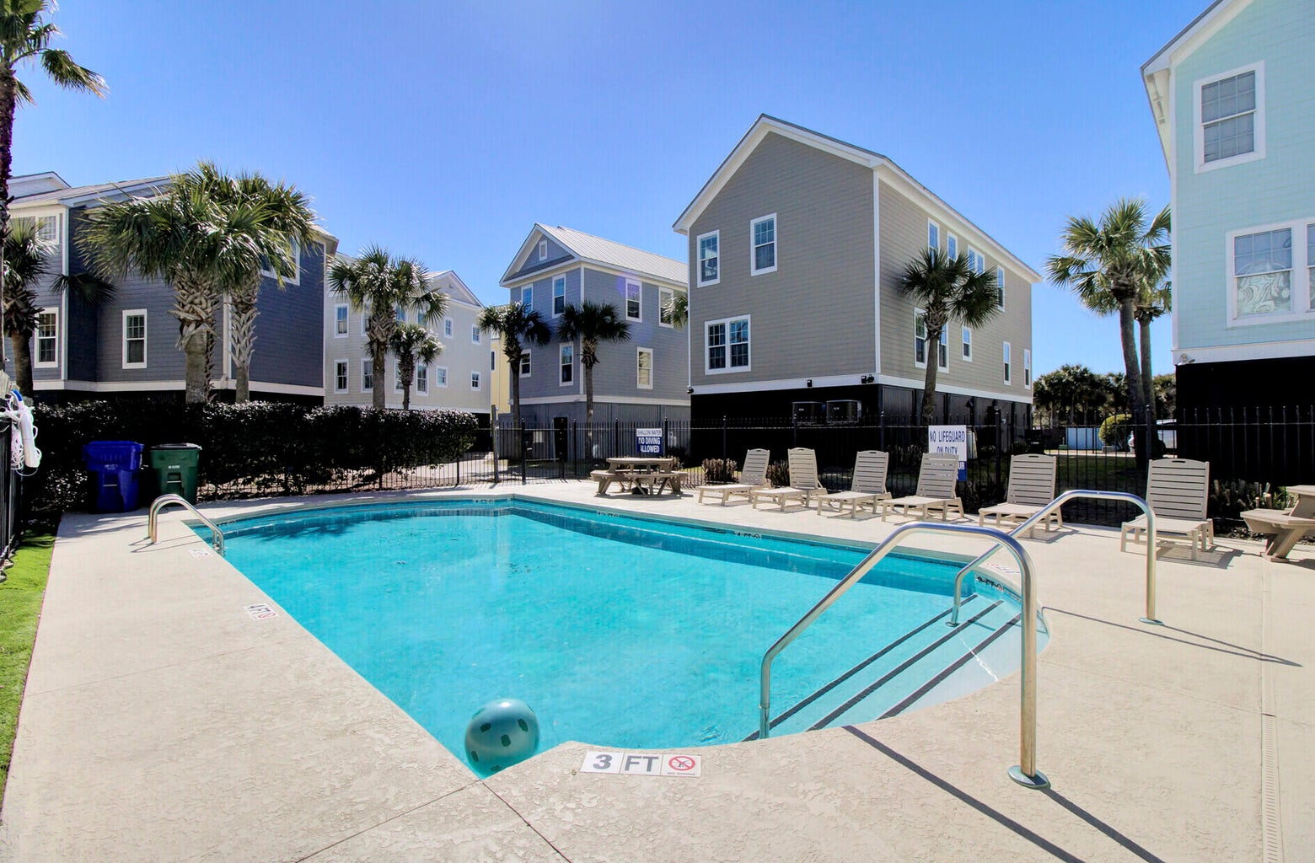
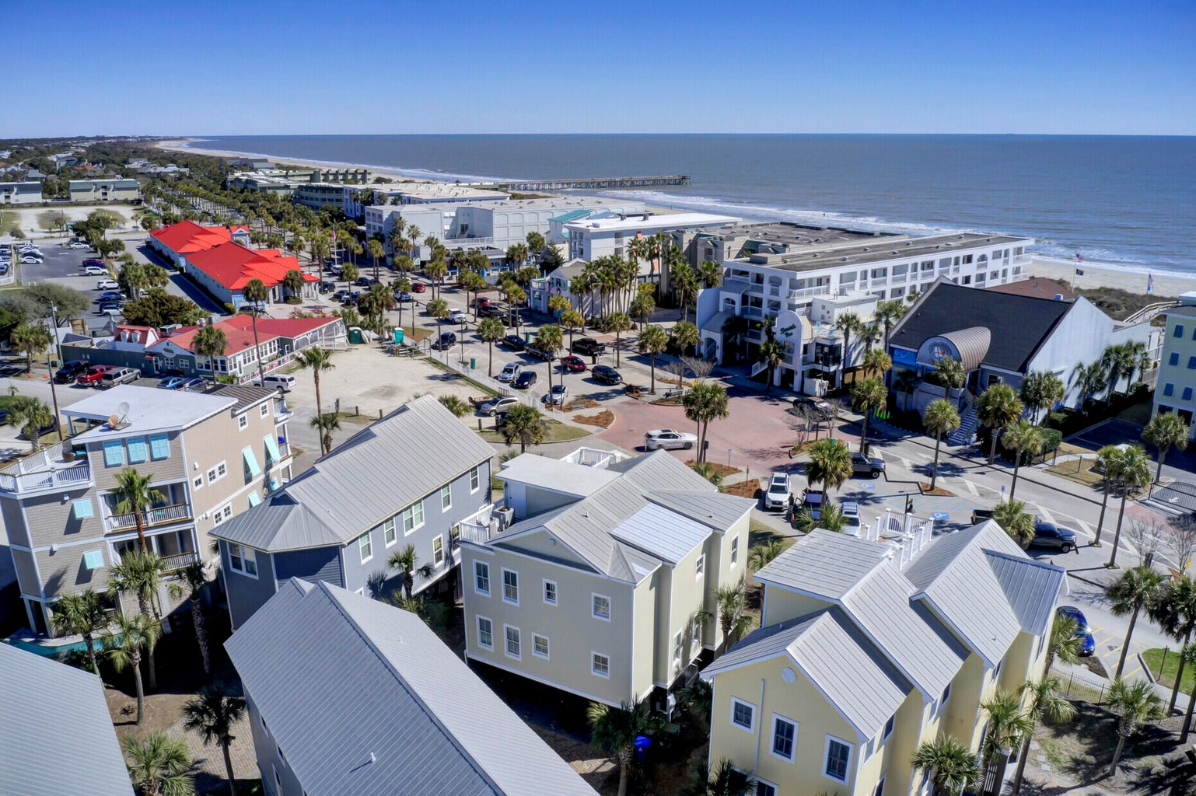

Steps to the Beach
1003 Ocean Boulevard
Isle of Palms, SC 29451
MLS# 24004083
$2,890,000
Truly custom home- no expense spared, lovingly maintained,2nd row Beach home w/drive under garage, block pilings, solid construction, elevator, open floor plan for entertaining, loads of sunshine, ocean views, rooftop deck, custom shiplap throughout )walls &ceilings many rooms, Brazilian cherry floors, community of 7 houses, shared pool, beach access across street, gourmet kitchen, newer appliances, tankless water heaters, new exterior paint, many upgrades, large beach shower, storage galore, custom interior doors, professionally interior designed, furniture conveys!! walk out your door to ice cream, restaurants, famous music venues. Watch sunrises and sunsets from your rooftop deck , ocean breezes, or enjoy a barefoot walk on the sand. This gorgeous beach house is turnkey ready for you!
Jennifer Garner
404-641-3332
sandandsunrealtor@gmail.com
The Boulevard Company, LLC • 806 Johnnie Dodds Blvd Ste 100 • Mt Pleasant, SC 29464

