Slide 1
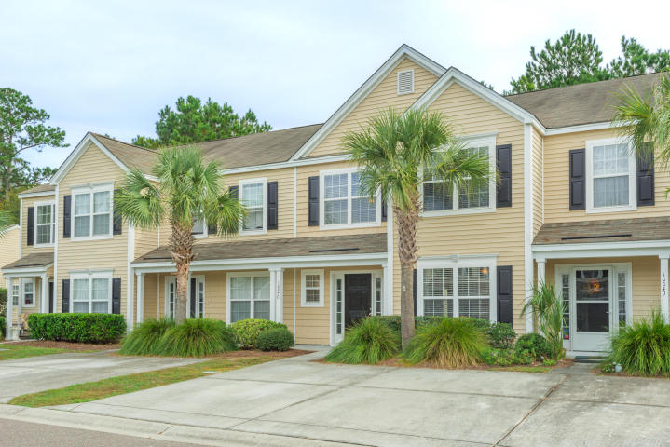

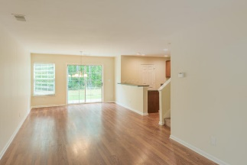
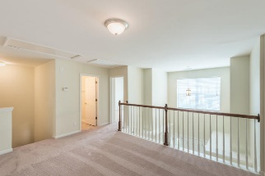
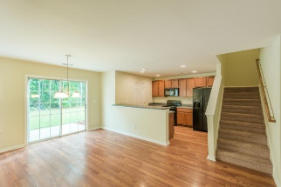
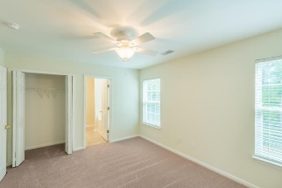
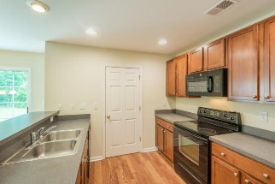
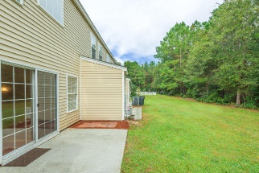


Immaculate &
Move-in Ready!
Virtual Tour Available at
https://www.youtube.com/watch?v=B-ZMWzHEJu0&feature=youtu.be
1004 Washitonia Way Unit C
The Peninsula ~ Charleston ~ MLS# 17028538 ~ $205,000
This spacious townhome style condo boasts 3 large bedrooms and 3.5 baths with dual masters (one upstairs and one downstairs) and is located in the highly sought after Island Club Two section of The Peninsula. The interior has been freshly painted and new carpet installed! The downstairs living, dining & kitchen areas have beautiful wood laminate floors. You are greeted with an abundance of natural light with the two-story foyer which has a coat closet & convenient half bath. Large kitchen with plenty of cabinets & counter space. Off the kitchen is the laundry room. The downstairs master has two closets – one is a large walk-in. Upstairs is the other master with two closets, a large bathroom with dual vanities, a garden tub and a separate shower.
There is also another large bedroom and a spacious loft area with lots of possibilities (playroom, office, den, workout area, etc). Out back is a storage room, patio and a large grassy common area that backs up to the woods â€“ a great space for entertaining, relaxing, letting the kids play or walking the dog. There is also pool access and a playground close by. New Philip Simmons schools are just down Clements Ferry Rd. Conveniently located off Clements Ferry Rd close to 526, Hwy 41, Mount Pleasant & Daniel Island. The work has been done....you just need to move in! This one is a must see and won't last long!
Bill Barnhill
843-364-6903
bill@billbarnhill.com
496 Bramson Ct., Suite 200
Mount Pleasant, SC 29464

