Slide 1
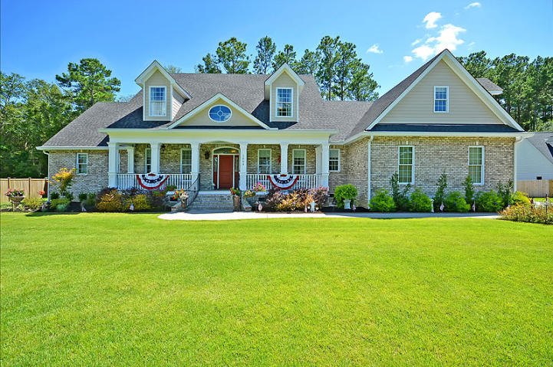
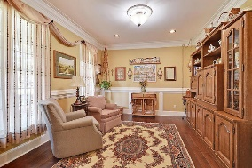
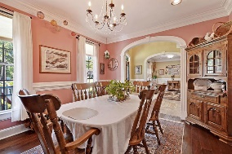
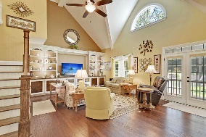
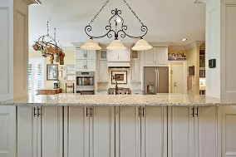
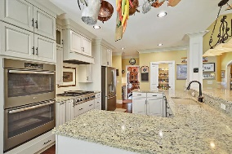
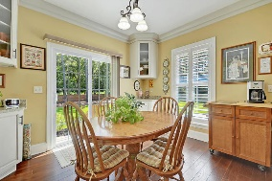
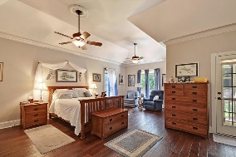
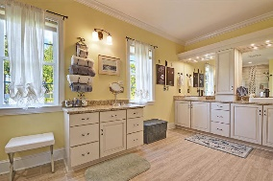
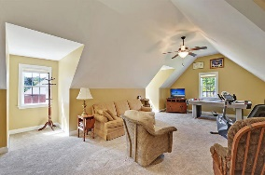
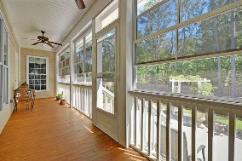
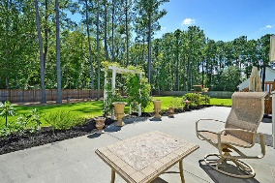
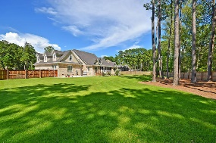
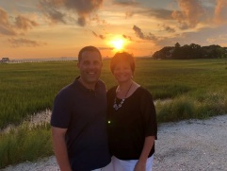

Custom Home Close to Downtown Summerville!!
1004 Denali Court
The Summit
Summerville, SC 29483
MLS# 20020397
$649,000
5 Bedrooms | 4½ Baths | 4,300 sf
This beautiful 4,300 sq ft., custom built, brick home sits on nearly an acre and is in IMMACULATE condition! The gourmet kitchen features granite counters, Dacor gas cooktop, custom cabinetry, large sitting bar, pot filler, double ovens, walk-in pantry and is open to the family room. The family room has vaulted ceilings and built-in cabinetry as well as beautiful hardwood floors! A butlers pantry and beverage refrigerator lies between the kitchen and formal dining room which features beautiful trim and crown molding. Buyers will also find a formal living room or office downstairs as well as an eat-in kitchen area and laundry room with sink and cabinetry. The master bedroom is downstairs and offers trey ceilings, a sitting area and access to the screened porch. The master suite offers two walk-in closets and a master bathroom featuring glass shower, dual vanities, make-up counter and granite counters. There is a second bedroom on the ground floor that also has a full bathroom and can be considered a 2nd master or a mother-in-law suite. Two staircases (front and back) lead upstairs where buyers will find two spacious bedrooms with walk-in closets and two full bathrooms as well as a huge FROG which can be a 5th bedroom, media room, playroom or practically anything a buyer wants it to be! The yard is professionally landscaped and the backyard is fully fenced-in. The home also offers a oversized two car garage with storage room, gutters, lawn irrigation, spray foam insulation in attic (low bills!), a tankless hot water heater, central vacuum, screened porch, patio, plenty of extra storage space and a fully encapsulated and dehumidified crawlspace! All located just 5 minutes from downtown historic Summerville shopping and restaurants, this home is a MUST SEE!
Larry & Kathy Mazalatis
Larry Cell 843-693-0529
Kathy Cell 843-693-0159
Office 843-871-9133
AGENTOWNED PREMIERE GROUP | 1800 TROLLEY RD | SUMMERVILLE, SC 29485

