Slide 1


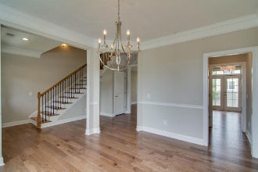
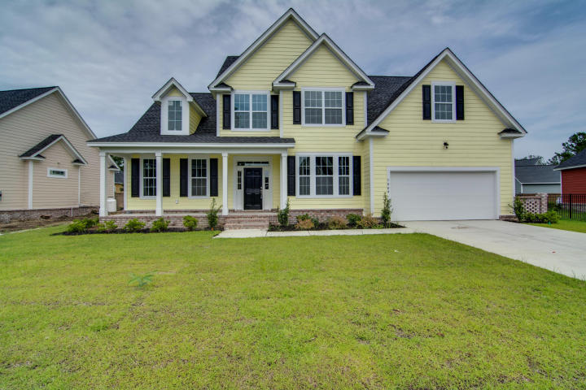
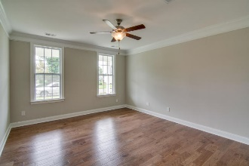
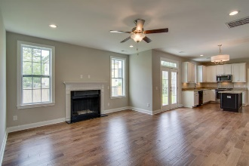
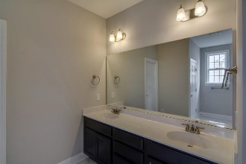
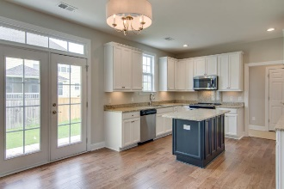
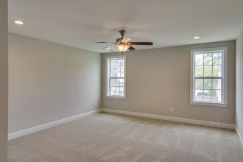
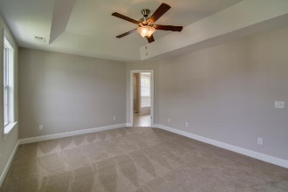
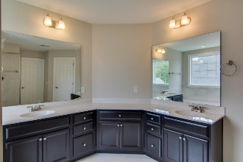
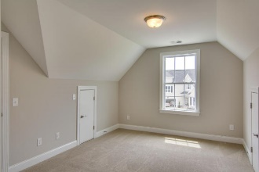
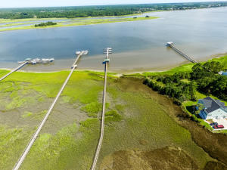
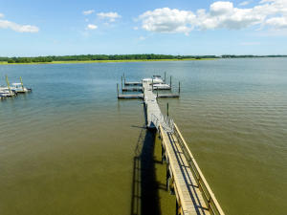

River Reach Agent Open House
November 30th from 11a - 2p
Light Lunch + $50 Gift Card
1004 Jervey Point Road
River Reach Pointe ~ Charleston
MLS# 16029659 ~ $459,900
High quality new construction in a quiet subdivision with no through traffic. It is located off Rivers Reach Drive, Daniel Island. The development is just a few hundred yards from the Wando River with a locked neighborhood dock. It is within walking distance of new Philip Simmons schools, elementary, middle and high. A new major chain grocery store is coming to the entry to the schools. There are 72 houses in the development with low HOA fees - $600 per year - even with a dock. The neighborhood has property with values from $400K to over $1,000K.
The house was built with executive style appointments and is a 3-foot raised slab with brick facing to exclude moisture under and in the house. Inside the house you will find a master bed room down stairs and one upstairs. There are hard floors on the entire first floor, hardwood in kitchen, living, dinning and downstairs master; Good quality ceramic is in the hall from the garage, laundry, and baths. Good quality granite counter tops and stainless appliances. Five bedrooms, 3 1/2 bath. Very open first floor with 9-foot ceilings. A neighborhood pool is in the advanced planning stage with land purchase agreements done and the land cleared
Jim Heslep
(843) 343-7188
jim.heslep@goldenbearrealty.com
Golden Bear Realty | 654 Coleman Blvd, Suite 100 | Mt Pleasant , SC 29464
Office (855) 352-9088 | Fax (561) 721-3311

