Slide 1


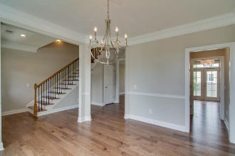
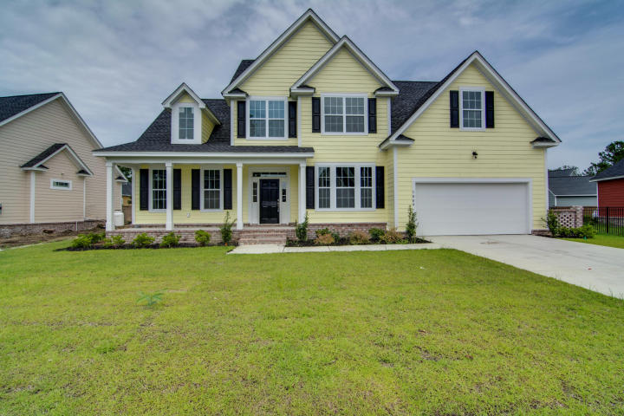
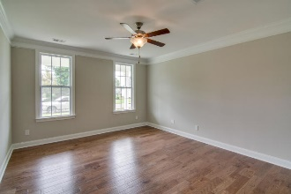
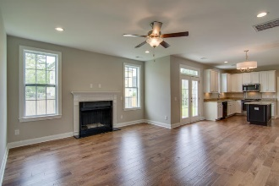
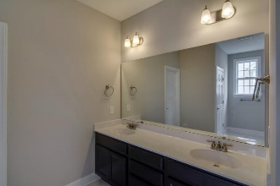
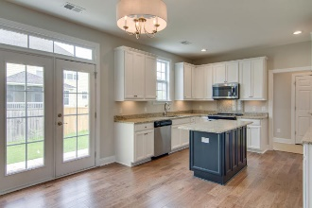
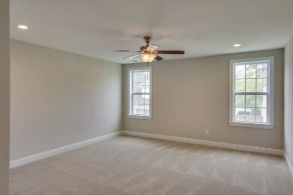
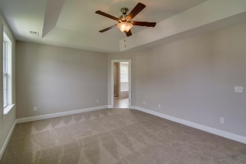
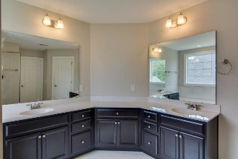
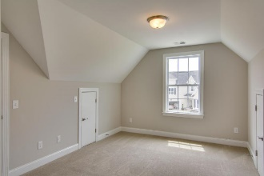
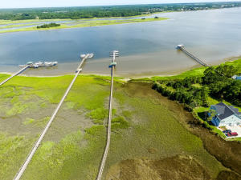
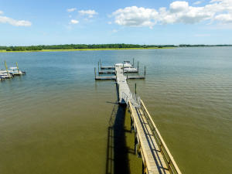


River Reach New Construction 5 bedrooms, 3 1/2 baths, $150 per sq ft.
1004 Jervey Point Road River Reach Pointe ~ Charleston
MLS# 18010620 ~ $438,000
High quality new construction in a quiet subdivision with no through traffic. It is located off Rivers Reach Drive, Daniel Island. The development is just a few hundred yards from the Wando River with a locked neighborhood dock. It is within walking distance of new Philip Simmons schools, elementary, middle and high. A new major chain grocery store is coming to the entry to the schools. There are 72 houses in the development with low HOA fees - $600 per year - even with a dock. The neighborhood has property with values from $400K to over $1,000K. The house was built with executive style appointments and is a 3-foot raised slab with brick facing to exclude moisture under and in the house.
Jim Heslep (843) 343-7188
jim.heslep@goldenbearrealty.com
NV Realty Group | 91 Broad St | Suite A | Charleston, SC 29401
Office (855) 352-9088 | Fax (561) 721-3311

