Slide 1


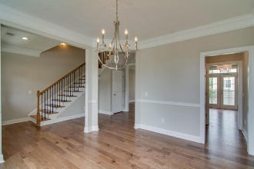
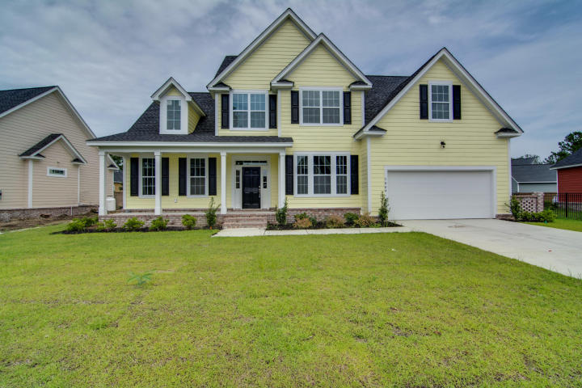
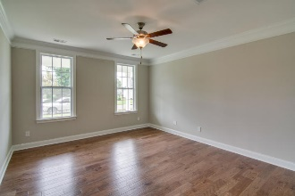
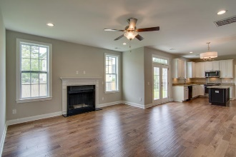
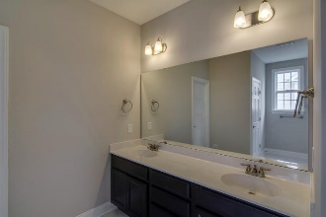
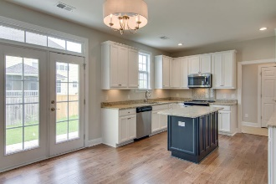
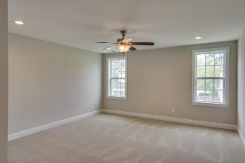
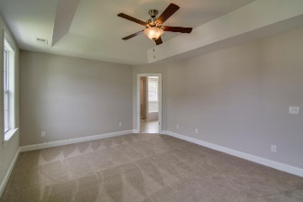
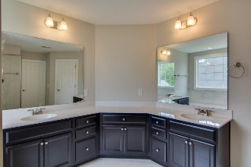
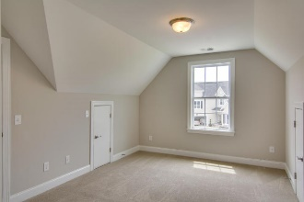
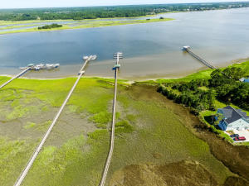
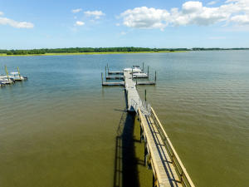

New Construction In Waterfront
Community On The Wando River
1004 Jervey Point Road
River Reach Pointe ~ Charleston
MLS# 16029659 ~ $459,900
New Construction in a quiet subdivision with no through traffic. It is located a few hundred yards from the Wando River with a locked neighborhood dock. There are 72 houses in the development so HOA fees are low - even with a dock. The house will be very open. You can pick the colors, trim, counter tops if you act quickly as the house is just under construction. Come see the plans. A neighborhood pool is in the advanced planning stage with land purchase agreements done and the land cleared.
Jim Heslep
(843) 343-7188
jim.heslep@goldenbearrealty.com
Golden Bear Realty | 654 Coleman Blvd, Suite 100 | Mt Pleasant , SC 29464
Office (855) 352-9088 | Fax (561) 721-3311

