Slide 1
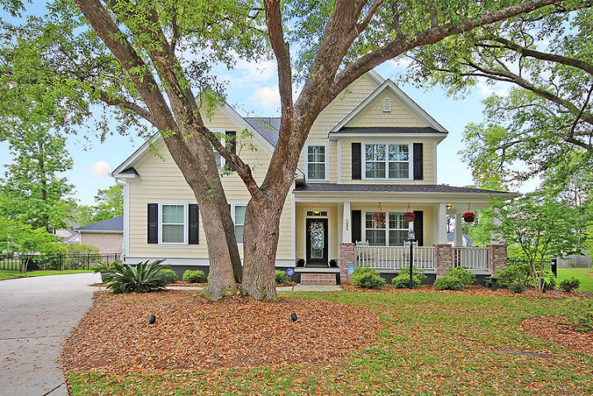
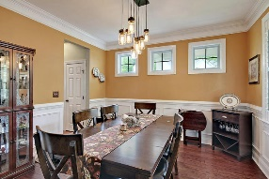
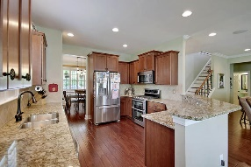
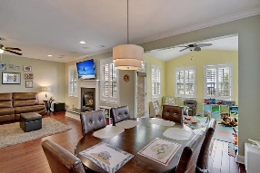
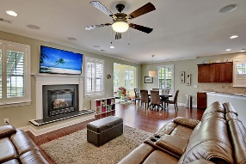

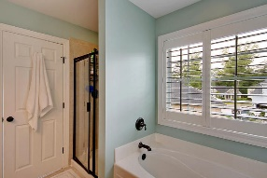

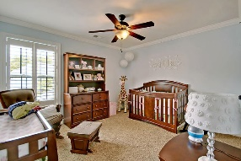
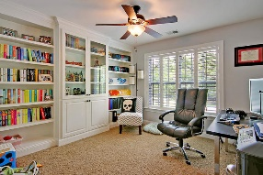
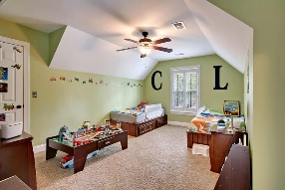
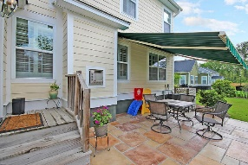
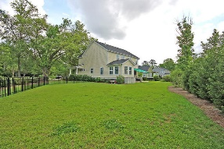


Hanahan Beauty ~ Move in Ready
1004 Randy Kinard Ln
Tanner Plantation
Hanahan, SC 29410
MLS# 17011342
$359,900
5 Bedrooms | 3 Baths | 2,730 sf
Want a 'like new' home that's been upgraded with all the bells and whistles? In a gorgeous cul-de-sac setting with gorgeous Grand Oak trees? Then this is this home for you!! Located in the beautiful Mossy Creek section of Tanner Plantation, this home has it all! The wrap around front porch greets you and once you step in, you'll immediately notice the extras in this home. Tons of trim work, upgraded light fixtures, and plantation shutters!! Gorgeous wood floors! The dining room is a great size for entertaining with extensive trim work and gorgeous light fixture. Walk thru the dining room to the awesome kitchen. It's a cooks delight! Plenty of storage in the lovely maple cabinets, stainless steel appliances, tiled backsplash, gas range w/double oven & pantry, all overlooking the family room. The family room offers a gas fireplace with a raised hearth, wood floors and tons of natural light! Off the eat in kitchen area is a gorgeous sunroom, currently being used as a playroom. Also on the first floor you'll find a bedroom, perfect for guests, with its own full bath right outside the door! There is closet storage for all your audio/visual equipment in one spot! The house has been custom wired for this! Upstairs, you'll find the large master bedroom with a tray ceiling, large master bath with a separate tub and shower. There is also a large walk in closet. Walk back out to the hall and you'll find a very large bedroom with two closets! This room can be a media room as well. Down the hall you'll pass the large laundry room. Another bedroom, with amazing built in cabinetry is the perfect bedroom for someone who needs tons of storage, because this room has it! Or, it would be a perfect home office! The fifth bedroom and a full bath in the hall finish off the second floor. Head back downstairs and check out the garage! The owner had custom garage storage installed! Storage will never be an issue in this home! Out back, you'll find a gorgeous patio with a remote controlled retractable awning! This awning automatically retracts when wind is sensed! You can pull down a panel from the awning for extra privacy and shade! The backyard is completely fenced in with a beautiful wrought iron fence. The yard also has custom landscaping lighting and an upgraded irrigation system.
This home shows pride in ownership and is ready for you to move right in!!
Larry & Kathy Mazalatis
Larry Cell 843-693-0529
Kathy Cell 843-693-0159
Office 843-871-9133
AGENTOWNED PREMIERE GROUP | 1800 TROLLEY RD | SUMMERVILLE, SC 29485

