Slide 1
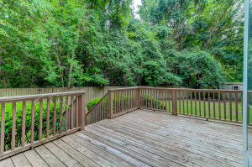
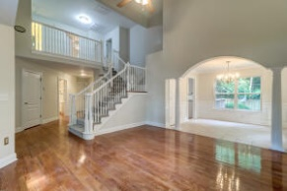
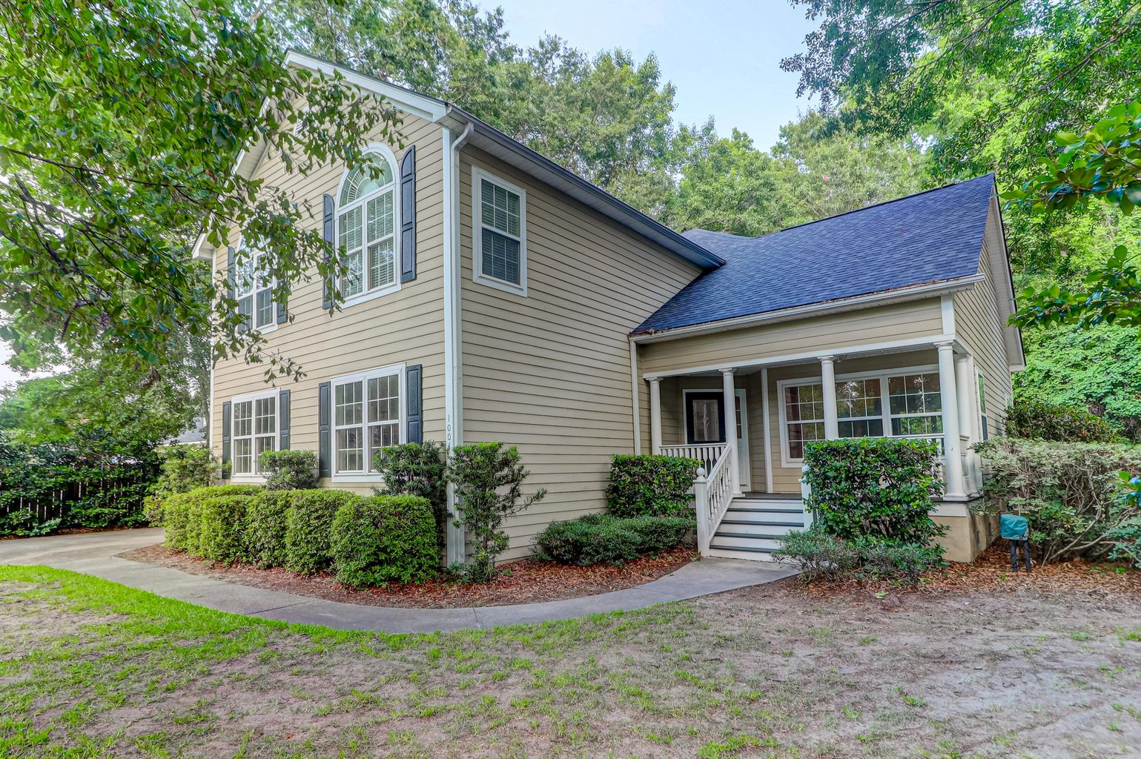
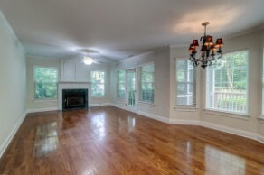
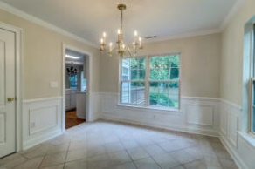
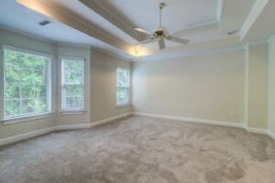
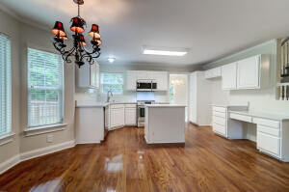
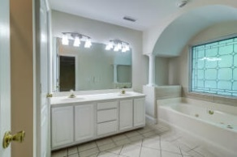
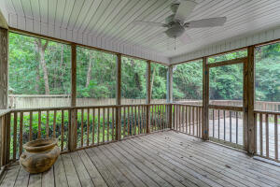
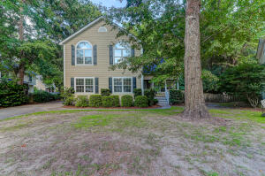


Renovations JUST Completed!!
Price Reduced
1004 Five Oaks Court
Patriots Plantation | Charleston, SC 29412
MLS# 22017034 | $749,000
This FIVE bedroom Beauty is Move in ready! Freshly Painted throughout the interior!! Brand New Carpet! New Stainless Steele Range and Microwave. New Faucet along with White Quartz counters in the updated All White Kitchen. It has a separate Living room with hardwood floors, Separate Dining room plus a nice den with a Gas fireplace. Three of the Bedrooms are VERY LARGE! There is a bedroom and bath on the first floor that could double as a home office. The Master Bedroom has double closets, a double tray ceiling and is quite large! Plenty of room for work from home or a growing family! Loads of built in shelving in the side entry garage! There is a screened porch AND a deck overlooking a privacy fenced backyard. The backyard is private with a wooded area behind the fencing that is adjacent to the Bayview Soccer fields. Note that the roof shingles are 2019, Newer Tankless water heater and there is a termite bond in place. Enjoy a Fantastic LOCATION on James Island with the many Parks, Beaches, Eateries and shops as well as Historic Downtown Charleston within minutes! A Short Walk to the Popular restaurant "Edison" for Dinner or Sunday Brunch! Parks, playgrounds and Beaches very nearby too!!
Lori Nolan
843-343-5700
lorinolantmp@gmail.com
Trademark Properties, Inc
2070 Sam Rittenberg Blvd #B276
Charleston, SC 29407

