Slide 1
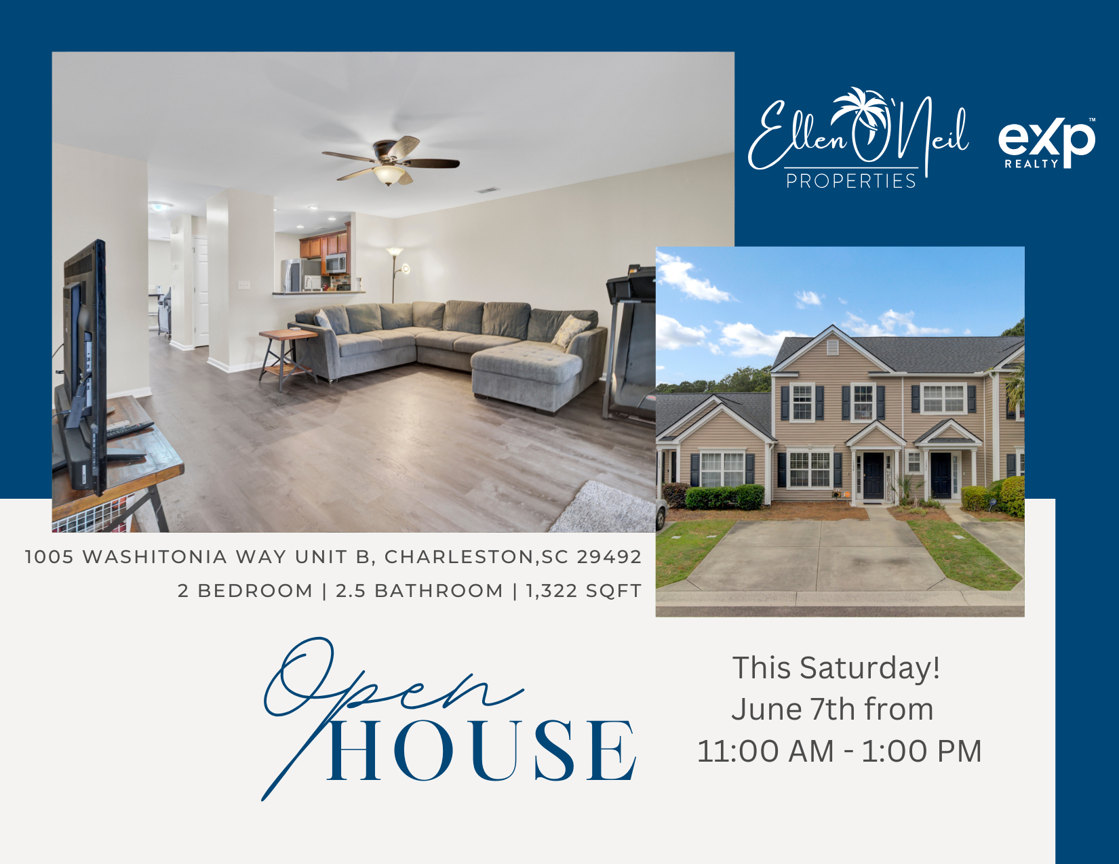
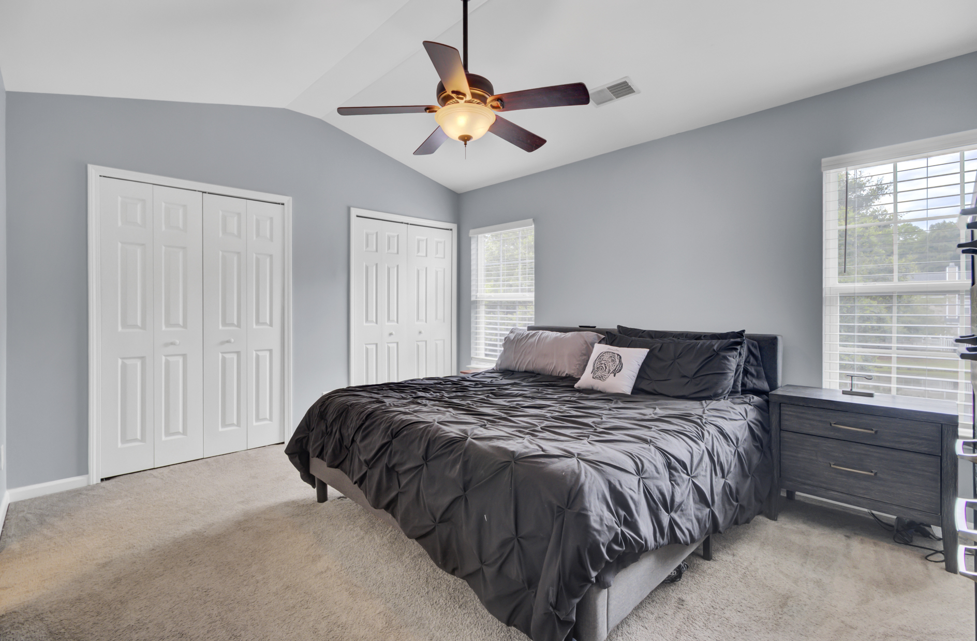
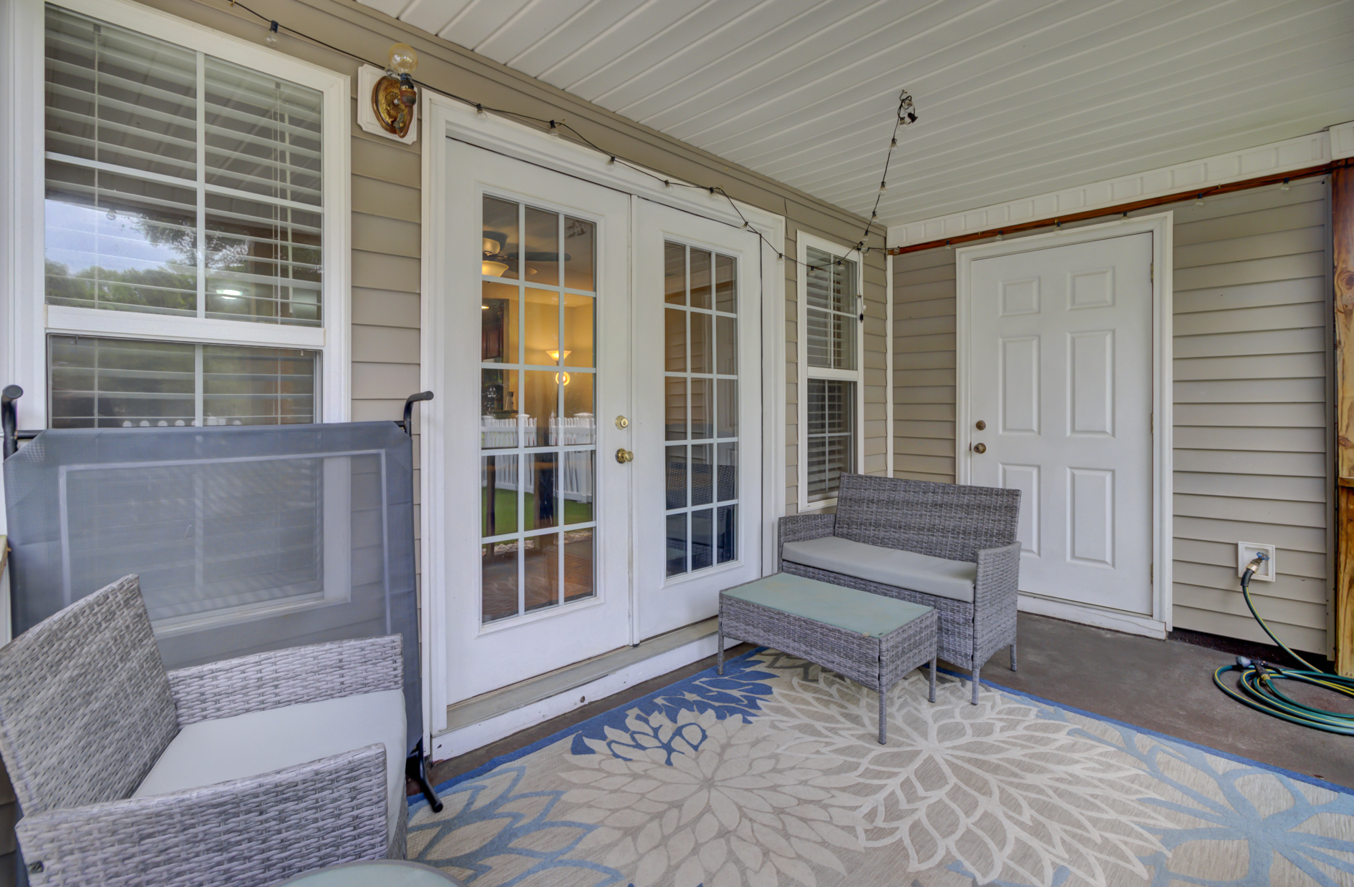
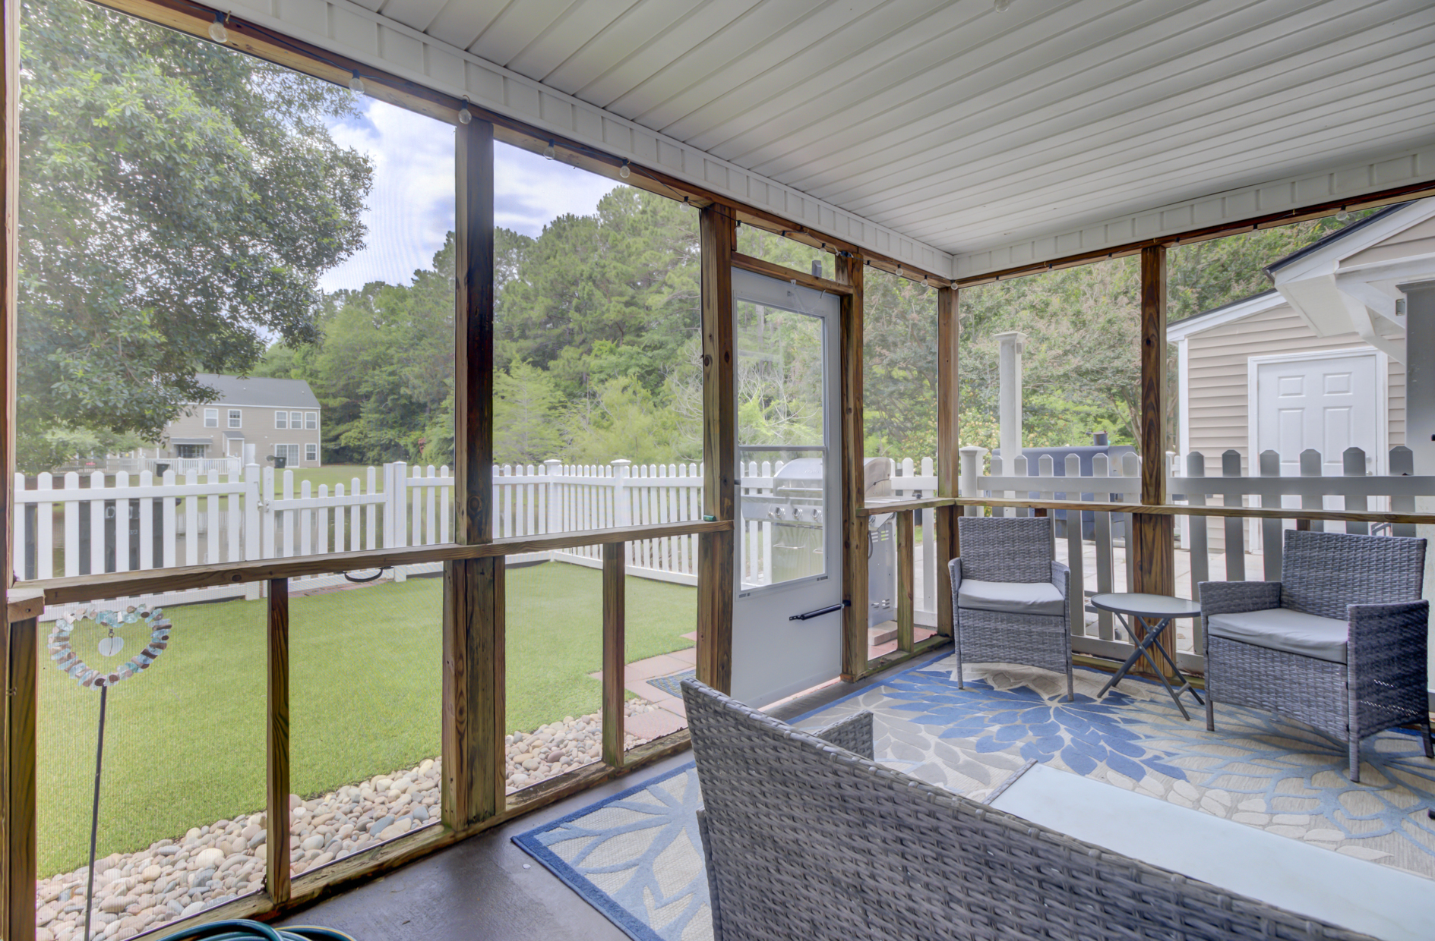
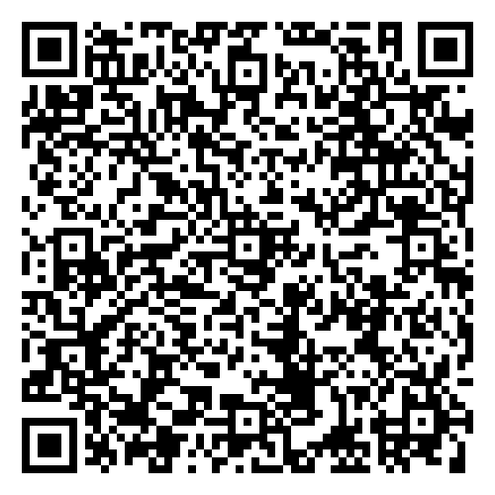
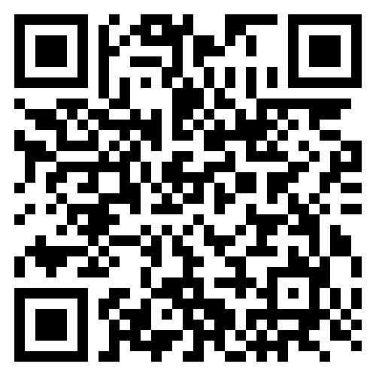
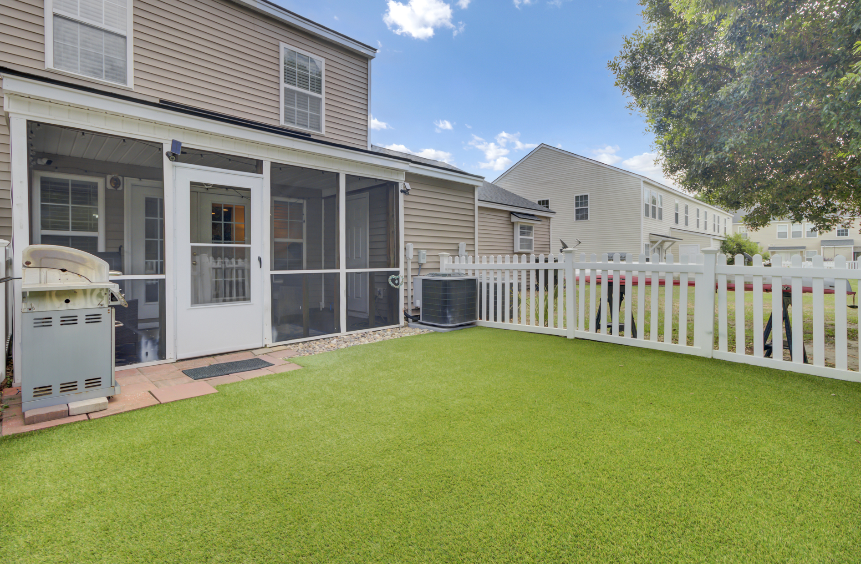


Just Listed in The Peninsula!
Sellers are offering buyer agent compensation at 2.5%
Virtual
Tour
Video Tour
📍 1005 Washitonia Way Unit B, Charleston
📆 Open House: Saturday, June 7 | 11 AM – 1 PM
Schedule your tour today!
This move-in-ready 2BR/2.5BA townhome offers new LVP flooring, fresh paint, dual suites, and a fenced turf yard with pond views. Enjoy pools, playgrounds, and unbeatable locations near Mt. Pleasant, Daniel Island, and top schools.
Video Tour
Ellen O'Neil
Broker/Owner, ABR, e-PRO, CNE
Charleston Realtor of Distinction
843-300-8530
www.EllenONeilProperties.com

