Slide 1
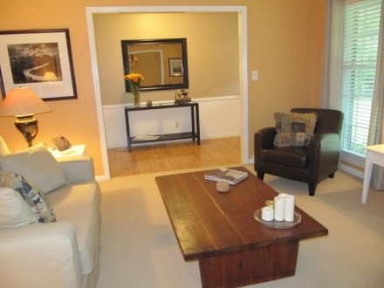
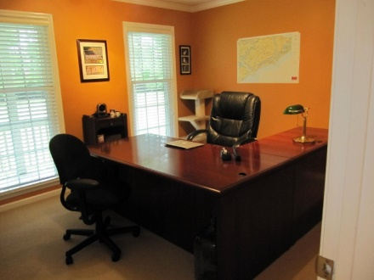
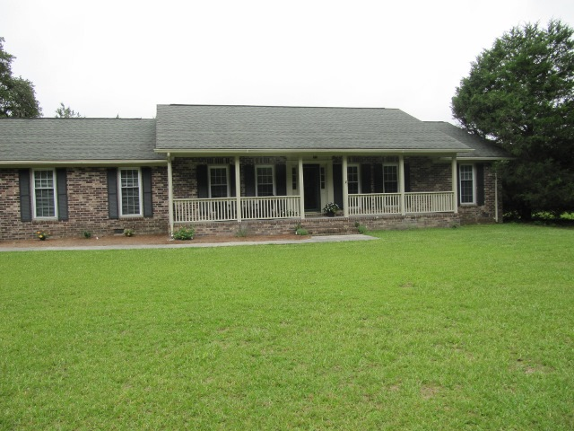
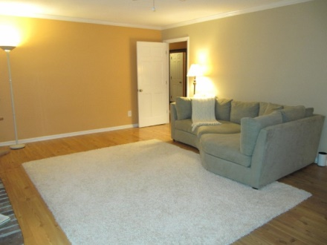
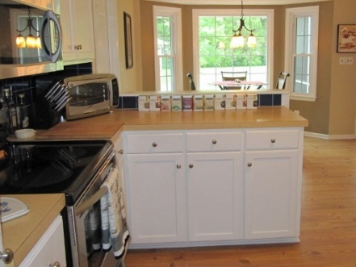
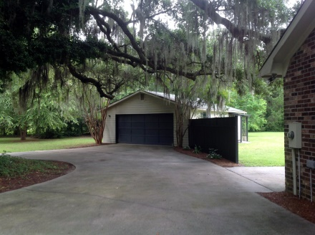
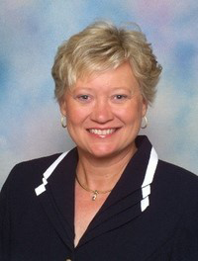

1005 Sunnybrook Dr Chisolm Green MLS# 1420907 $395,000
Beautiful home site surrounded by mature trees give you much desired privacy. This immaculate home is turn key ready for you to move in. The living room off the entrance hall offers flexible space for an office, study, music room or keep as a living room. Separate dining room is great for those holiday meals. Kitchen is updated with all stainless steel appliances including built in microwave. Outfitted with an reverse osmosis drinking water system that conveys with the home. Deep ceramic sink with tile back splash makes cooking a breeze. Eat in kitchen with bay window. The family room opens to the large screened in porch for you to enjoy autumn breezes. Bright Master bedroom downstairs with walk in closet and dual bathroom sinks. Other 2 downstairs bedrooms are currently being used as "his" and "hers" offices. The Frog can be a 4th bedroom or flex space. Oh, did mention Storage??? The attached 2 car garage comes with 2 large closets and built in shelves. Add to this the HUGE detached garage once used as an artist studio. This space is large enough to hold 4 cars. Multiple uses with a separate 1/2 bath and built in storage bins. Access to neighborhood community dock available with $150 homeowners annual dues. Fish or boat to the Intracoastal Waterway.
Irene Thomas
Sales Associate
Cell: (843) 509-8058
Fax: (843) 725-7048
Irene.Thomas@agentowned.com
AgentOwned Realty | 902 Savannah Hwy | Charleston, SC 29407

