Slide 1
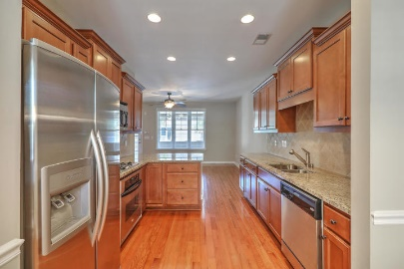
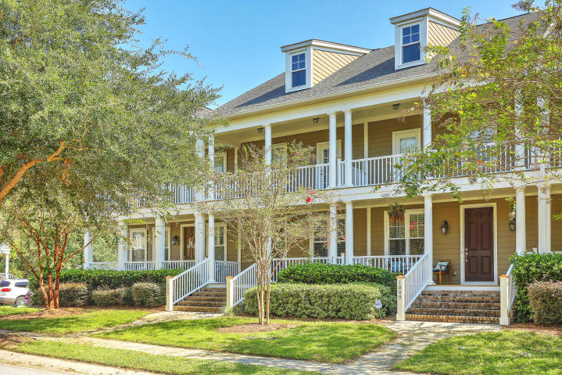
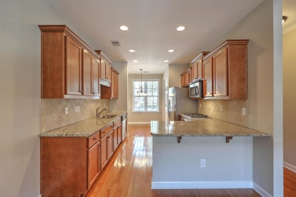
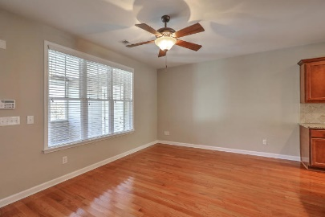
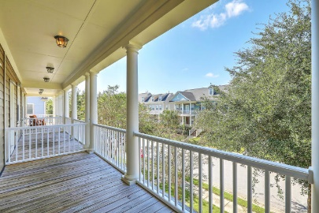
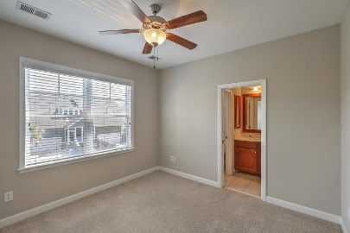
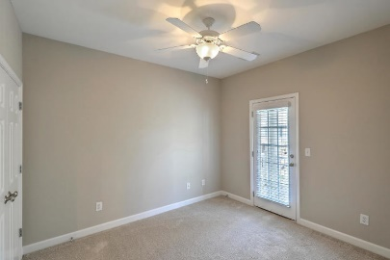
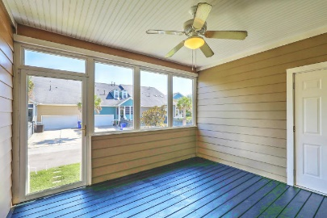


1005 Zinser Street
Hamlin Plantation | Mt Pleasant, SC 29466 | MLS# 18026254 | $270,000
REALTOR OPEN HOUSE FRIDAY & SATURDAY
October 5th & 6th from 11A TO 2P
Come see this beautiful townhome in the coveted section of Waverly in Hamlin Plantation! The home has been professionally cleaned and freshly painted and is ready for you to move right in. At first sight, you'll notice the spacious double porches on both levels where you can sit with a cup of coffee and view your tree-lined street. As you enter, you will see your dining room area just to the right with nice trim detail. The kitchen is a cook's dream with granite countertops, maple' staggered cabinets, and stainless steel appliances including a gas range. At the end of the counter is space for barstool seating. You'll also notice the gleaming hardwood floors that run throughout the first floor and into the living area. From the living area extends a sizeable screened in porch.
Upstairs you will find the two bedrooms. Your master is equipped with a walk-in closet and double sinks. The laundry area is also located upstairs near the bedrooms for convenience. Outside you will find not one but two storage areas. The Hamlin amenities are bar none including a spectacular pool with a water slide, workout facility, tennis courts, miles of walking/jogging/biking trails, play park and a beautiful clubhouse and lawn where community events are held. Minutes to beaches, town center and award-winning schools. Agent is related to seller.
Kimberly Mosher
(843) 697-4928
kmosher@century21properties.com
Century 21 Properties Plus | 3301 Salterbeck Ct Suite 100 | Mt. Pleasant, SC 29466

