Slide 1
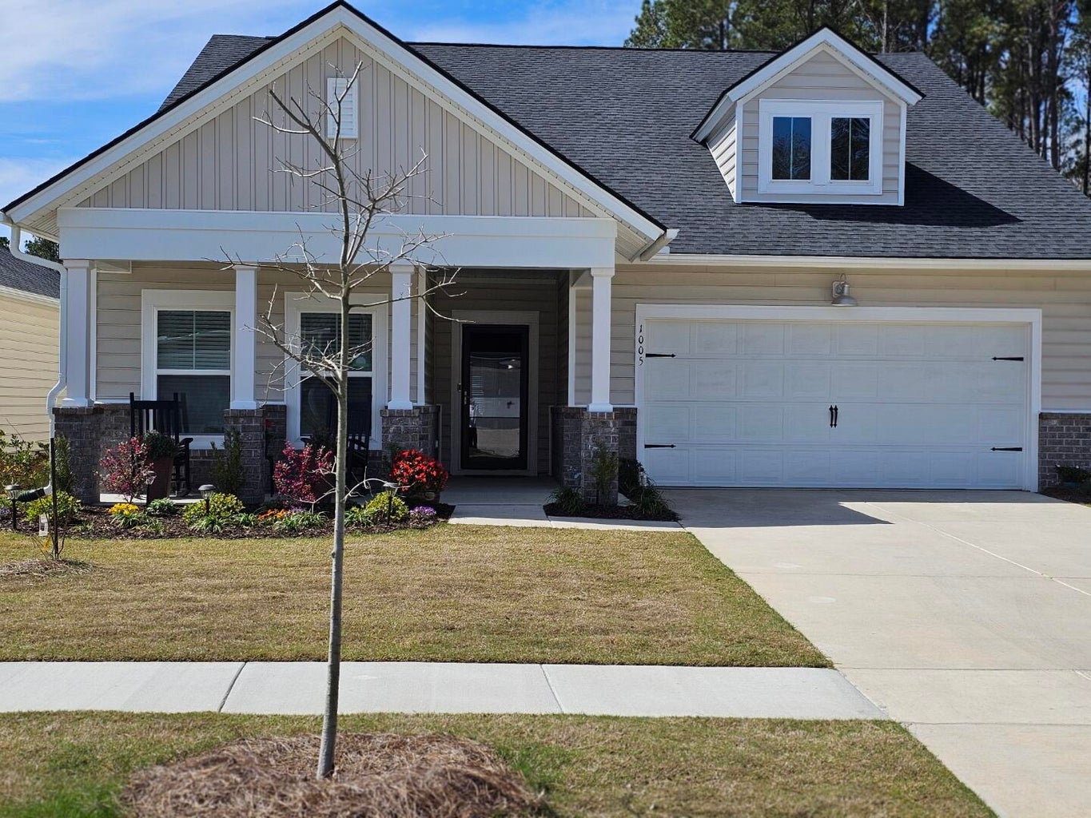
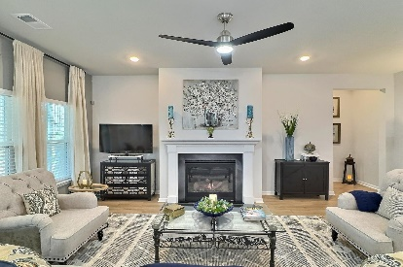
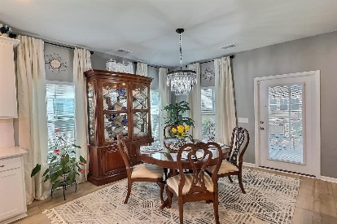
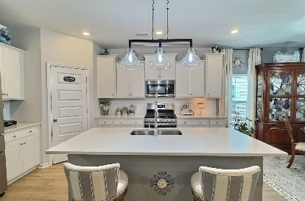
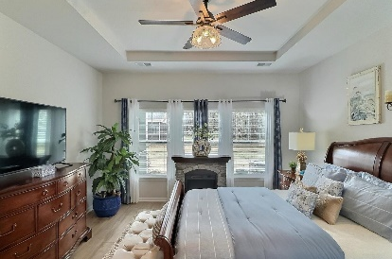
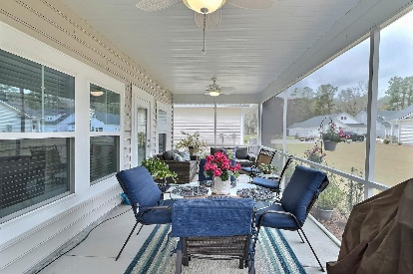
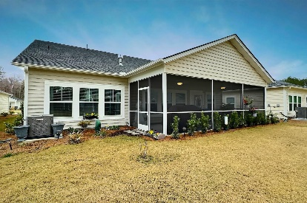
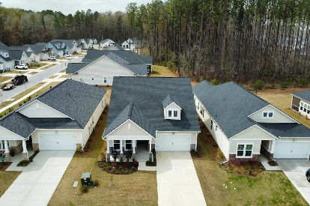


1005 Locals Street
Summers Corner | Summerville, SC 29485 | MLS# 24006098 | $414,000
$500 VISA GIFT CARD BONUS!!!
Introducing this stunning, BETTER THAN NEW, light-filled single-story SMART home that welcomes you in with an inviting open floor plan. Seller has added CUSTOM LIGHTING w/DIMMERS, 2'' BLINDS, CURTAINS & RODS, STORM DOOR, TOWEL BARS and a NEW FRIDGE. The heart of the home is its chef's dream kitchen which overlooks the living/dining areas and offers a large island that is perfect for entertaining, meal prep and casual dining, stainless appliances including a gas stove, loads of cabinets and quartz countertop space and a generous walk-in pantry. The spacious family room with a gas fireplace is the perfect place for relaxing with your loved ones, watching tv or reading a great book. Retreat to the Owner's Ensuite which features a gorgeous zero-entry tiled shower with a frameless glass door, double vanities and a large walk in closet. Enjoy outdoor living on the huge screen porch overlooking a beautiful green space and tranquil woods. Experience the perfect blend of elegance and comfort in this remarkable residence located in the highly desirable Horizons neighborhood, an exclusive 55+ gated active adult community within Summers Corner. Fabulous amenities coming soon to include a club house, dog park, pool, tennis courts and exercise area.
Take a virtual walkthrough!
Beth Mandell
M 803-463-7734 | O 843-871-2121
bmandell@century21properties.com
www.bestcarolinahomedeals.com
Century 21 Properties Plus of Summerville | 118 W Richardson Ave | Summerville, SC 29483

