Slide 1
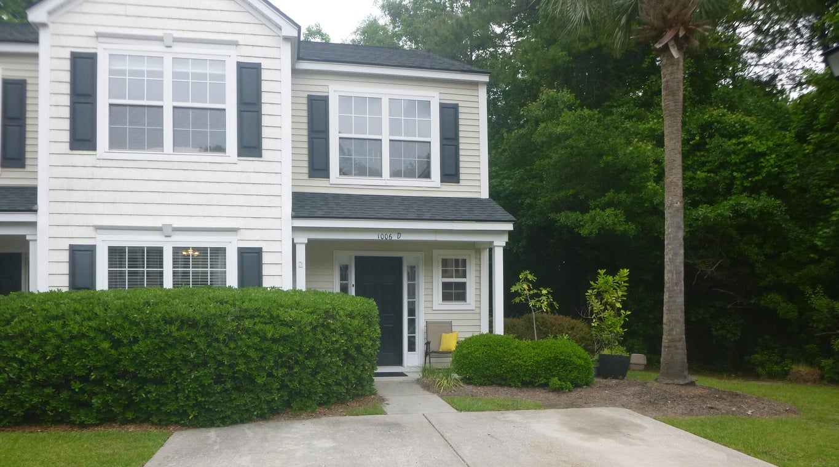
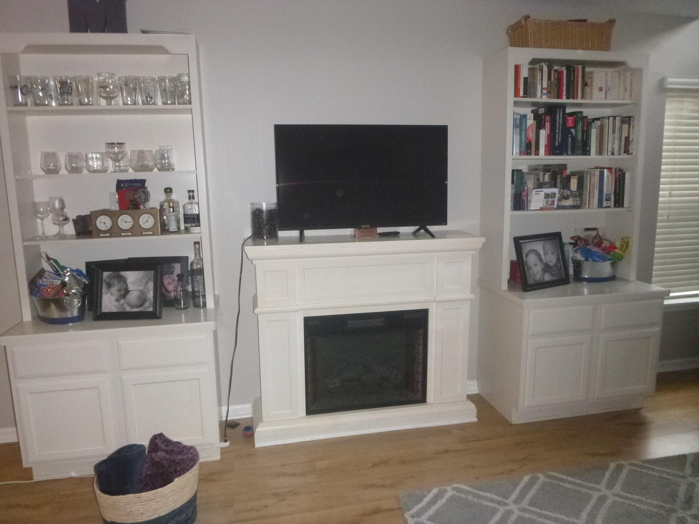
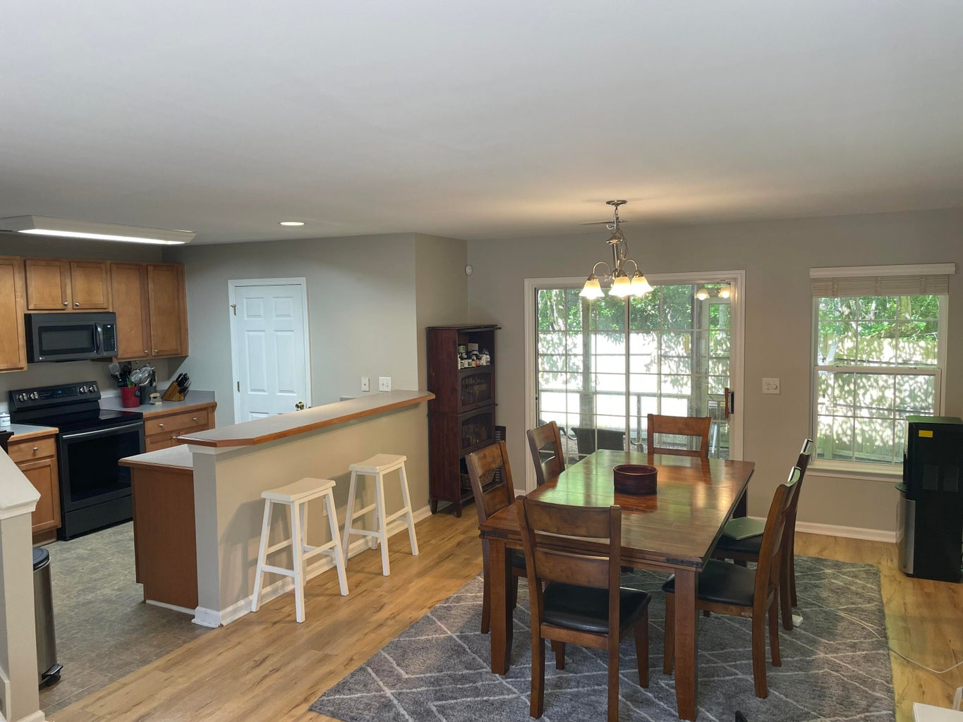
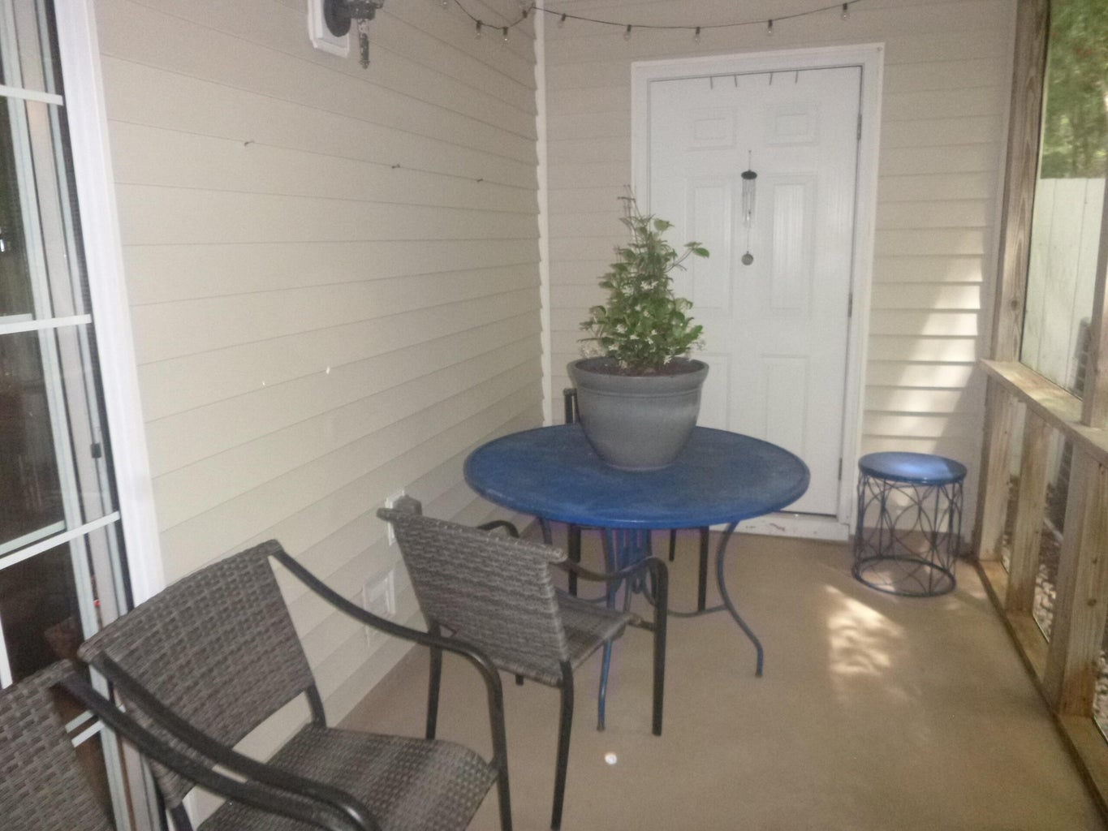
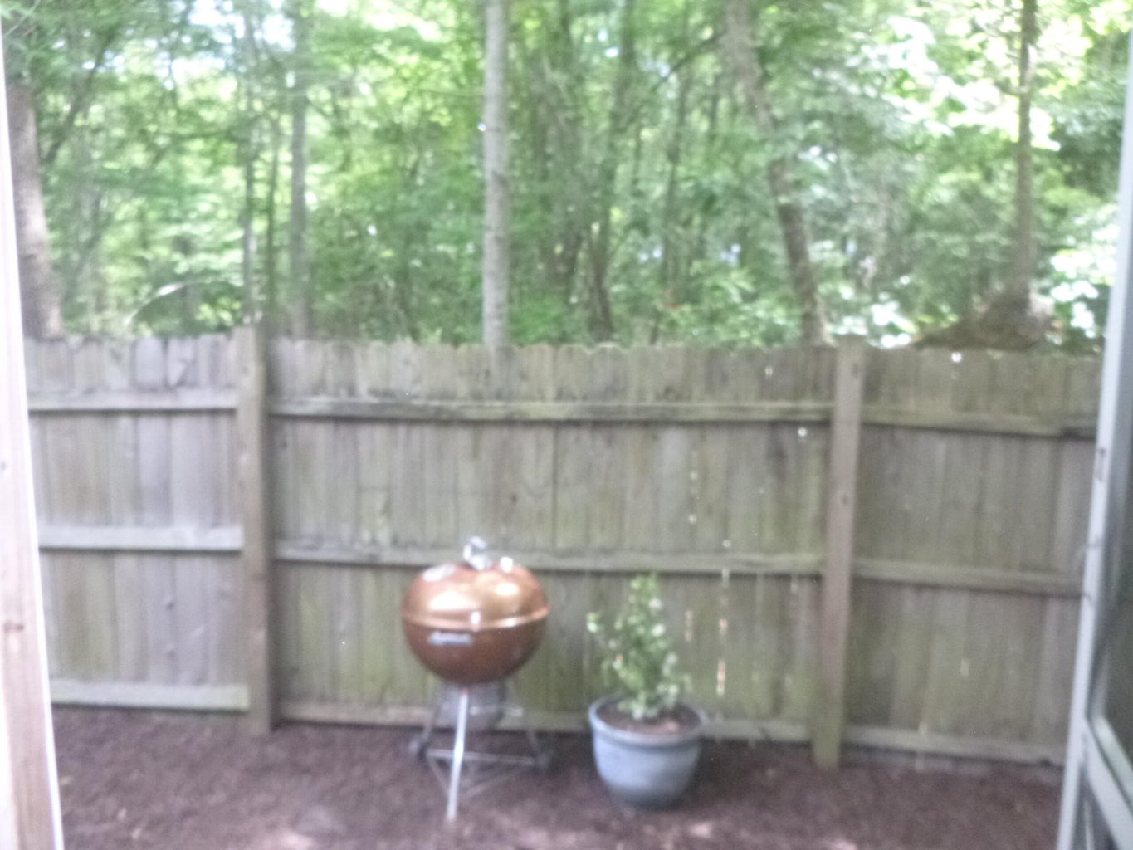
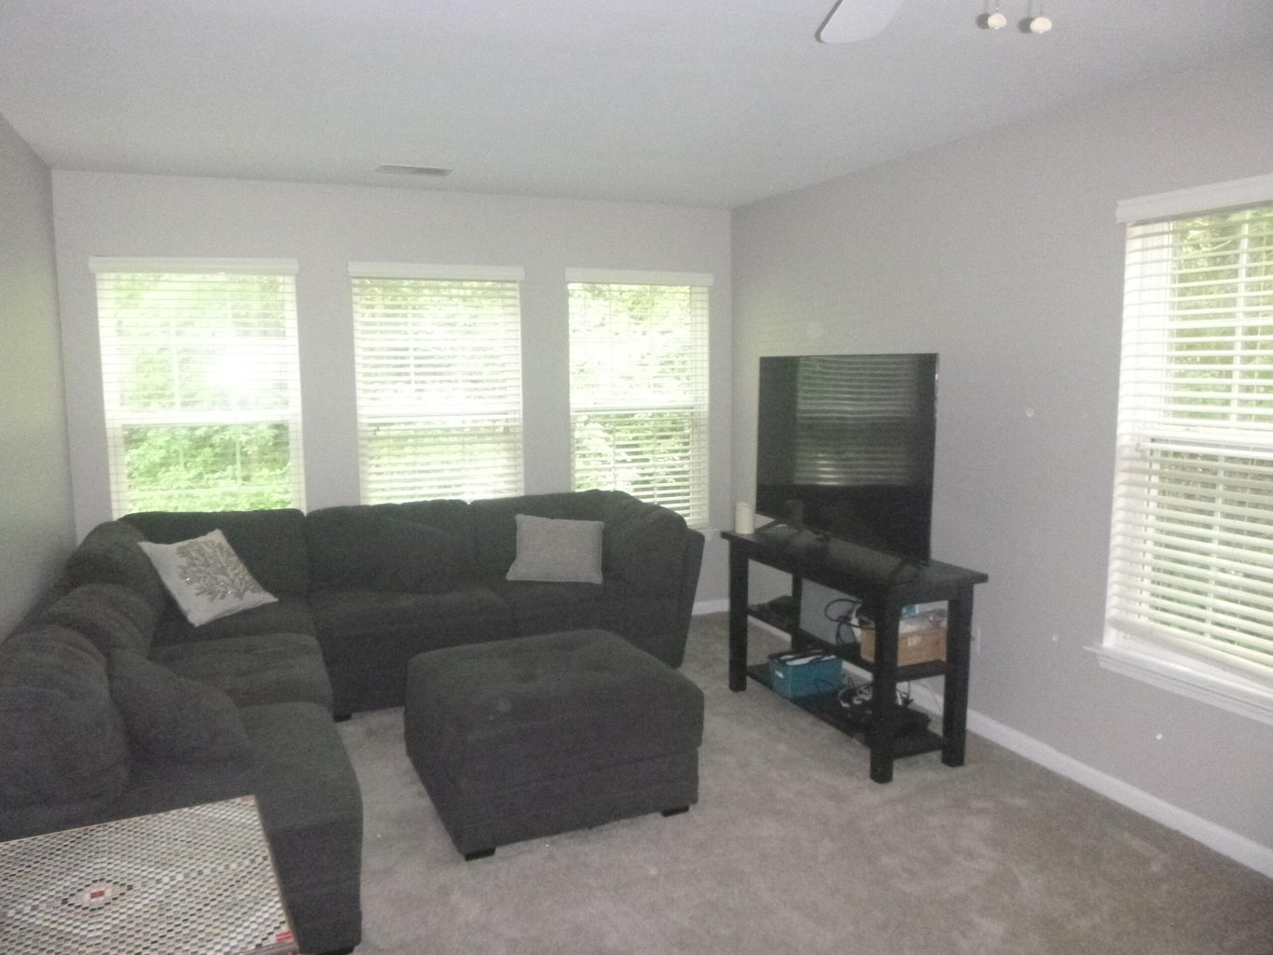
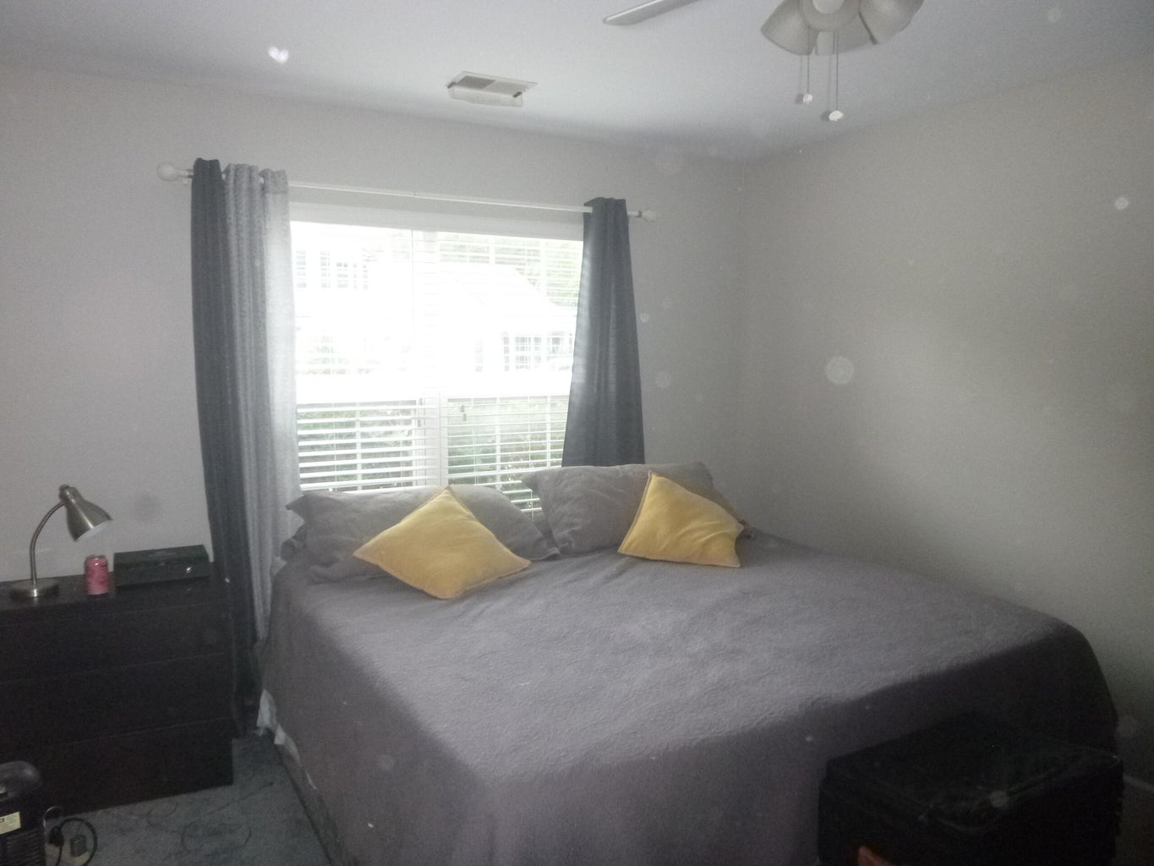
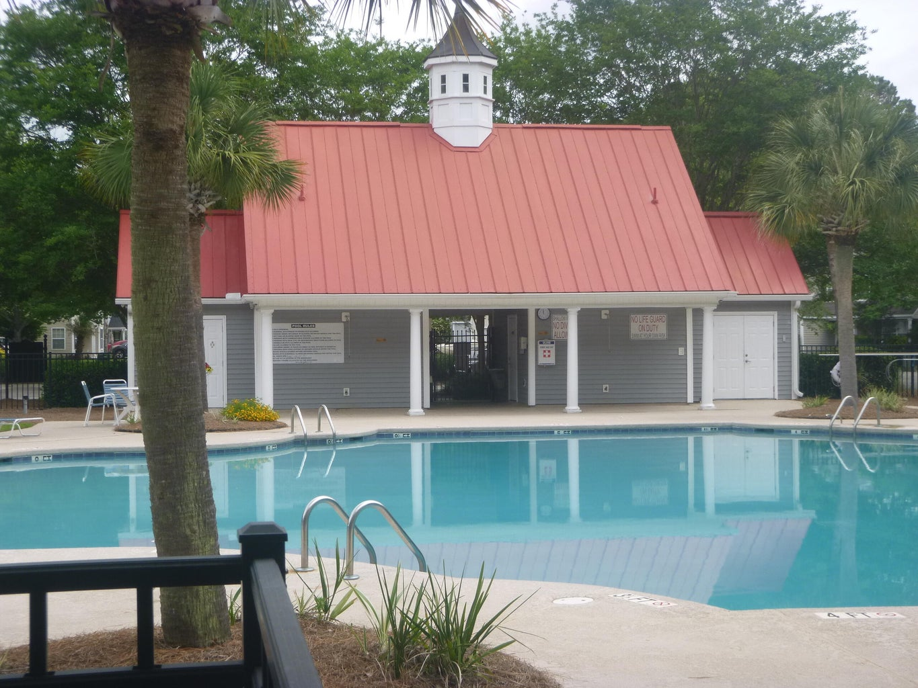
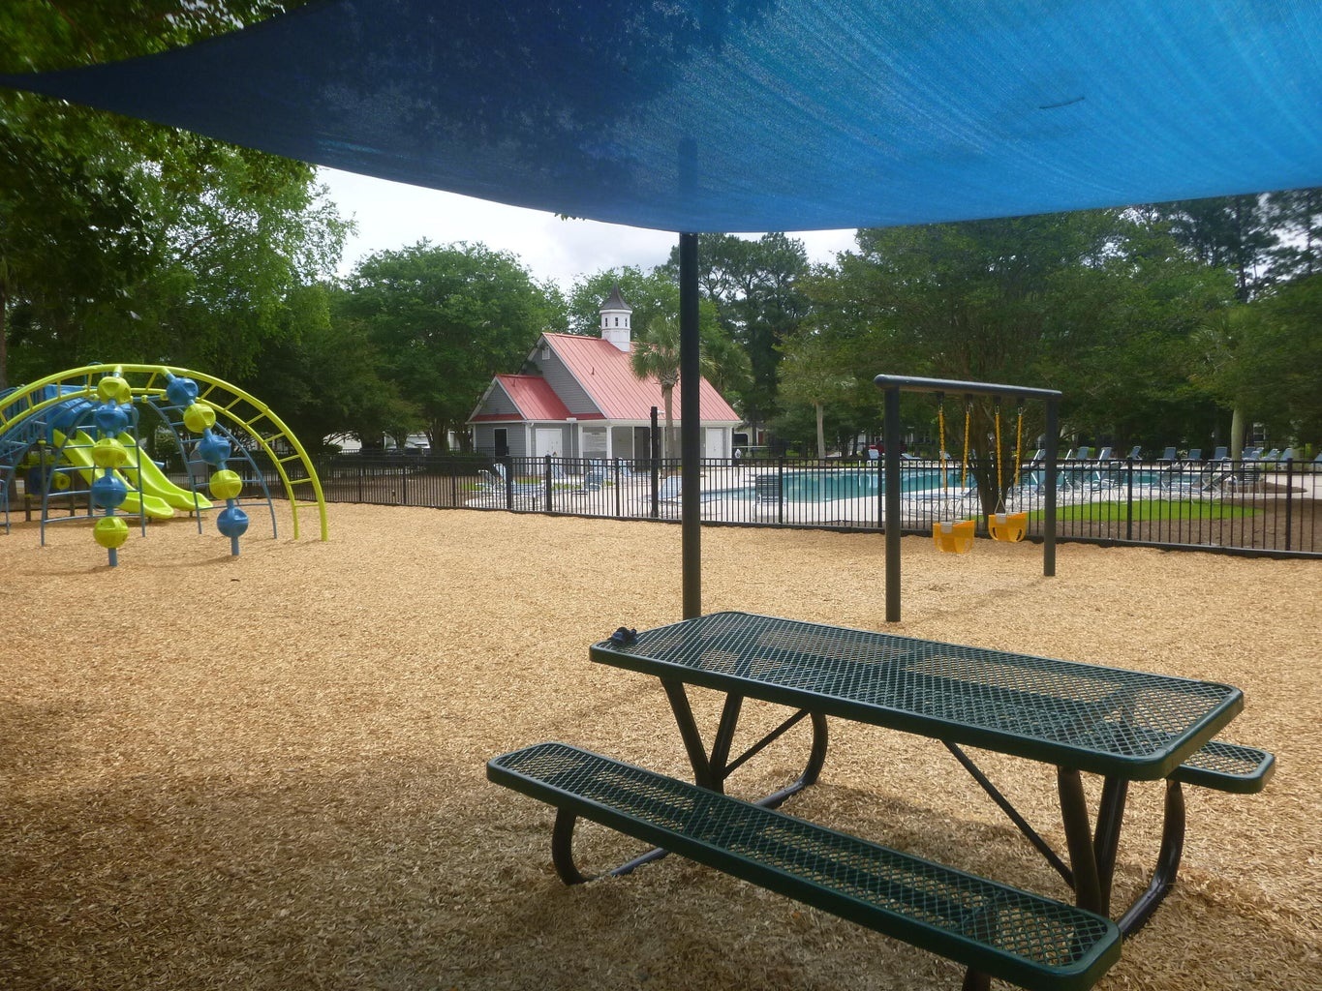
Open House
Saturday 10-4
1006 Summerhaven Place D
The Peninsula | Charleston, SC 29492 | MLS# 24011378 | $379,900
Not only is this an end unit townhome but it is on a dead-end street with no through traffic. It is in Flood Zone X and requires no mandatory flood insurance. Owner and neighbor both say that even in storms, water is never an issue. It backs up to trees that give privacy and views. Compare this home's size and wooded view and you'll be favorably impressed as it has the best price per sq. footage around! Award winning schools (Phillips Simmons) are within 3 miles. There are 2 pools and a play yard for young kids. HOA fees cover the landscaping, roof, siding, and exterior termite treatments. The master bedroom is on the first floor!
Debby Hulett
843-814-0255
debby@hbrtwn.com
www.hbrtwn.com
Harbourtowne Real Estate
672 Marina Drive, Ste 110
Daniel Island, SC 29492
Harbourtowne Real Estate | 672 Marina Drive, Ste 110 | Daniel Island, SC 29492

