Slide 1
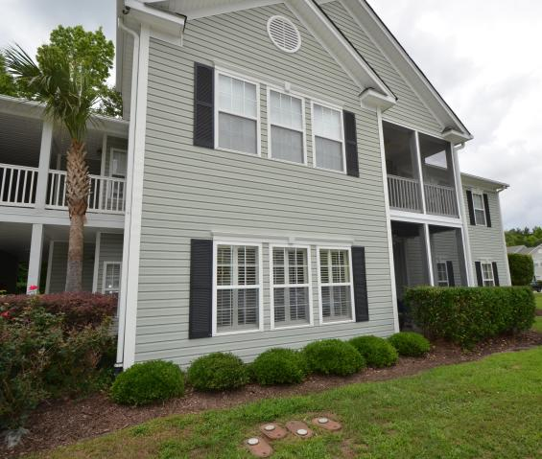
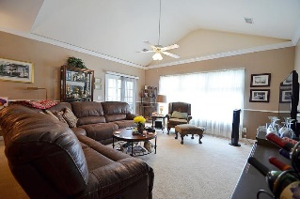
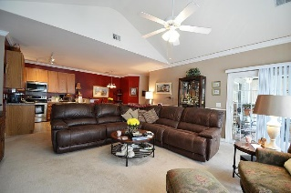
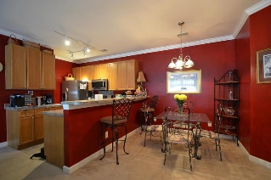
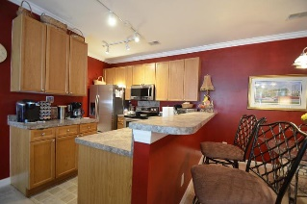
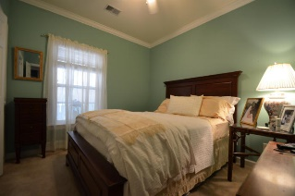
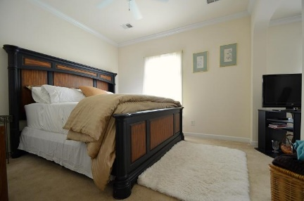
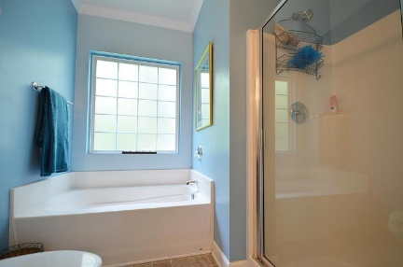
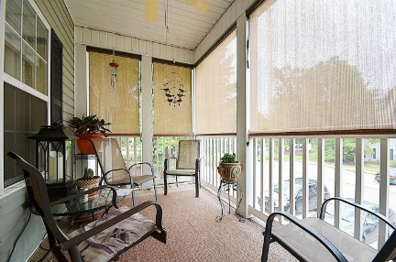
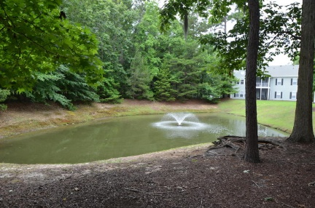



1006 W Marymont Lane
Grand Oaks Plantation
Charleston, SC 29414
MLS# 18021881
$195,000
Open House ~ Saturday ~ 12-1
Just Listed
+
Open House
Saturday, March 24th 11-1
Great upper unit with vaulted ceiling and open floor plan.
Well maintained and move in ready.
Screened porch has custom blinds for ultimate privacy.
Master bath has garden tub and separate shower.
This community has a great community building available for private parties and pool.
HVAC updated 2016.
Gas heat and hot water.
Separate storage closet located just outside the unit.
Andrew Sorrentino
(843) 371-6218
andrew.sorrentino@agentowned.com
Marty Sorrentino
(516) 551-0082
martysorrentino@gmail.com
The AgentOwned Realty Co | 902 Savannah Hwy | Charleston, SC 29407
Real Estate • Mortgage • Insurance
www.AgentOwned.com

