Slide 1
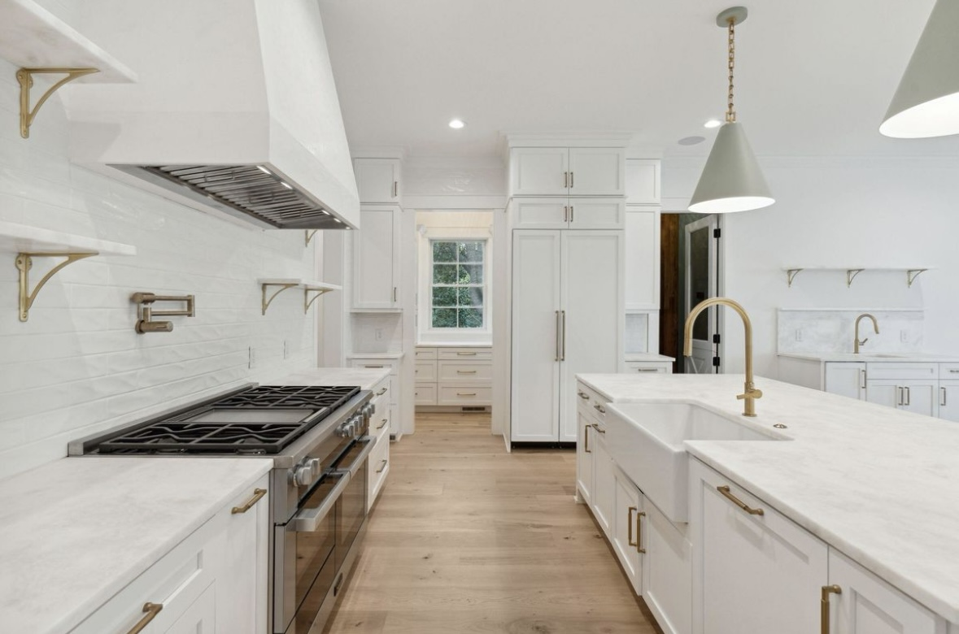
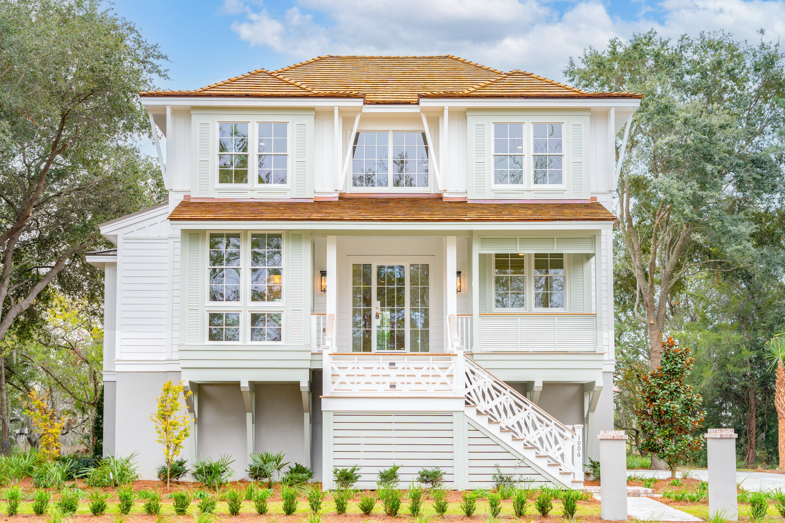
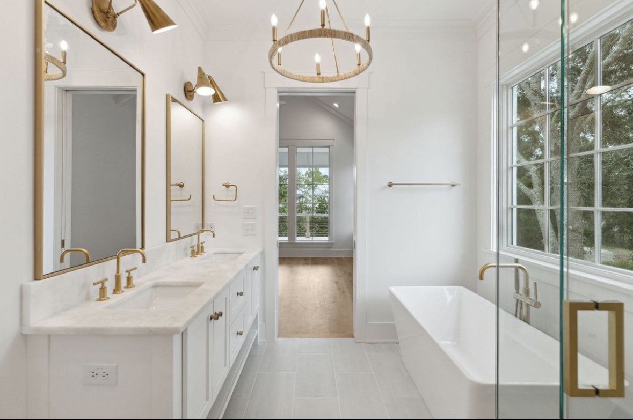
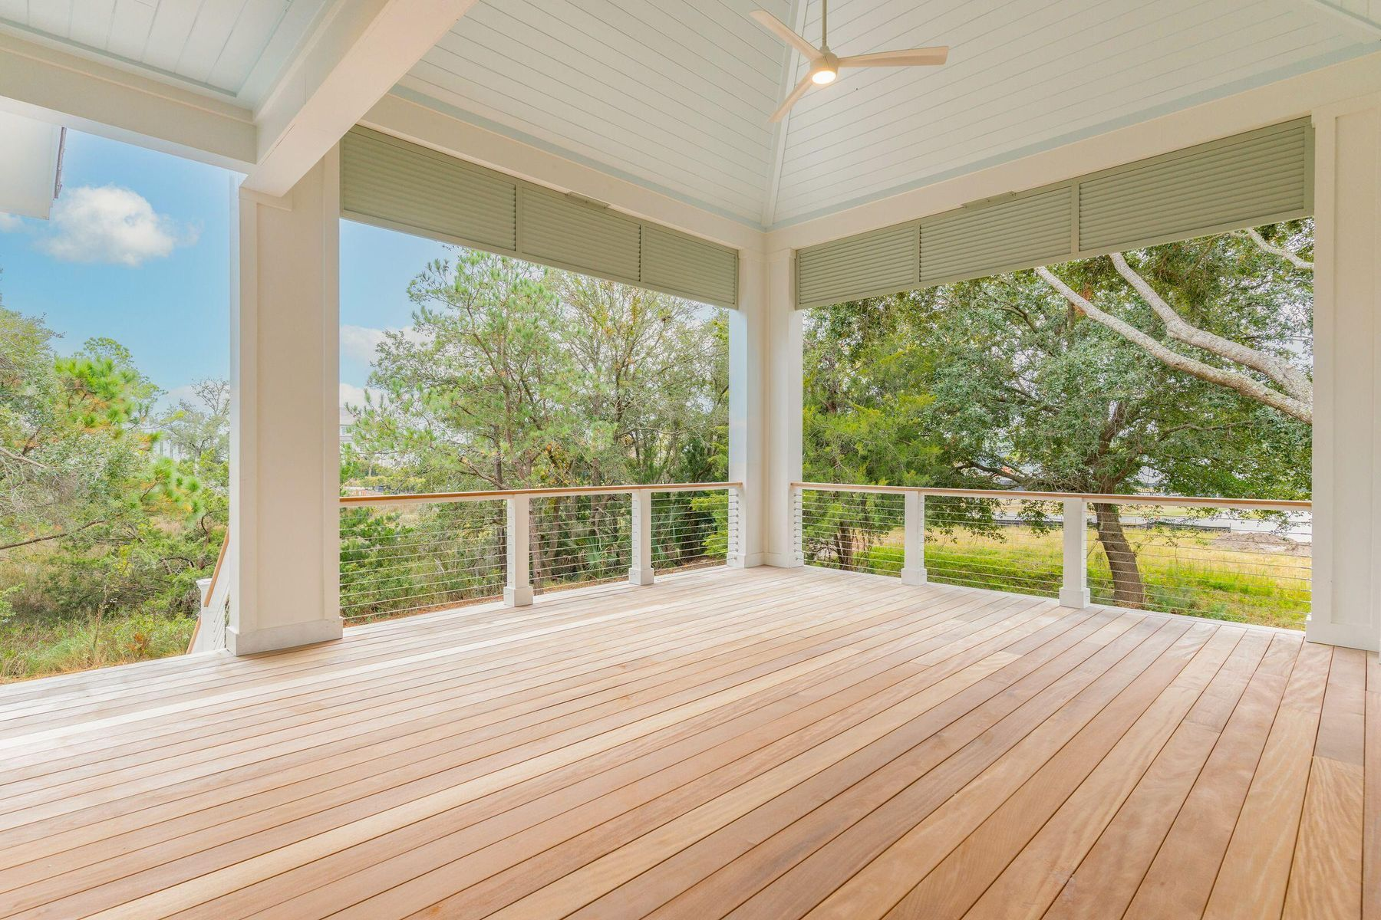

New Construction | Custom Build
Open House Sunday, January 28th 1-4pm
1006 Basin Lane
Kiawah River | Johns Island, SC 29455
MLS# 23021085 | $2,695,000
Cocktails And Light Refreshments!
Come See The Latest Custom Home By Delpino Custom Homes In The Sought After Kiawah River!
This home is situated on a south facing site in the exclusive neighborhood of Bell Cove, which only has 13 residences. Within steps to the riverfront and the Springhouse, Kiawah River's swim and fitness center, this beautiful 3800 sq. ft. home by Delpino Custom Homes features numerous amenities including 2 bedroom suites on the main floor, one of which is the primary bedroom. In addition, there is an office on the main floor, as well as a wine room with a wormy chestnut wine wall. There are 2 bedroom suites on the second floor along with a secondary family space. Located in Kiawah River, Charleston's only true agrihood, amid two thousand acres of peaceful marshland, of which nearly half are reserved for preservation, this residential oasis encompasses winding trails, custom and semi-custom homes, and a waterfront boutique hotel by Auberge, set to open this June. Kiawah River is an idyllic waterfront community created with the sole purpose of celebrating coastal living, where the Lowcountry's natural beauty meets resort-style amenities.
Video Tour
Nathan Delpino
843-200-2721
nathan@delpino.build
delpinocustomhomes.com
Delpino Custom Homes
1023 E Montague Ave
North Charleston, SC 29405

