Slide 1
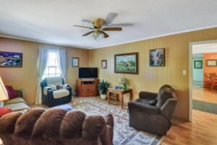
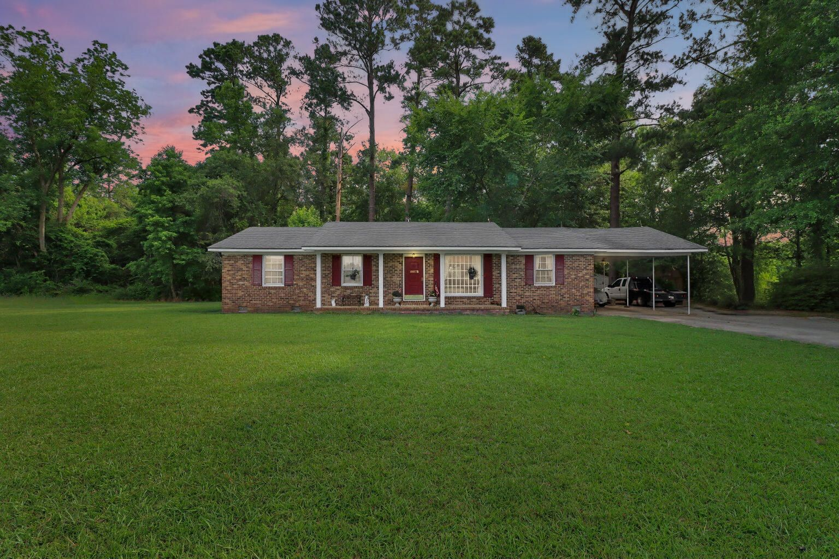
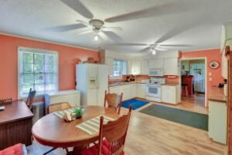
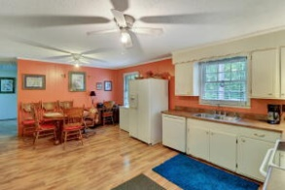
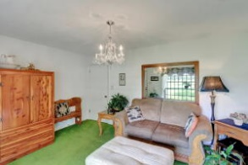
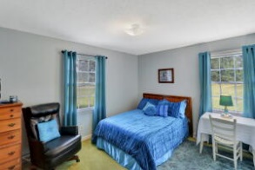

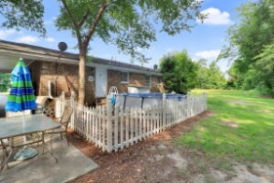
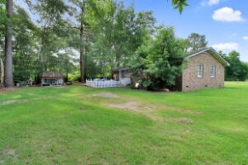
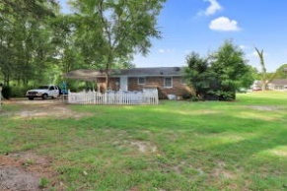


10075 Charleston Highway Saint George, SC 29477 | MLS# 22016273 | $235,000
$500 Agent Bonus Plus 3%!
Brokers Open House
Friday August 19th
12-2pm
Charming brick home with 3 bedrooms,1 full bathroom, 1590 sq ft of living space on 1.19 acres! Enjoy the privacy and possibilities with over an acre of land and no HOA! Approaching the home, you are welcomed with a long driveway leading to the home and a large inviting front porch, perfect for relaxing on some rocking chairs. Enter the home into a formal living area. Natural light fills this room from the large picture window facing the front of the home. Off the Fromal living room is a spacious open kitchen. White wood cabinets, a generous amount of counter space, and an adjoining dining area make this kitchen a perfect place to enjoy all your meals. Off the kitchen is a cozy family room. The master bedroom and two more additional bedrooms share the full-sized bathroom. If you like to entertain outdoors, or enjoy some family fun outdoors, this is the home for you! With 1.19 acres of land and mature trees for privacy, this outdoor space is sure to accommodate your family. Located only 10 minutes from Saint George and only 35 minutes from Summerville! Make sure to schedule your appointment as soon as possible so you don't miss out!
Brandon Ray
(843) 499-1928
brandon.ray@carolinaone.com
www.therightrayhome.com
Carolina One Real Estate
900 N Main St
Summerville, SC 29483

