Slide 1
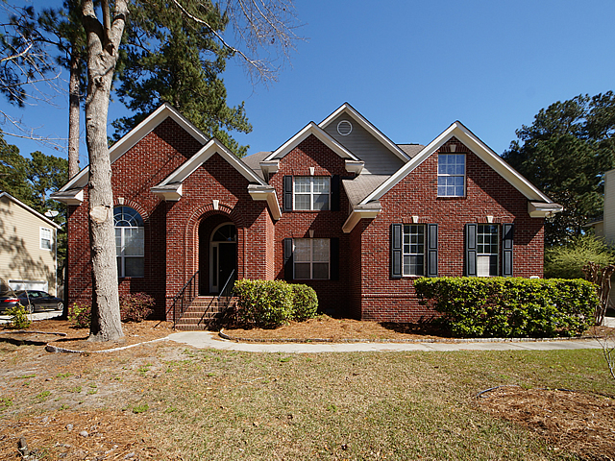
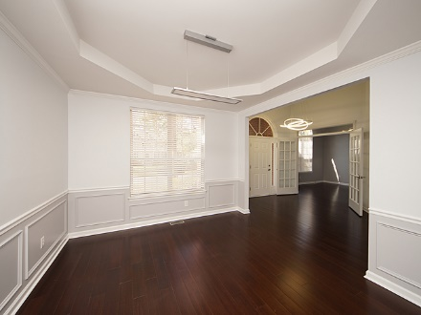
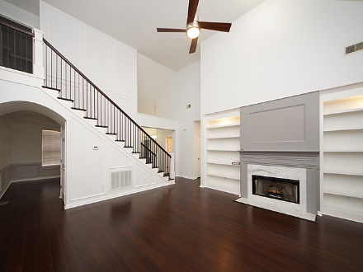
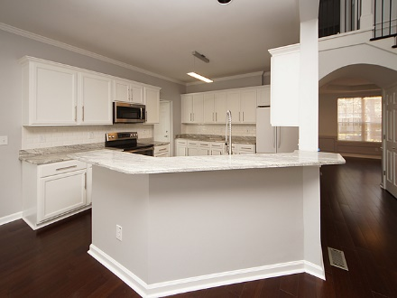
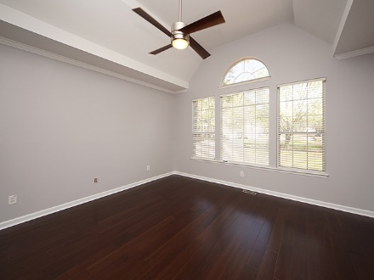
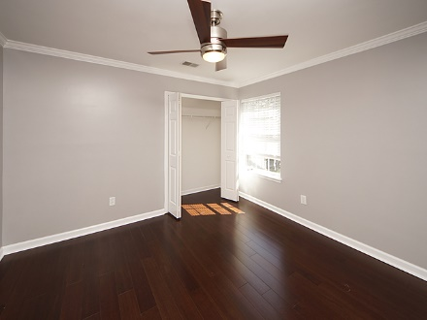
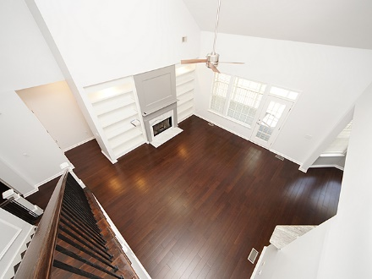
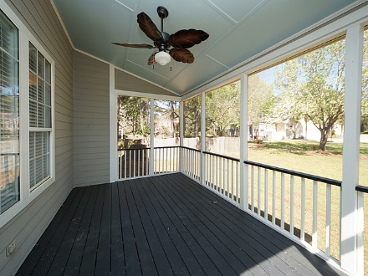
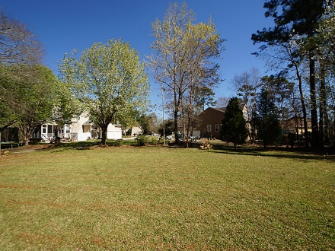
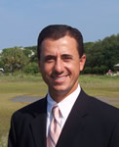
Price Reduced!
Legend Oaks Plantation Open House
Sunday, March 18, 12-2pm
1007 Crooked Oak Road Summerville, SC 29485
MLS# 18006553 ~ $350,000
Kevin Driggers
843.345.9069
kevindriggers@msn.com
Ravenel Associates Real Estate. LLC
PO Box 21526
Charleston, SC 29413

