Slide 1
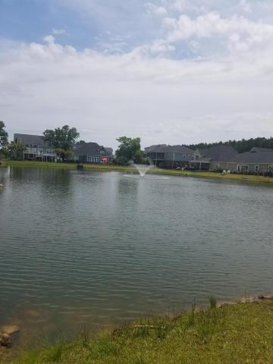
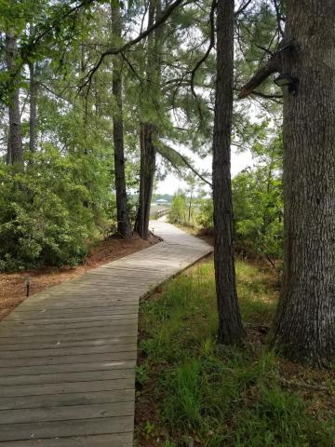
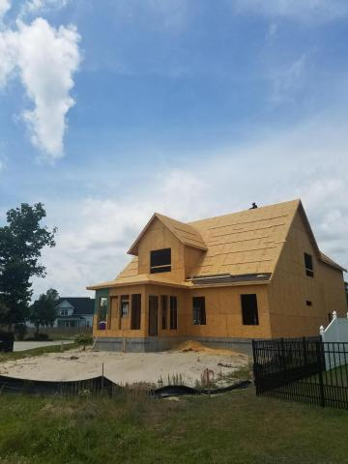
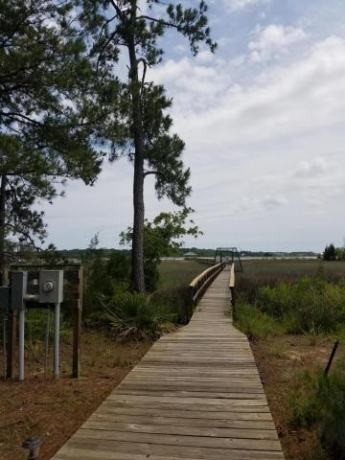
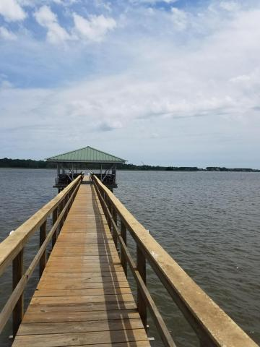
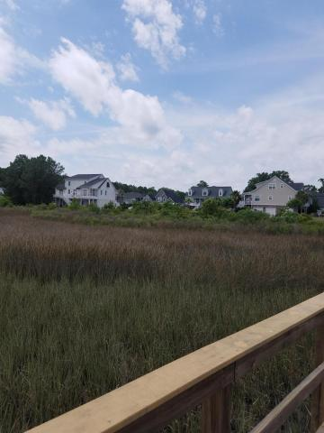
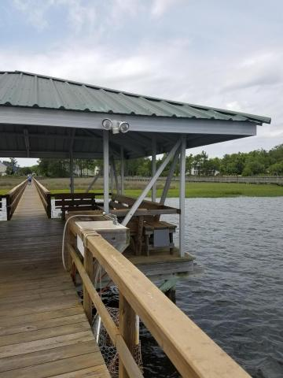
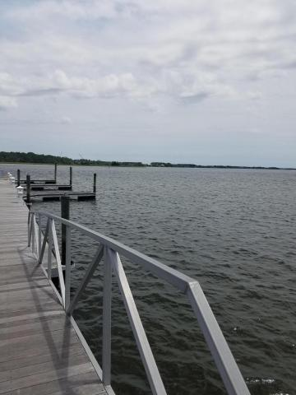
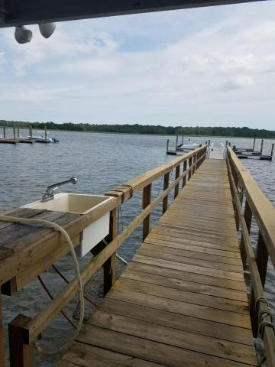
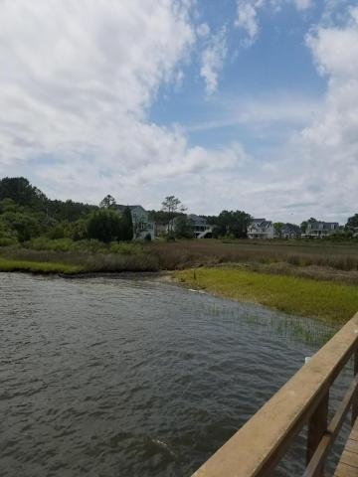


NEW Construction Community Dock on Wando Master DOWN!
1007 Jervey Point Road
River Reach Pointe
Wando, SC 29492
MLS# 16013076
$459,000
Beautiful NEW CONSTRUCTION in small enclave neighborhood with COMMUNITY DOCK & GAZEBO ON THE WANDO RIVER! Brand new state of the art Phillip Simmons schools nearby & scheduled to open in 2016
Gorgeous & bright home overlooking sparkling lake
Great kitchen, separate Dining room & fireplace in family room
Large Master on main level with en-suite bath
SUNROOM
3 BRs upstairs PLUS a media room/office that could be a 5th BR.
Short walk to the community dock for fishing, crabbing or lounging on the Wando River & salt marsh teeming with wildlife! Fresh & relaxing river breezes! Minutes from Daniel Island, Dunes West, Rivertowne & area beaches!
Sheila Romanosky
(843) 224-0242
sromanosky@carolinaone.com

