Slide 1

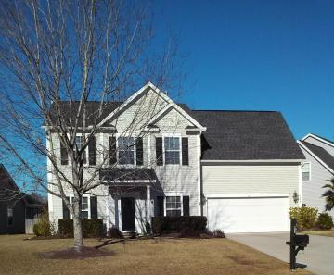
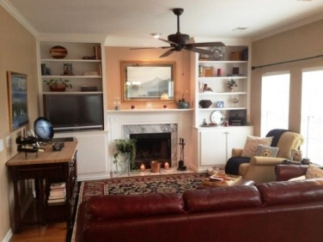
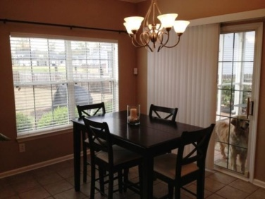
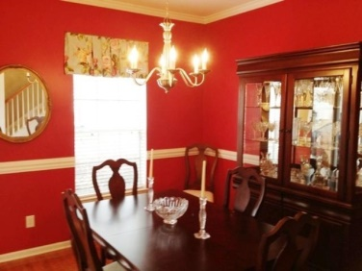
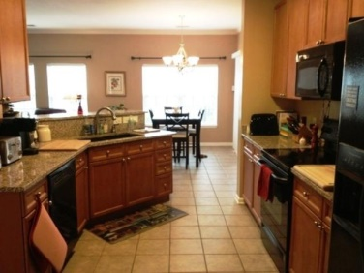
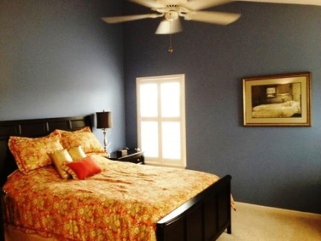


Gorgeously maintained home in Grand Oaks.
1008 Tyron Circle
Grand Oaks Plantation
Charleston, SC 29414
MLS# 14031155
$255,000
2,112 SF
3 Bedrooms
2½ Baths
This home features many high end finishes including granite counter-tops, custom closet system in the master, beautiful built ins in the living room and in the Flex room. The downstairs is home to the well appointed kitchen and over sized breakfast nook, formal dining room, living room, and a powder room. In the formal dining room and living room you have beautiful hardwood floors and the kitchen and breakfast nook have nice ceramic tile. The great room has a wood burning fireplace with custom built bookcases and cabinets on each side. There is a large screened porch with ceramic tile floor and a nice size patio with ceramic tile floor. The front and back yard is beautifully landscaped with an irrigation system and a pond view. There are three bedrooms, two full baths on the second level and a very large finished room over the garage which can be used as a media room, den, playroom or fourth bedroom. The Bees Landing Recreation Centre within Grand Oaks has the following: The facility is 17,700 square feet, a multi-purpose gymnasium with concessions, multi-purpose room, admin offices and restrooms, There are tennis courts, a soccer/multi-purpose field, a playground area, baseball/softball fields, a dog park and several nature trails. There is a termite bond in place since 2003.
Lizzie H Ray
Mobile (843) 452-9298
lizzieray1122@gmail.com
www.charlestonrealestategroup.com
Charleston Real Estate Group | 789 Meeting Street | Charleston, SC 29403

